Slide 1
Effects of strong magnetic fields in heavy-ion collisions
Koichi Hattori (Yonsei Univ.)
10th Saga-Yonsei workshop@Yonsei Univ., 13th Jan. 2014
Photon spectrum in strong B fields
KH, K. Itakura
Neutral pions in strong B fields
KH, K. Itakura, S. Ozaki
Charmonium spectroscopy in strong B fields
S.Cho, KH, S.H.Lee, K.Morita, S. Ozaki

Slide 2
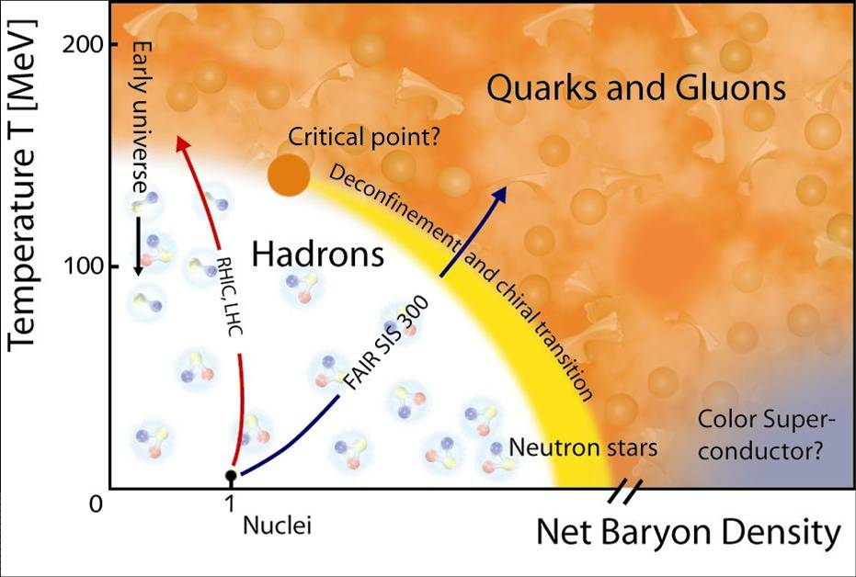
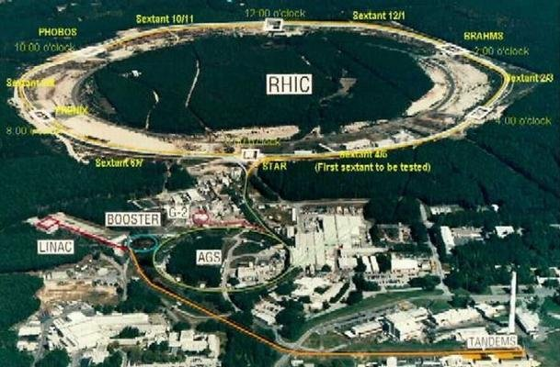
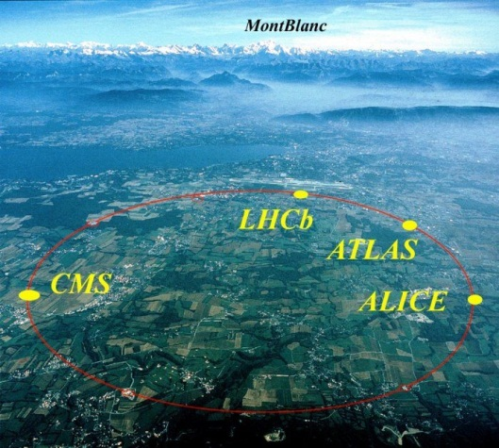
Exploring the quark-gluon plasma by accelerators
Asymptotic freedom
Phase diagram of QCD
RHIC@BNL
LHC@CERN

Slide 3
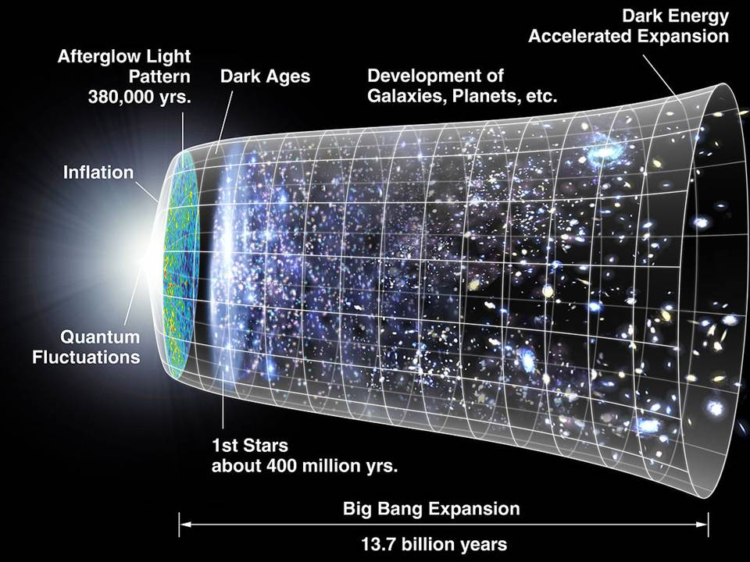
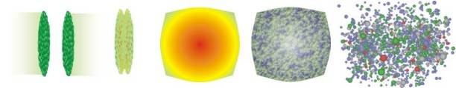
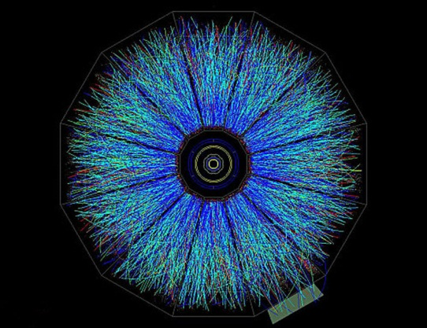
Motivation: early-time dynamics in heavy-ion collisions
Photon freeze-out
Interacting matter
？
Early-time dynamics
Thermal QGP
Hadrons
Pre-thermal state
Photons as penetrating probe
↕
CMB
RHIC@BNL

Slide 4
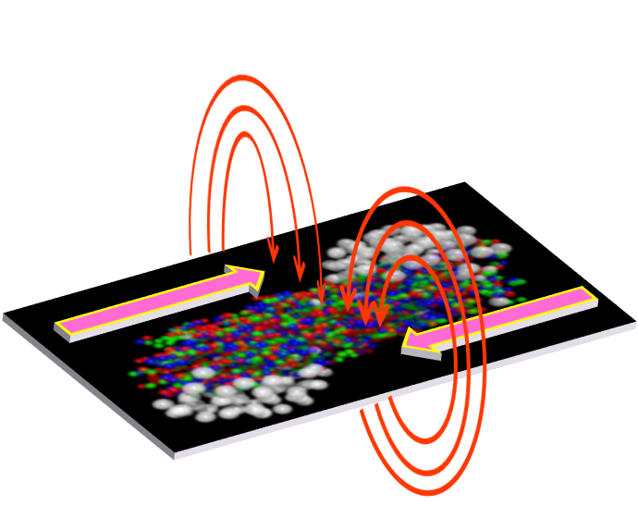
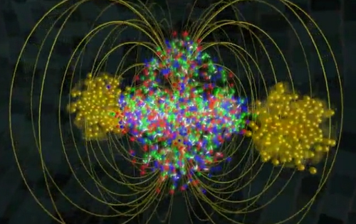
Possible signature of the early-time dynamics
Key ingredient 1: Strong magnetic fields
Lienard-Wiechert potential
Chromo electromagnetic fields
Magnetic fields (QED)
Z = 79(Au), 82(Pb)
Key ingredients 2: EM probes
Possible effects of strong magnetic fields on
1. neutral pions related to dilepton spectra KH, K.Itakura, S.Ozaki, 2013
2. direct-photon propagations (vacuum polarization tensor) KH, K. Itakura (I) (II) 2013
Penetrating probes are porters carrying information of the early-time dynamics.
Challenging on both theoretical and experimental sides!

Slide 5
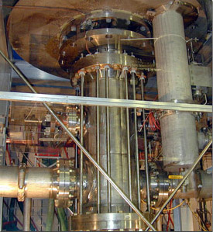
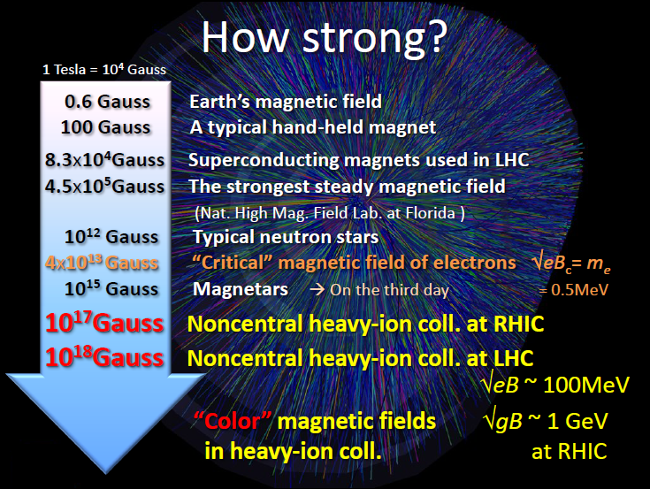
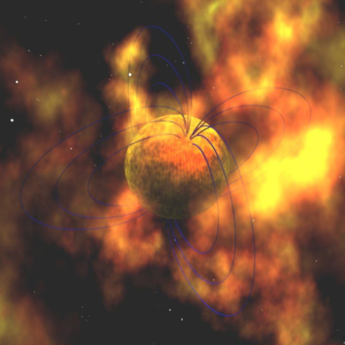
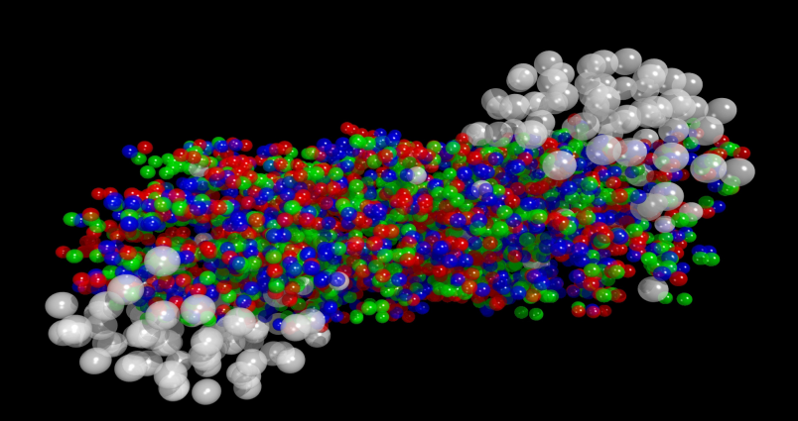
Strong magnetic fields in nature and laboratories
Magnet in Lab.
Magnetar
Heavy ion collisions

Slide 6
Photon propagations in strong magnetic fields
“Vacuum birefringence” and “real-photon decay”

Slide 7
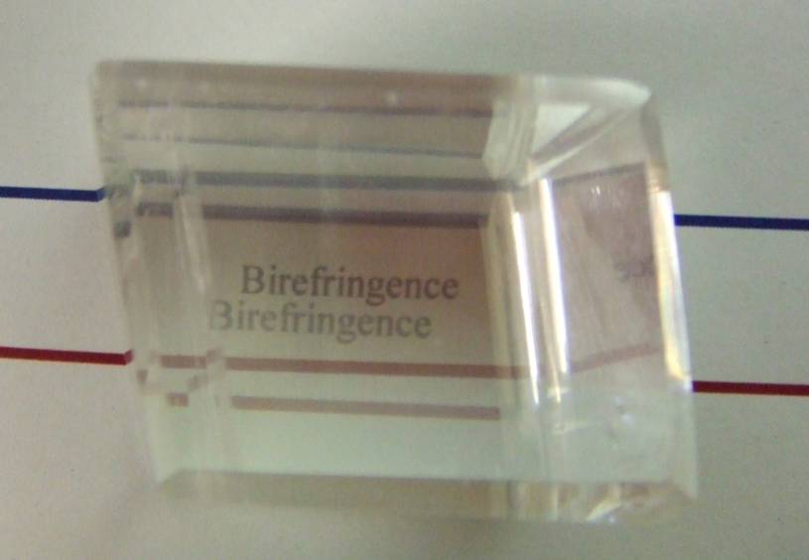
What is “Birefringence” ?
Two polarization modes of a propagating photon
have different refractive indices.
Doubled image due to a ray-splitting in birefringent substances
Polarization 1
Polarization 2
Incident light
“Calcite” (方解石)
How about the vacuum with external magnetic fields ?
+ Lorentz & Gauge symmetries → n ≠ 1 in general
+ Oriented response of the Dirac sea → Vacuum birefringence

Slide 8
Modifications of photon propagations in strong B-fields
Modified Maxwell eq. :
Photon vacuum polarization tensor:
Dressed propagators
in Furry’s picture
Magnetic field
Refraction of photon in the vacuum with B-fields
without medium effects
Real photon decay
Dilepton emissions from real photon decay,
as well as virtual photon conversions (γ* → e⁺e⁻ )
QGP
Could be important in pre-equilibrium stage,
and in QGP additively to medium effects

Slide 9
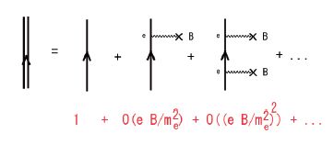
Break-down of naïve perturbation in strong magnetic fields
Dressed fermion propagator in Furry’s picture
Critical field strength
B_{c} = m_{e}² / e
In heavy ion collisions,
B/B_{c} ~ O(10⁴) >> 1
Employing Fock-Schwinger gauge x^{μ}A_{μ}= 0 ,
Naïve perturbation breaks down when B > B_{c}
→ Need to take into account all-order diagrams
Resummation w.r.t. external legs by “proper-time method“
Schwinger
Nonlinear to strong external fields

Slide 10
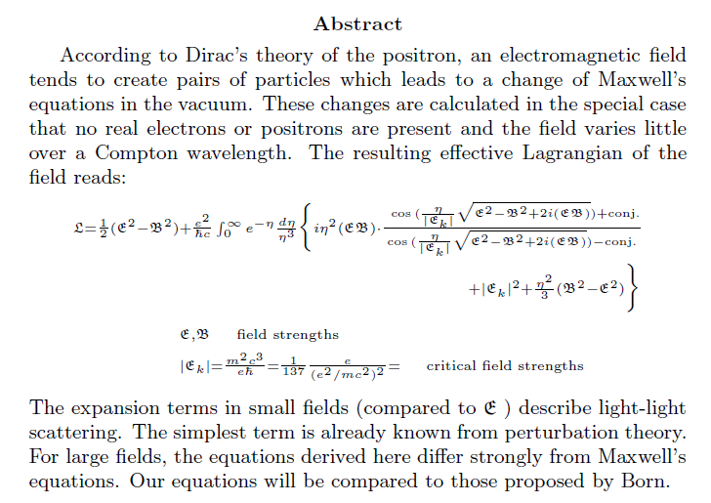
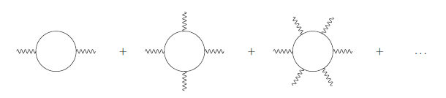
The first seminal work in “nonlinear QED”
“Consequences of Dirac’s Theory of the Positron”
W. Heisenberg and H. Euler in Leipzig1
22. December 1935
Euler – Heisenberg effective Lagrangian
- resummation wrt the number of external legs
Correct manipulation of a UV divergence in 1935!

Slide 11
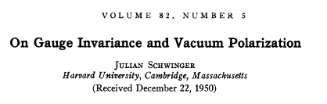
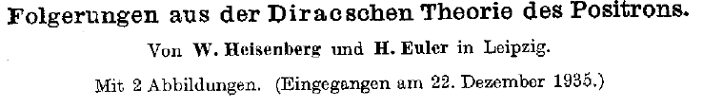
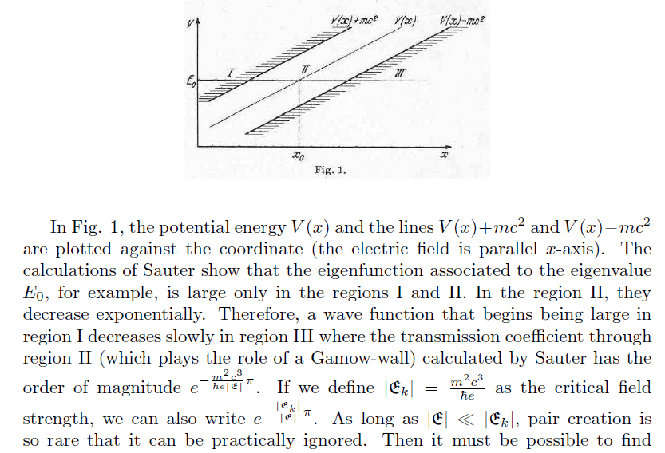
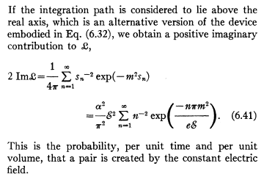
Pair creation (vacuum instability) induced by strong electric field
as known as Schwinger mechanism
General formula within 1-loop & constant field
obtained by the “proper-time method”.

Slide 12
Photon propagation in a constant external magnetic field
θ: angle btw B-field and
photon propagation
Lorentz and gauge symmetries lead to a tensor structure,
B
Integrands having strong oscillations
Schwinger, Adler, Shabad, Urrutia,
Tsai and Eber, Dittrich and Gies
Exponentiated trig-functions generate
strongly oscillating behavior with
arbitrarily high frequency.

Slide 13
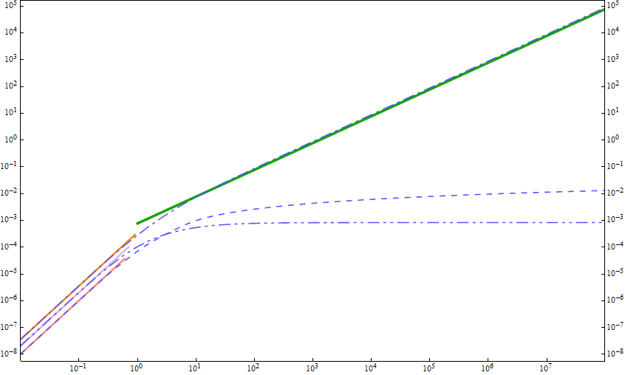
Summary of relevant scales
and preceding calculations
General analytic expression
?
Untouched so far
Ultrarelativistic heavy-ion collisions
Br-dependence of the coefficients
in soft-photon limit:
Comparison btw limiting behavior
and numerical computation.
Numerical computation
below the first threshold
(Kohri and Yamada)
Weak field & soft photon limit
(Adler)
Strong field limit: the lowest-Landau-level approximation
(Tsai and Eber, Shabad, Fukushima )
B_{r}=B/B_{c}

Slide 14
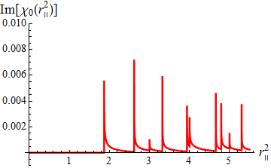
Analytic results of integrals without any approximation
Dimesionless variables
Decomposition into a double infinite sum
Vacuum birefringence has been led by the tensor structure.
What dynamics is encoded in the scalar functions, χ_{i} ?
Every term results in either of three simple integrals.
Polarization tensor acquires an imaginary part
above

Slide 15
Quick derivation of the Landau level
Discretized spectrum of charged particle in the cyclotron orbits.
B = rot A = ( 0, 0, B )
Harmonic oscillator + Continuous longitudinal spectrum

Slide 16
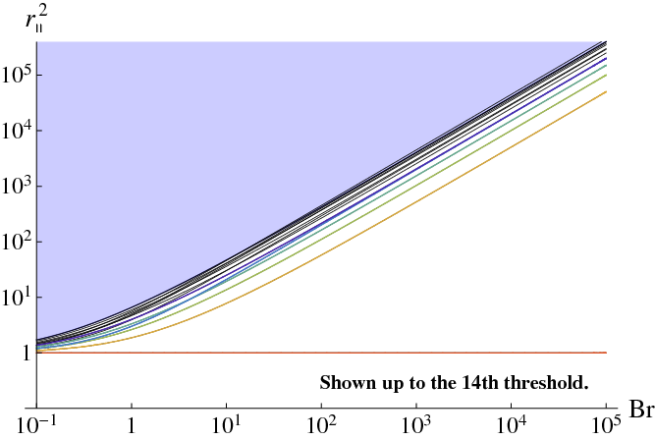
Summary of relevant scales revisited
- An infinite number of the Landau levels
(Photon momentum)
UrHIC
Prompt photon ~ GeV²
Thermal photon ~ 300² MeV²
~ 10⁵ MeV²
Untouched so far
Narrowly spaced Landau levels
(Photon momentum)
Strong field limit (LLL approx.)
(Tsai and Eber, Shabad, Fukushima )
Soft photon & weak field limit
(Adler)
Numerical integration
(Kohri, Yamada)

Slide 17
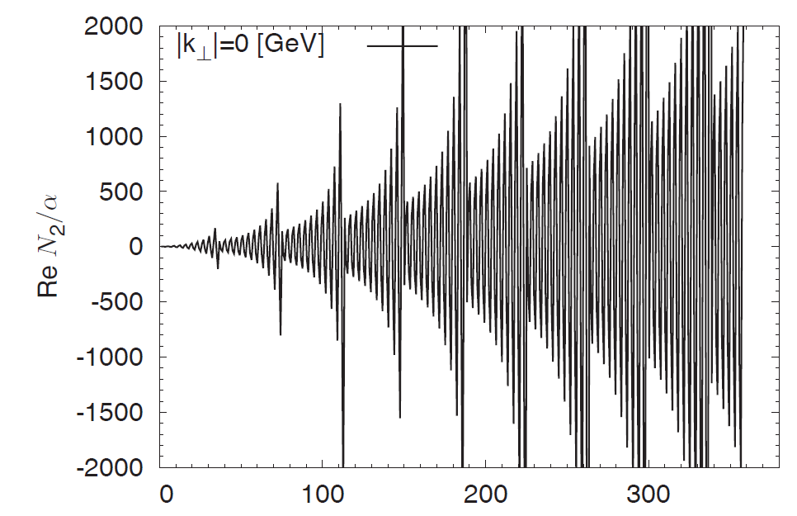
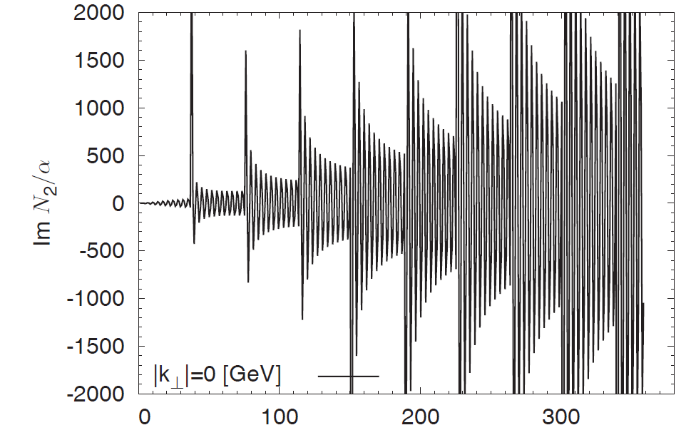
Renormalization
=
+
+
+
・・・
Log divergence
Subtraction term-by-term
Finite
Ishikawa, Kimura, Shigaki, Tsuji (2013)
Re
Im
Taken from Ishikawa, et al. (2013)

Slide 18
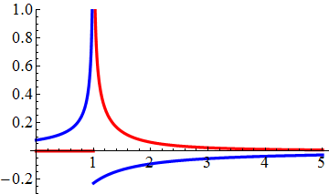
Complex refractive indices
Solutions of Maxwell eq.
with the vacuum polarization tensor
The Lowest Landau Level (ℓ=n=0)
Dielectric constant at the LLL
Polarization excites only along the magnetic field
``Vacuum birefringence’’

Slide 19
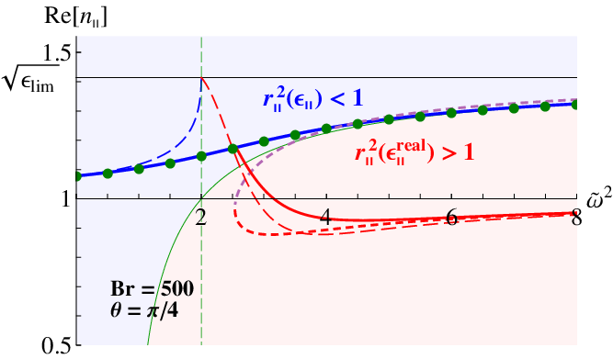
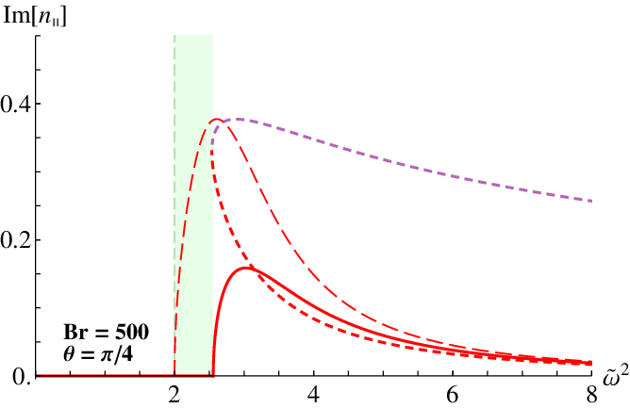

Self-consistent solutions of the modified Maxwell Eq.
Photon dispersion relation is strongly modified
when strongly coupled to excitations (cf: exciton-polariton, etc)
$$ω^{2}/4m^{2}$$
≈ Magnetar << UrHIC in RHIC and LHC
cf: air n = 1.0003, water n = 1.333

Slide 20
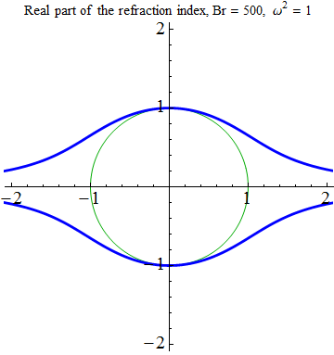
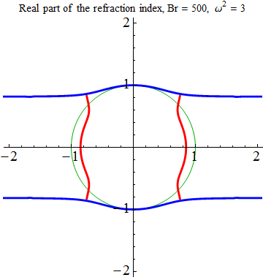
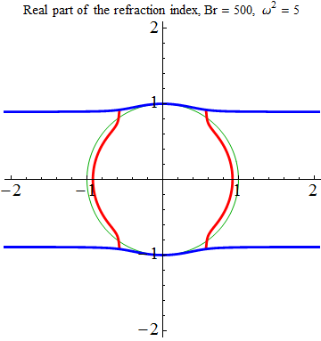
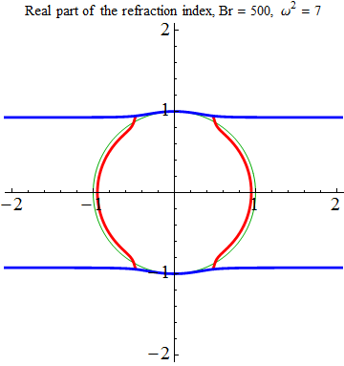
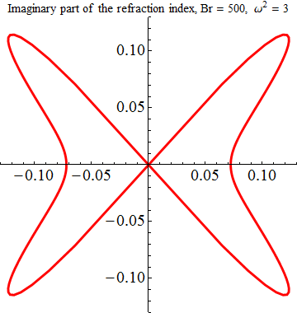
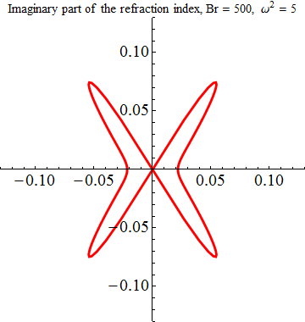
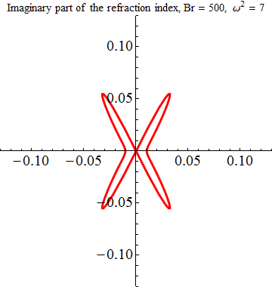
Angle dependence of the refractive index
Real part
Imaginary part
No imaginary part

Slide 21
Summary
We obtained the general analytic form of the resummed 1-loop polarization tensor
in magnetic fields as the summation w.r.t. the Landau levels.
+ Confirmed to reproduce the preceding approximate calculations.
Ishikawa, Kimura, Shigaki, Tsuji
+ We obtained the complex refractive indices (photon dispersions)
by solving the modified Maxwell Eq.
Prospects
Applications of photon propagation to phenomenologies
in the heavy-ion collisions and the magnetars (neutron stars).

Slide 22
Neutral pion properties in strong B-fields

Slide 23
Violation of axial current conservation
LO contribution to the total decay rate
Dominant (98.798 % in the vacuum)
99.996 %
NLO contribution to the total decay rate
Only corrections to external legs are possible
``Dalitz decay ‘’ (1.198 % in the vacuum)
Adler, Bell, Jackiw, 1959
Absence of radiative correction Adler & Bardeen, 1960
Triangle diagram gives the exact result in the all-order perturbation theory

Slide 24
Effects of external magnetic fields
Replacement of a photon line by an external field
Correction to external legs: “real photon decay”
Decay mode possible only in external field
Lifetime of neutral pion (in vacuum)
c τ = 25.1 nm
Real photon decay occurs within c τ ～ pm, or smaller
(depending on |B|, energy, angle…)
“Bee decay” can be comparable to Dalitz decay
and even π₀ →2γ, depending on B.
WZW effective vertex
γ
π⁰
Decay width of “Bee decay”

Slide 25
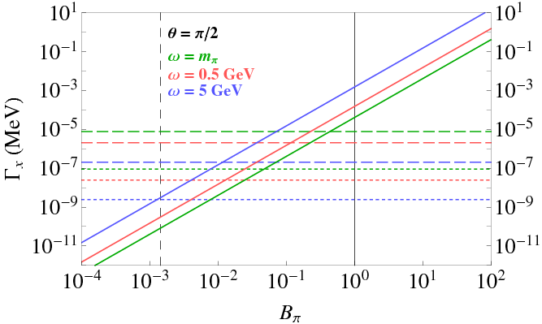
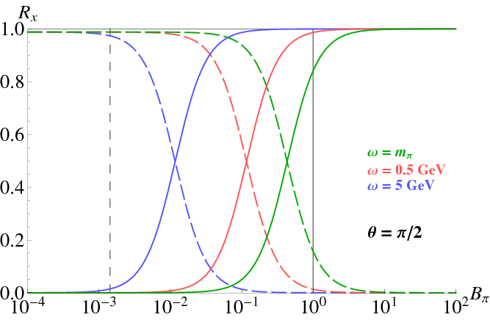
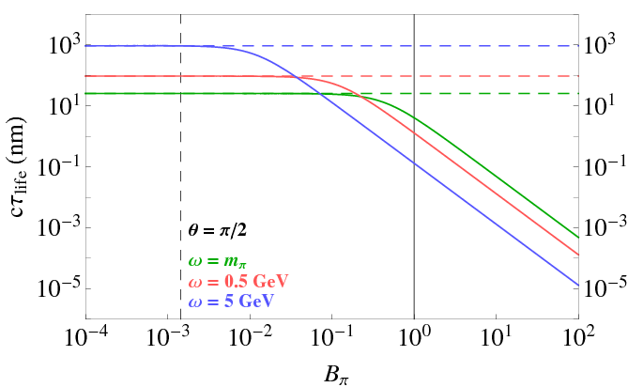
Decay widths
Branching ratios
Mean lifetime
Dalitz decay
Bee decay
femtometer

Slide 27
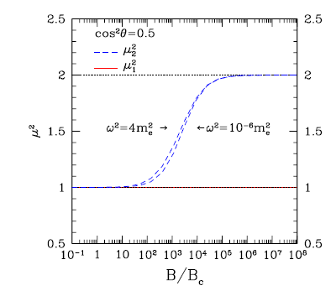
To make Jordan’s lemma work well,
we want a simpler expression:
Dimesionless variables
Schwinger, Adler, Shabad, Urrutia,
Tsai and Eber, Dittrich and Gies
Exponentiated trig-functions generate
strongly oscillating behavior by arbitrarily
high frequency.
1st step: Use a series expansion known as partial wave decomposition Baier and Katkov
Kohri and Yamada

Slide 28
After 1st step:
2nd step:
Associated Laguerre polynomial
Then, any term reduces to either of three elementary integrals.

Slide 29
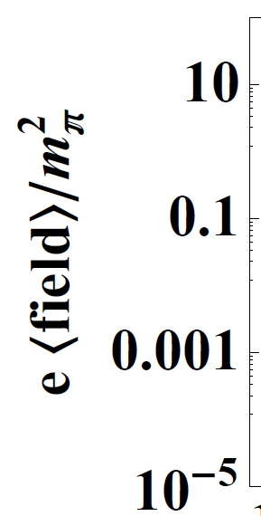
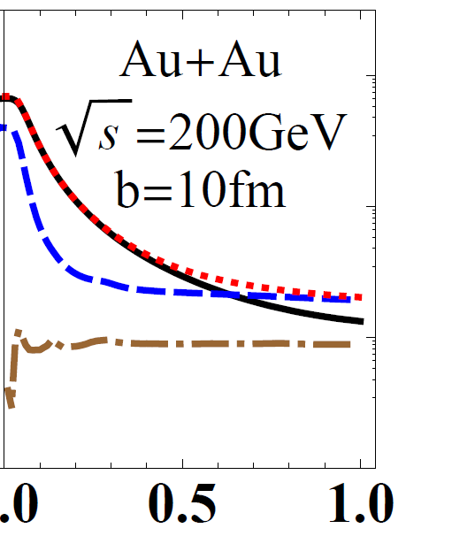
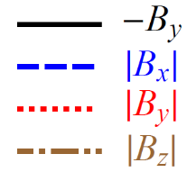


Lienard-Wiechert potential
Strong magnetic fields in UrHIC
Analytical modeling of colliding nuclei,
Kharzeev, McLerran, Warringa, NPA (2008)
Event-by-event analysis, Deng, Huang (2012)
Pre-equilibrium
Au-Au
200AGeV
b=10fm
QGP

Slide 30
Effective coupling between π⁰ and 2γ
(Rest frame)

Slide 31
Neutral pion decay into dilepton
Bext = (0,0,B),
Eext = 0
EM current

Slide 32
Neutral pion decay into dilepton (continued)
q
q

Slide 33
Branching of virtual prompt photon
Isotropic dilepton production
2 Im
q
q
Anisotropic on-shell pion production
2 Im
q
q
Fourier component of an external field
Anisotropic pion production

Slide 34
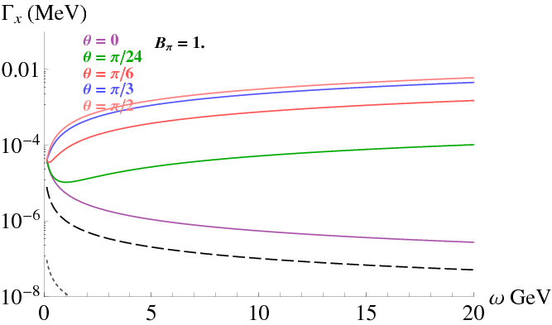
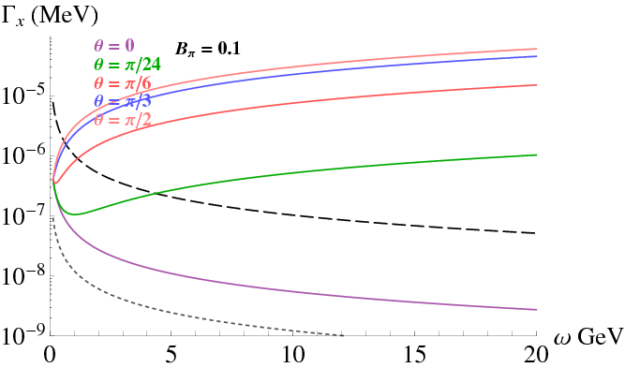
Decay rates in three modes
Mean lifetime
Energy dependence of the decay rates

Slide 35
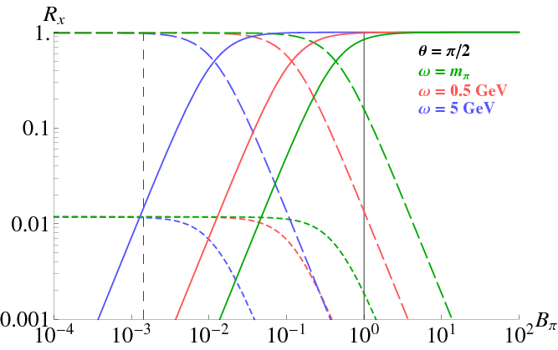
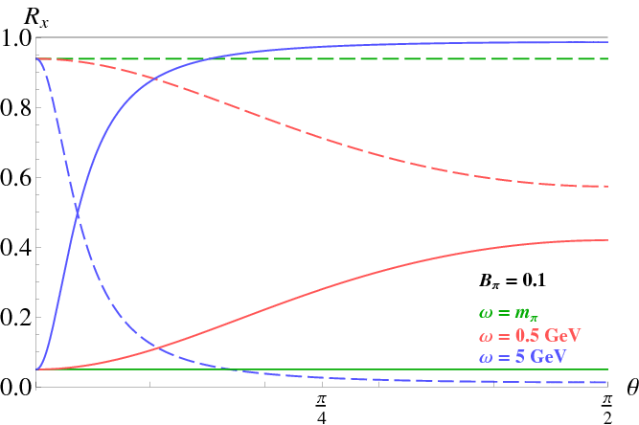
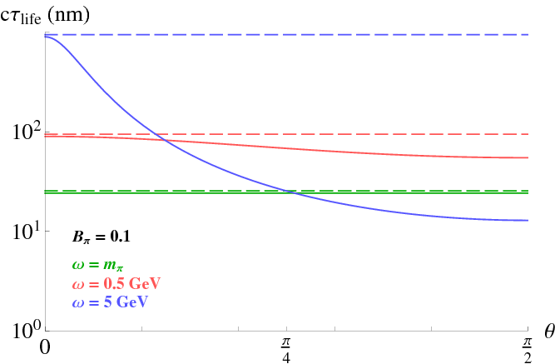
Field-strength dependence of the branching ratio
Angle dependence of the branching ratio
Angle dependence of the lifetime

Slide 36
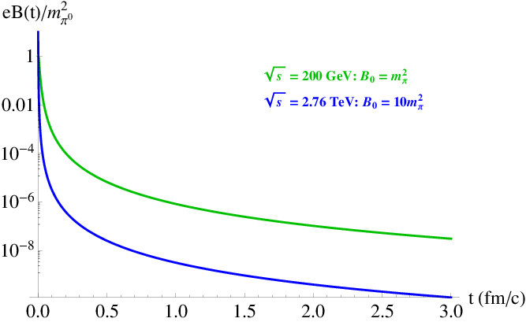
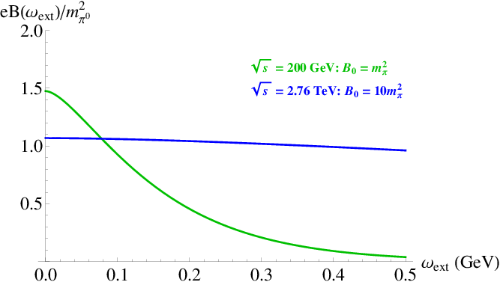
Profiles of time-dependence magnetic fields
Time-dependence
Fourier component

Slide 37
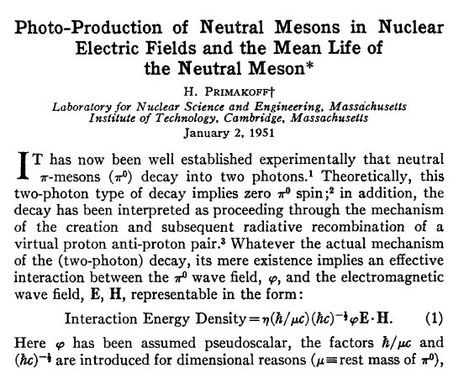




Primakoff effect
1950: First observation of neutral pion
Dominant decay mode was found experimentally.
1951: Primakoff proposed a pion production mechanism
in atomic Coulomb field
1951: Dalitz proposed a secondary decay mode
Recent measurement in JLab (2011)
(PrimEX collaboration)
Prompt photon from hard parton scatterings
Gluon compton scattering in LO
$q\overline{q}$ annihilation in LO
+ Prompt photon is analyzed by perturbation theory in QCD.
+ Prompt photon is measureable in appropriate kinematical window.
+ Prompt photon is produced at the moment of AA (pp, dA) collision,
so that it has much chance to interact with B-field.
+ Prompt photons are produced at the moment of AA (pp, pA) collisions,
so that they have much chance to interact with B-field.

Slide 38
Neutral-pion production from prompt γ* in strong B-fields
γ
π⁰
q₀
q=q₀+k
k
Number of neutral pions → increase
Number of dilepton → decrease
Elliptically anisotropic pion productions
Positive v₂ of neutral pions
Negative v₂ of dileptons

Slide 39
Close look at the integrals
What dynamics is encoded in the scalar functions ?
An imaginary part representing a real photon decay
⇔
⇔
Invariant mass of a fermion-pair in the Landau levels

Slide 40










Analytic representation of Π^{μν}(q,B)
Infinite summation w.r.t. n and l = summation over two Landau levels
Numerically confirmed by Ishikawa, et al. arXiv:1304.3655 [hep-ph]
couldn’t find the same results starting from propagators with Landau level decomposition

Slide 41
Dielectric constant at the lowest-Landau-level
ArcTan : source of an imaginary part
above the lowest threshold
Dielectric constant at the LLL
Polarization excites only along the magnetic field
Limiting behavior of dielectric constant

Slide 42

Complex refractive index
Angle dependence of the refractive index
Shown as a deviation from unit circle
Magnetic field
Direction of arrow :
direction of photon propagation
Norm of arrow :
magnitude of the refraction index

Slide 43




Real part of ε on stable branch
Real part of ε on unstable branch
Relation btw real and imaginary parts
on unstable branch
Imaginary part of ε on unstable branch
Br = (50,100,500,1000,5000,10000, 50000)

Slide 44
Schematic picture of the birefringence
Polarization in dielectric medium :
a classical argument
Lorentz-type dispersion :
Anisotropic constants result
in an anisotropic response.
Incident light
What happens with the anisotropic (discretized)
spectrum by the Landau-levels ?
Incident light field
Dissipation
Linear bound force

