Slide 1

Neutron Stars
-The 2nd densest object in the Universe-
Motoi Tachibana (Saga Univ.)
Jan. 13, 2014 @ 10th Yonsei-Saga partnership program

Slide 2
Physics: Research Arena
for Matters and Universe
★ What are matters made of？
★ How are matters created and
changed in various conditions？
★ How was the universe born
and how will it be?
Approaches: Experiment, Observation,
Theory, Computer

Slide 3
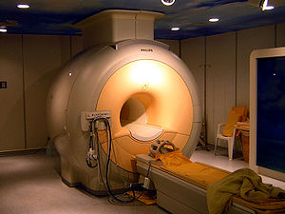
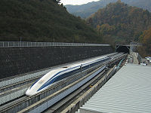
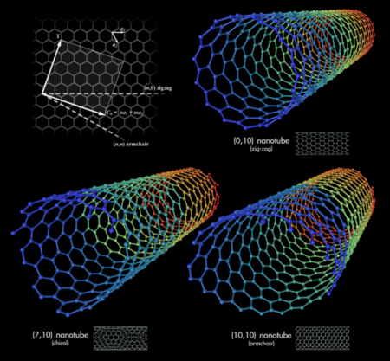
“Children” of Physics
Commun.：Mobile, GPS
Medical：X-ray, MRI, PET
Tech.：Semicond., Computer
Material：Supercond., Nano
Transp.：Linear motor-car
Q. The Nobel Prize in Physics of 2013?

Slide 4

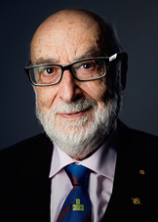
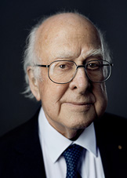
Nobel Prize in Physics 2013
Theoretical discovery of a mechanism that contributes to our understanding of the origin of mass of subatomic particles, and which recently was confirmed through the discovery of the predicted fundamental particle,
by the ATLAS and CMS experiments
at CERN’s Large Hadron Collider
F. Englert
P. Higgs
http://www.nobelprize.org/nobel_prize/physics/laureates/2013

Slide 5
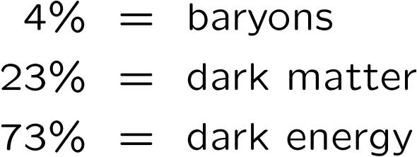
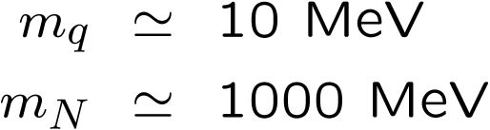
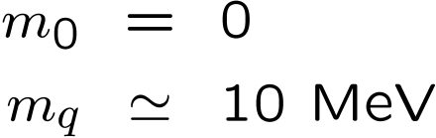
Origin of masses Structure of the vacuum
quark
baryons
bare
quark
quark
Universe
baryon
Cosmological constant
“Chiral” condensate
“Higgs” condensate
Einstein (1917)
Nambu (1960)
Anderson (1963)
Englert-Brout, Higgs (1964)
WMAP, Planck
RHIC, LHC
LHC, ILC

Slide 6
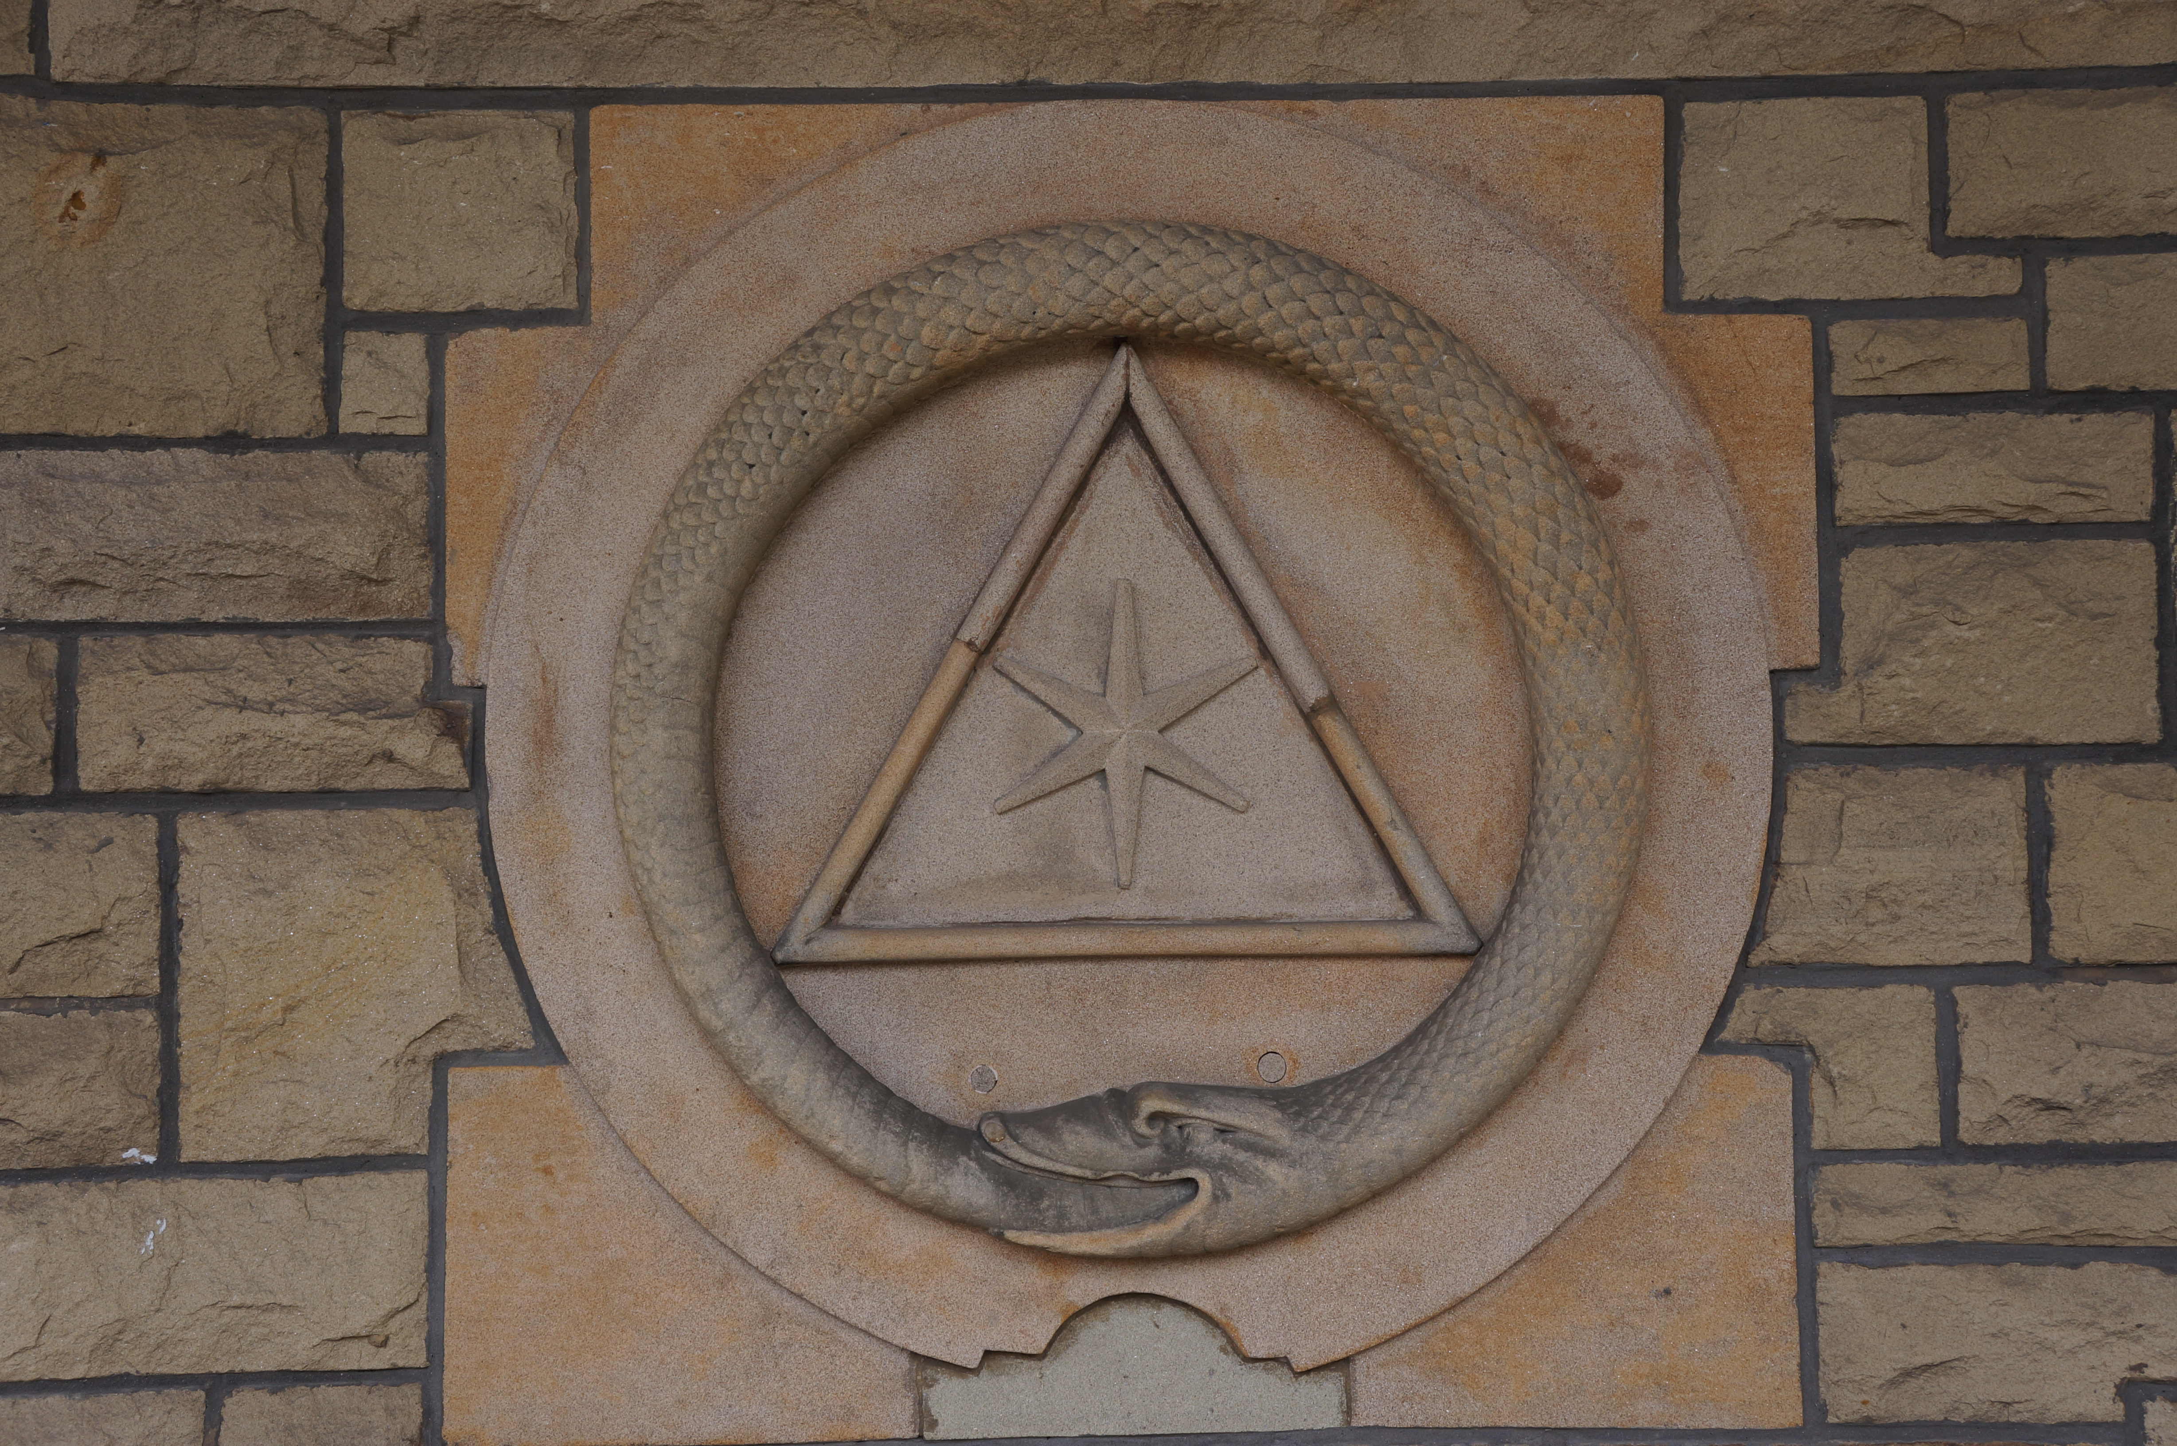
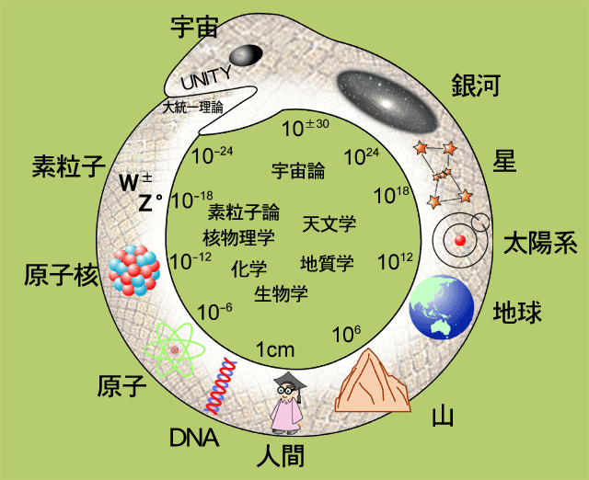
UROBOROS
Universe
Galaxy
Particles
Stars
cosmology
nuclear
particle
physics
astro
physics
Sun
Nuclei
chemistry
biology
Earth
Atom
Mountain
DNA
Human

Slide 7
Interesting connection
between
matters and universe
Physics of Neutron Stars
Harmony of particle, astro-, and condensed matter physics

Slide 8
Content
§1. Introduction
§2. What is Neutron Star?
§3. Various properties of Neutron Stars
Stellar structure, mass-and-radius, thermal behavior,
rapid rotation, strong magnetic field and dark matter
§4. Summary

Slide 9
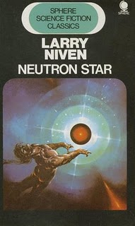
What is Neutron Star ?

Slide 10
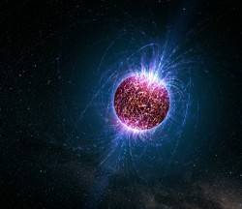
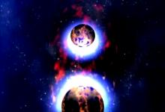
• A stellar remnant after Supernova explosion
• Literally, composed almost entirely of neutrons
• Its density is approximately equivalent to the
human population condensed to the size of
a sugar cube.
something extraordinary

Slide 11
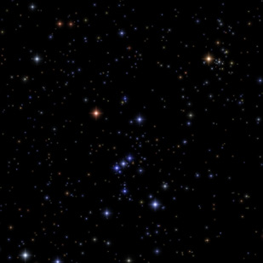
Betelgeuse

Slide 12
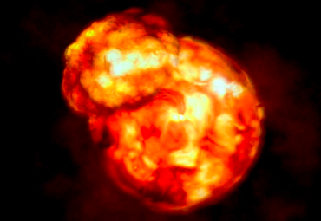
Precursor of supernova explosion?

Slide 13

Tim Burton
“Beetlejuice” (1988)
A star of “Beetle Juice”？

Slide 14
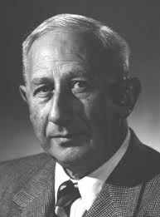
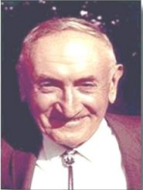
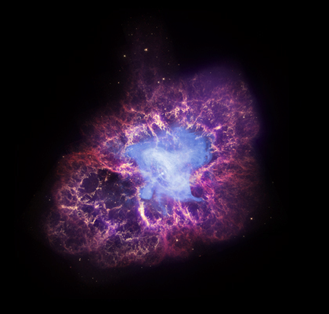

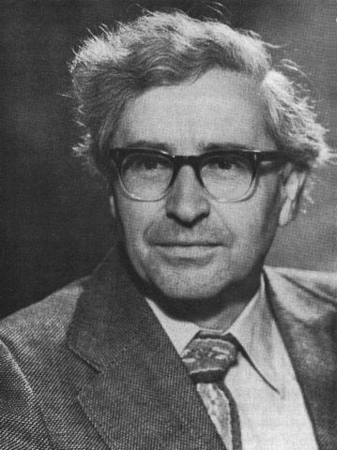
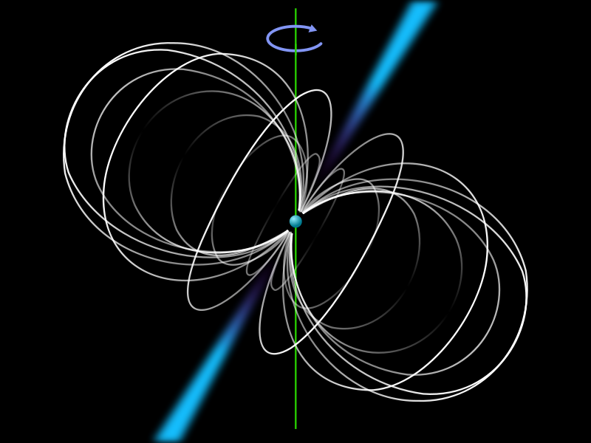
Discovery of Neutron Star
Baade and Zwicky (1934): 1st theoretical prediction of NS
Crab Nebula
W. Baade
F. Zwicky
supernova
Bell and Hewish (1967): Discovery of Pulsar (1st pulsar)
Jocelyn Bell Burnell
A. Hewish
pulsar image

Slide 15
Basic profiles of a neutron star
(Typical) radius:
(Typical) mass:
Temperature:
Magnetic field:
Rotation period:
M : solar mass
Earth’s B field ~ 0.6G
4
SUN
1eV ~ 10 K

Slide 16
Q. The speed of the equator?
About 10% of speed of light !!

Slide 17
Major questions
How to be born and evolve?
Why so compact?
How it cools down?
Why so huge magnetic field?
Why so rapidly rotating?
How particle physics
comes into this business?

Slide 18
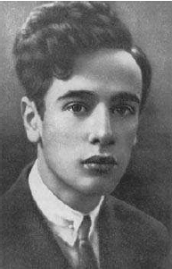
A lesson from history
-Landau and neutron star-
According to recollections of Rosenfeld,
Landau improvised the concept of NS
in a discussion with N. Bohr and Rosenfeld
just after the news of the discovery of the
neutron reached Copenhagen in February
1932, and published his paper a week later.
But this is not the case. The discussion took
place in March 1931 but not published until
Feb. 1932.
“Maximum mass of NS”
“One gigantic nucleus”
Ref.) D. Yakovlev et al., arXiv:1210.0682
Lev D. Landau (1908-1968)

Slide 19
Content
§1. Introduction
§2. What is Neutron Star?
§3. Various properties of Neutron Stars
stellar structure, mass-and-radius, thermal behavior,
rapid rotation, strong magnetic field and dark matter
§4. Summary

Slide 20
Stellar structure

Slide 21



Q. Why neutron star can stably exist?
(we know neutron beta-decays)
Electrons are highly degenerate
for a certain density,
lighter particles can
have more energy
e
p
e
p
n

Slide 22
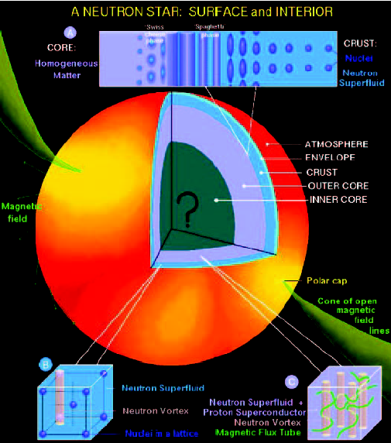
Neutron Star (NS) as “CIPOLLA” (Theorist’s view)
onion in Italian
① Atmosphere: hydrogen, a mix of
heavy elements
(providing info. of temperature)
② Envelope: a few tens of meters
(acts as a thermal insulator)
③ Crust: 500-1000m thickness
④ Nuclear Pasta: In-btw crust/core
⑤ Outer Core: a few kilometers
⑥ Inner Core: Big question mark!

Slide 23
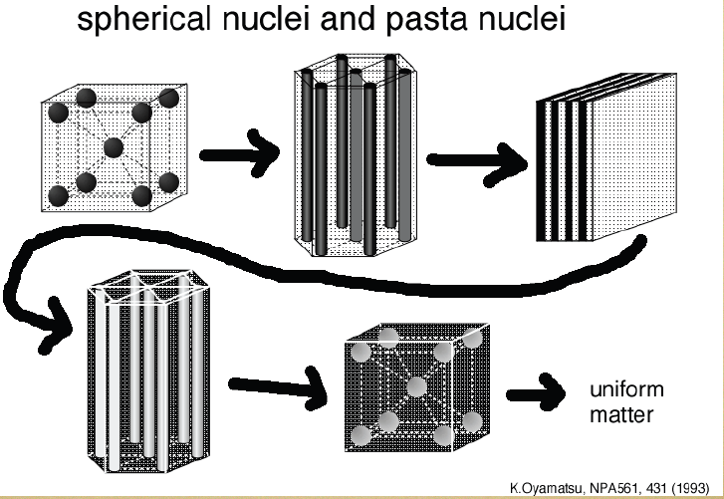
Nuclear “Pasta”
Meat ball
Spaghetti
Lasagna
anti-Spaghetti
Swiss cheese

Slide 24
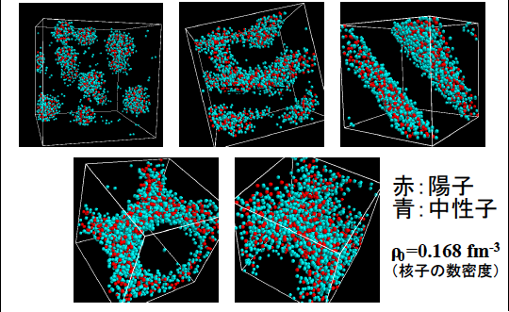
Quantum Molecular Dynamics (QMD)
proton
neutron
G. Watanabe et al. (2002)

Slide 25
Exotica
New states of matter could be present in NS !
Neutron star as laboratories for
the understanding of dense matter!
Superfluid neutron/Supercond. Proton
Bose-Einstein condensate (BEC) of mesons
Hyperons (hadrons w/ strangeness)
Deconfined quarks
Quantitative differences among them?

Slide 26
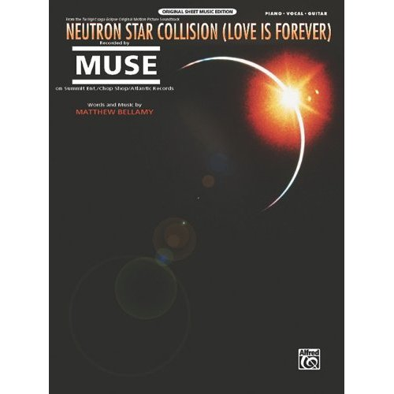
Song for Neutron Star
Our hearts combined like
a neutron star collision
Shall I karaoke ?

Slide 27
Mass and radius

Slide 28
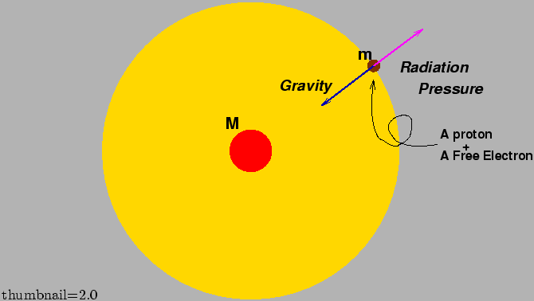
Determination of mass
-Eddington (luminosity) limit-
Obtained by setting the outward continuum radiation
pressure equal to the inward gravitational force
For pure hydrogen gas, the Eddington limit LE is
Thus, once the limit can be measured, the mass of
neutron star M is determined.

Slide 29
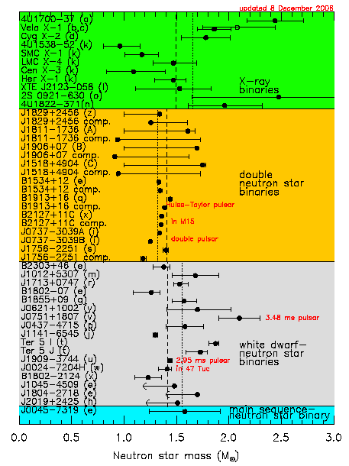
X-ray binaries
double NS binaries
WD-NS binaries
MS-NS binary

Slide 30
Simple estimate of NS mass/radius
For the stability of the star : R > Rs = 2GM
(Schwarzschild radius)
Consider a simple star made out of a number of nucleons,
whose number A and mass m~939 MeV and distance r0 ~
0.5 fm. Then the radius of the star is R~r0A and
the mass M~mA . Then from the limit R=2GM,
1/3
Not bad!

Slide 31

NS Mass & Pressure (Newtonian level)
hydrostatic pressure balance at the region btw r & r+dr
dr
r
R
This is not the end of the story..

Slide 32
(more strict) mass-radius relationship
Tolman-Oppenheimer-Volkov eqs. (Einstein’s general relativity)
with find
Then and NS radius
Need one more eq.!
Equation of State
(EOS)
“A bridge btw particle physics and NS !”

Slide 33
Theory curves for NS Mass-Radius

Slide 34
[HW] Solving TOV eqs.
For the case of massless free fermion,
find the equation of state (EOS).
2. Using the above EOS, solve TOV eqs.
at the Newtonian level. Changing the
initial conditions, find the maximum
mass and the corresponding radius.

Slide 35
Jargons
Nuclear matter
= matter made of nucleons
(quarks are confined into hadrons)
Quark matter
= matter consisting of quarks
(quarks are liberated from hadrons)
NM
NM
NM
QM
QM
DM
Neutron star Hybrid star Quark star
Dark star?

Slide 36
Recent topics for the observations 1
ー Massive Neutron Star ー

Slide 37
A NS measured using Shapiro delay
Demorest et al., Nature 467:1081–1083(2010)
PSR J1614-2230
(Binary Millisecond Pulsar w/ White Dwarf)
(Measurement based on Shapiro delay)
Announcement in NRAO webpage:
“Astronomers Discover Most Massive Neutron Star Yet Known”

Slide 38
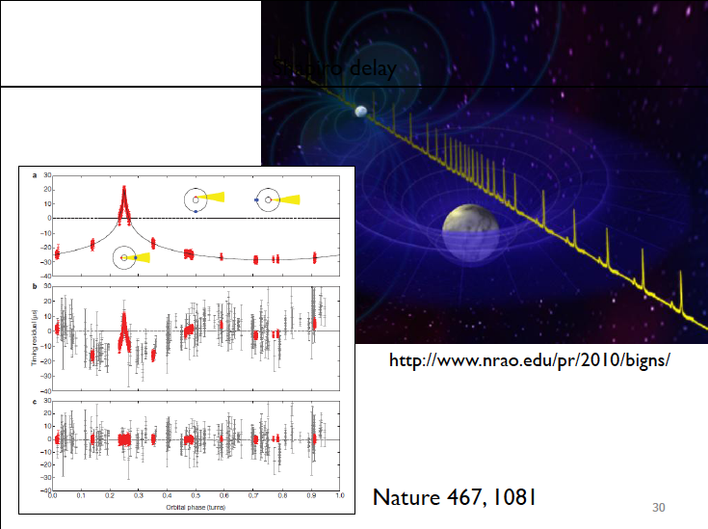
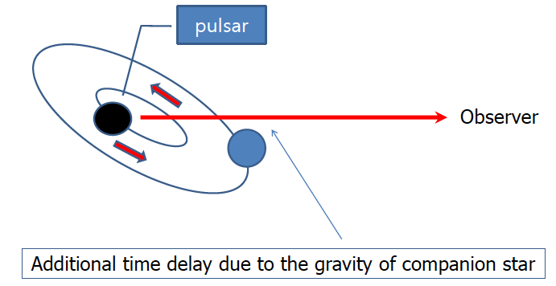
Shapiro delay
Shapiro delay
Slide from C.H.Lee

Slide 39
The authors has insisted that this observation
rules out almost all currently proposed
hyperon or boson condensate EOS’s and
quark matter can support a star this massive
only if the quarks are strongly interacting
and therefore not “free quarks”.
Theorists have to confront the observation!
What happens in quark matter case?

Slide 40
Maximum mass for (simple) quark matter
Ozel-Psaltis-Ransom-Demorest-Alford, ApJL(2010)
★
★
★
for free quarks
to
for
CFL quark matter
chosen to provide
nuclear→quark
(Slide from Alford @ Vienna)

Slide 41
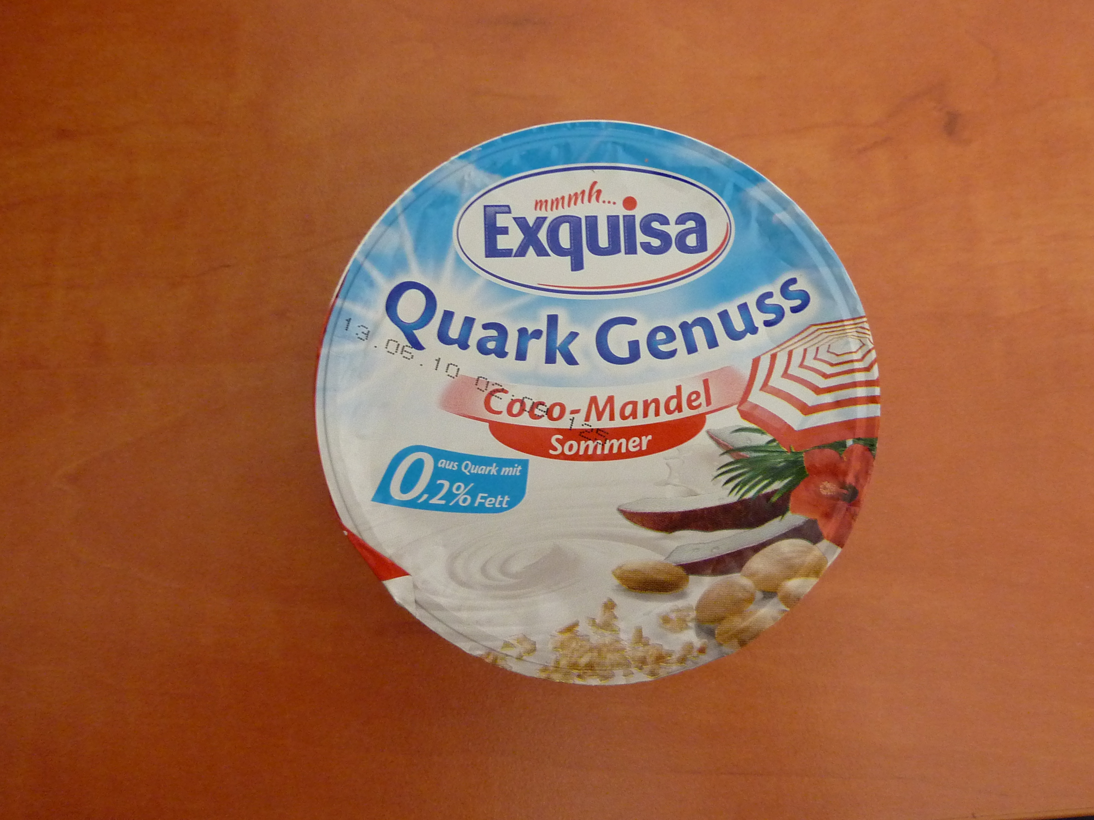
“Quark” in Germany (^0^)/
It says this is QUARK, but I cannot see its color.
Maybe this should be called “QUARKs” ?

Slide 42
Thermal behavior

Slide 43
Thermal history of a Neutron Star I
Cooling eq.
Cv : heat capacity L : luminosity
Bulk property
Microscopic
★Particle physics comes into THE GAME !★

Slide 44
Thermal history of a Neutron Star II
For regular NS cooling via neutrino emissions, there are 2 types:
① Direct URCA process (rapid cooling, sub-dominant effect)
② Modified URCA process (slow cooling, dominant)
spectator
carrying
momentum

Slide 45
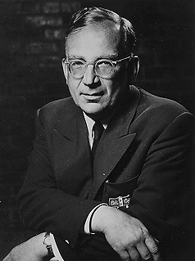
URCA process
(named by Gamow-Schoenberg)
From the name of Casino in Rio de Janeiro,
where these two gentlemen were visiting
“The energy disappears in the nucleus of
the supernova as quickly as the money
disappeared at that roulette table”
G. Gamow
In Gamow’s South Russian dialect,
it can also mean a “robber” or “gangster”

Slide 46
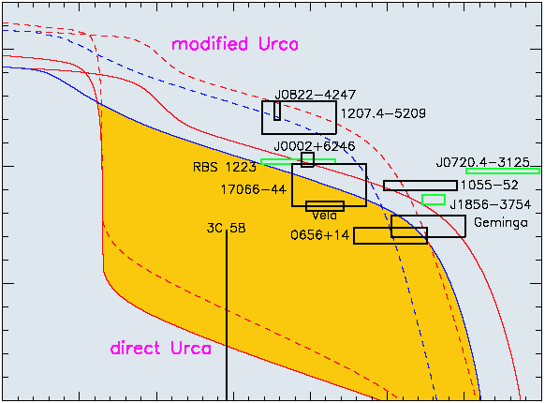
Cooling curves of Neutron Star
T
slow
cooling
rapid
cooling
t

Slide 47
Example of ν emissivity and cooling of NS
- Direct URCA process in quark matter -
To compute ν emissivity, one needs ν self-energy Σ
and the W-boson polarization tensor
Π
d
u
d
W
W
Σν =
Π =
u
ν
e
ν
[ν self-energy]
[W polarization]

Slide 48
Then (after a straightforward/tedious comp.) we end up with
On the other hand, the heat capacity for u and d quarks is
Thus we obtain

Slide 49
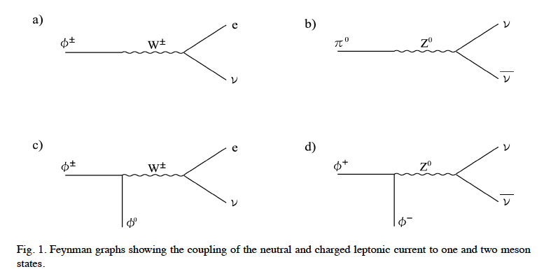


An interesting example of the medium effect
ーweak decay of CFL mesonsー
Reddy-Sadzikowski-Tachibana, NPA(‘02)
Neutral pion can decay into νν !
ー

Slide 50
Neutron Star as Pulsar
ー gravitational wave radiation ー

Slide 51
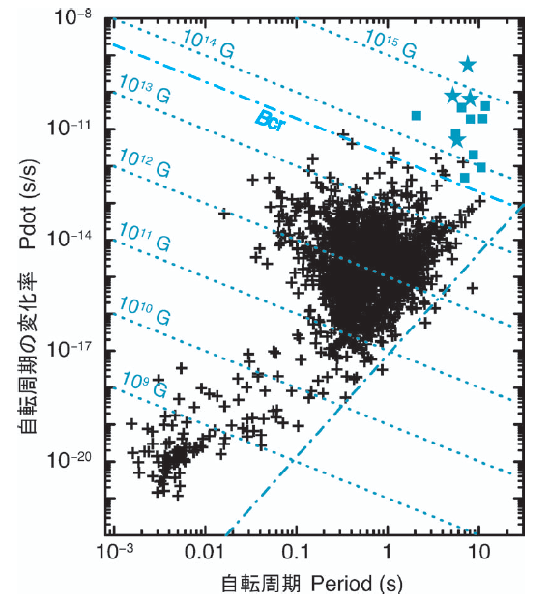
Pulsar = a star emitting the EM wave regularly
“rapid” means “compact”
NS loses the energy by dipole
EM radiation. This provides
some information of the surface
magnetic field (later). Moreover,
There could be another source
for the energy loss of NS.
gravitational wave radiation
“P-Pdot diagram”

Slide 52
The r(otational) mode instability of NS
(eg. N. Andersson)
A quadrupole flow that emits
gravitational wave (GW) radiation.
If dissipative phenomena are
not strong enough,
the oscillations will grow
exponentially, and the star
will keep slowing down until
some dissipation mechanism
can damp the r-modes.
Therefore, the study of the r-modes is
useful in constraining the stellar structure.
Various mechanisms been proposed

Slide 53
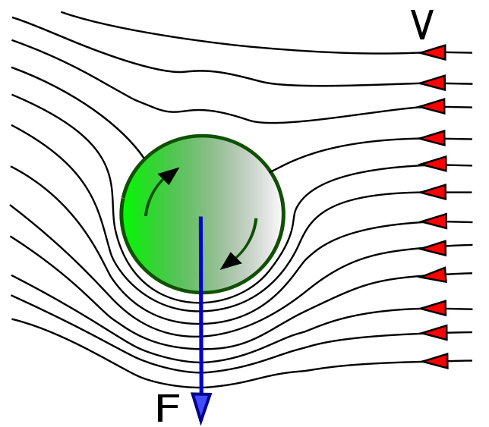
Mutual friction in superfluid vortex system
[Hall-Vinen (1956)]
A friction force btw normal & superfluid components
provided by vortices. It manifests in experiment as
a dissipation present in rotating superfluid state.
• Magnus force btw superfluid comp. and vortex
• Force produced by the normal excitations

Slide 54
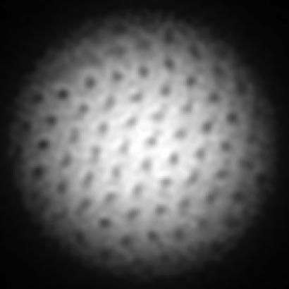
• Force balance condition for a vortex
If a perturbation of the superfluid velocity
is introduced, there is no guarantee that two
forces are balanced ( ).
Energy dissipation:

Slide 55
Magnetars
ーthe strongest magnet in the universeー

Slide 56
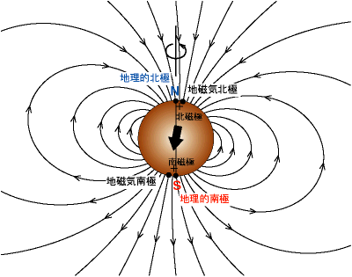
Pulsar ~ a rotating magnet
Rot. energy loss Esd
Magnetar
hypothesis
Duncan-Thompson
(1992)
Magnetic dipole radiation Lmag
then

Slide 57
So far the origin of huge magnetic field not known
and there are various proposals:
• Fossil-field model
• Dynamo formation
• Nuclear ferromagnetism
• Quark ferromagnetism
•••
SUZAKU satellite project has been developed to
observe hard (>10keV) X-ray component and
it might provide useful information for magnetars.

Slide 58
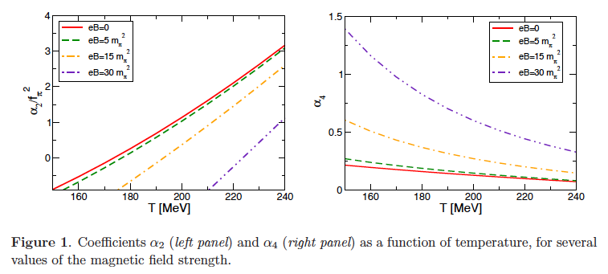
Chiral symmetry in a magnetic field
M.Ruggieri, M. Tachibana and V.Greco, JHEP (2013)

Slide 59
Neutron star and dark matter
ーBlack hole formation in neutron starsー
M. Tachibana and M. Ruggieri, arXiv:1312.5802 [hep-ph]

Slide 60
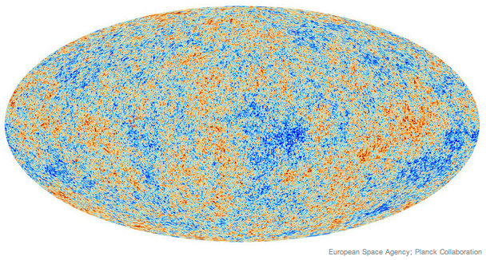
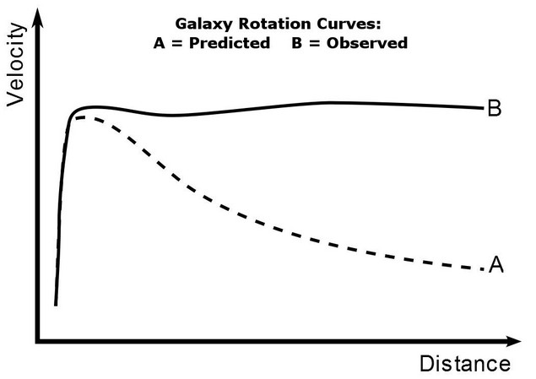
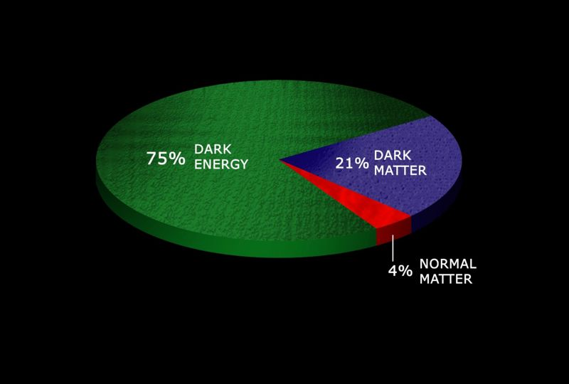
What/Why dark matter (DM)?
Undoubtedly exists, but properties unknown
Just weakly-interacting with other particles
Proposed by Zwicky as missing mass (1934)

Slide 61
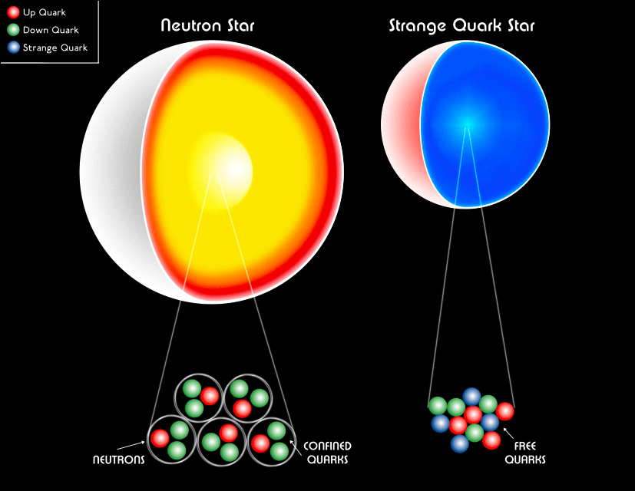
What/Why neutron star (NS)?
Landau’s gigantic nucleus
Good market selling ultimate environments
Proposed by Baade and Zwicky
as a remnant after supernova explosion (1934)
arXiv:1210.0682

Slide 62
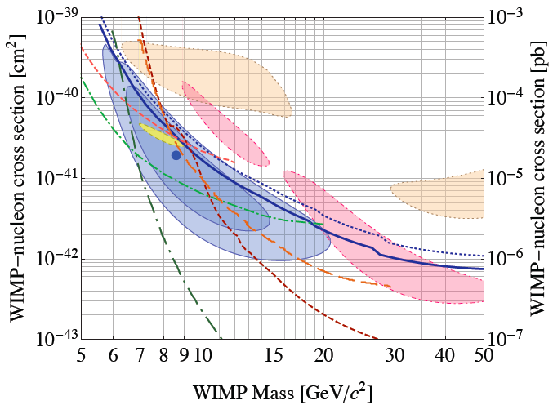
Why their connections?
Possibly constraining WIMP-DM properties via NS
CDMSII, 1304.4279
For a typical neutron star,
Way below the CDMS limit!
NS may constrain the DM properties

Slide 63
Constraining the dark matter mass and its scattering
cross section through the impacts on neutron stars
• Mass-radius relation with the DM EOS
• Cooling in the presence of dark matters
：
• (Asymmetric) dark matter capture in NSs and
black hole formation to collapse neutron stars
cf) This is not so a new idea, but people have considered
the DM capture by Sun and the Earth since 80’s.

Slide 64


Slide 65
Cooling eq. revisited
Cv : heat capacity L : luminosity
Bulk property
Microscopic
★Particle physics plays the role again !★

Slide 66
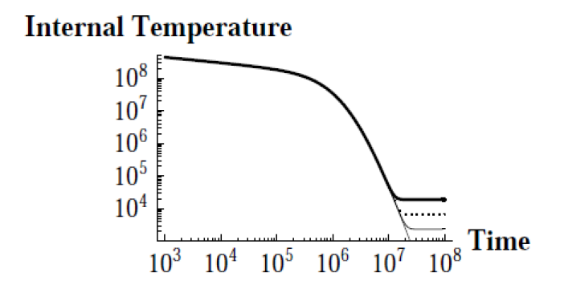
DM heating of Neutron Star
C. Kouvaris (‘10)

Slide 67
Content
§1. Introduction
§2. What is Neutron Star?
§3. Various properties of Neutron Stars
Stellar structure, mass-and-radius, thermal behavior,
rapid rotation, strong magnetic field and dark matter
§4. Summary

Slide 68
Summary
Physics of neutron stars and particle physics
Neutron star (NS) = Landau’s gigantic nucleus
2. NS = good market for particle physics
3. Future development of the observations
New people, new ideas and new results !
Concept of matters and space-time
감사합니다

