Slide 1
Nuclear Symmetry Energy from QCD Sum Rule Phys. Rev. C87 (2013) 015204 (arXiv:1209.0080) Saga-Yonsei Workshop January 17, 2014
Kie Sang JEONG
Su Houng LEE
(Theoretical Nuclear and Hadron Physics Group)
Yonsei University

Slide 2
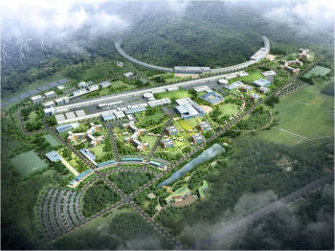
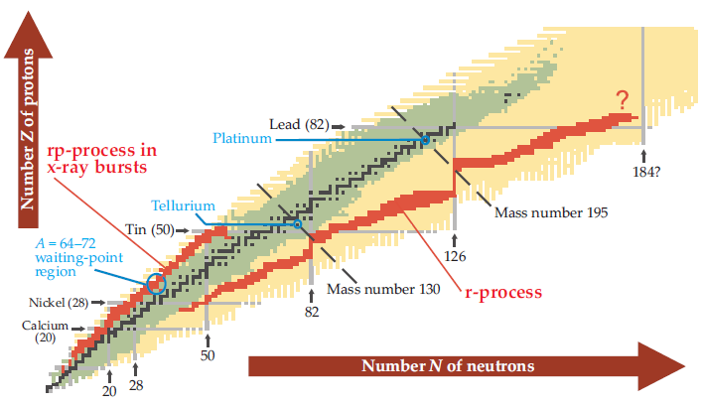
Motivation 1 – RAON plan
Rare Isotope Accelerator Plan
(Quoted from Physics Today November 2008)
Nuclear Symmetry Energy plays a key role in Rare Isotope and Neutron Star study

Slide 3
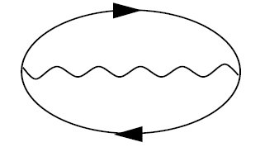
Motivation 2 – RMFT QCD SR
Dirac phenomenology of nucleon-nucleus scattering
This tendency naturally comes from RMFT
Strong vector repulsion Re V>0
Strong scalar attraction Re S<0
Dirac optical potential
QHD model, DBHF approximation etc.

Slide 4
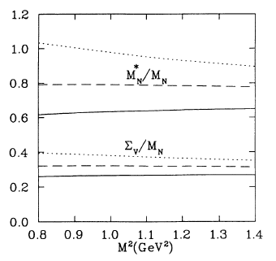
Motivation 2 – RMFT QCD SR
For symmetric nuclear matter, this large cancelation mechanism between the self energies can be understood in QCD degree of freedom
Could asymmetric nuclear matter be understood in QCD degree of freedom?
We applied QCD Sum Rule to asymmetric nuclear matter
Physical Review C 49, 464 (1993)
(Thomas Cohen et al. (1992))

Slide 5
Mean field approximation
Nuclear Symmetry Energy in infinite nuclear matter
RMF type nucleon propagator
Quasi-nucleon on the asymmetric Fermi sea
(Up to linear density order)

Slide 6
QCD Sum Rule
Correlation function
Energy dispersion relation
Phenomenological ansatz in hadronic d.o.f.
is medium four-velocity
Ioffe’s interpolating field for proton
Contains all possible hadronic resonance states in QCD degree of freedom
Equating both sides, nucleon self energies can be expressed in QCD degree of freedom

Slide 7
QCD Sum Rule
At short distance, Wilson coefficient can be obtained by perturbative calculation
Linear density approximation
Contains all non-perturbative contribution
For example,
(These figures are quoted from Ph.D. thesis of Thomas Hilger)

Slide 8
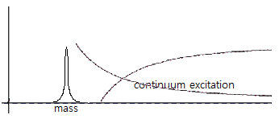
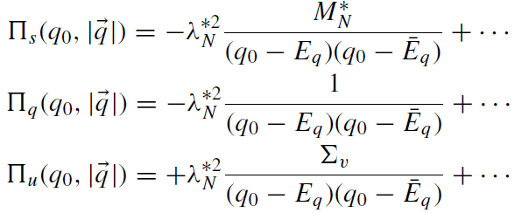
Borel transformation
To emphasize quasi-nucleon pole contribution
Borel transformed invariants
For OPE side
For phenomenological side, equivalent weight function has been used
With continuum correction

Slide 9
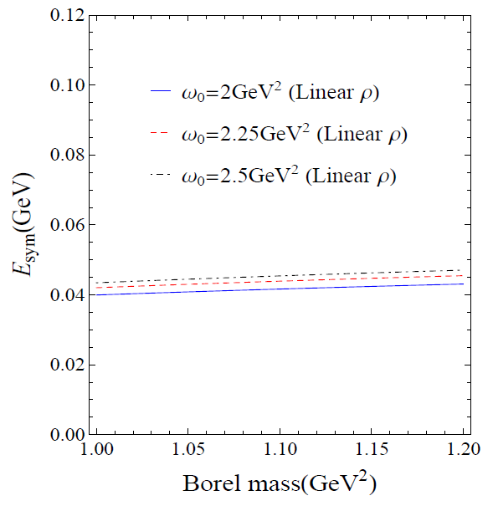
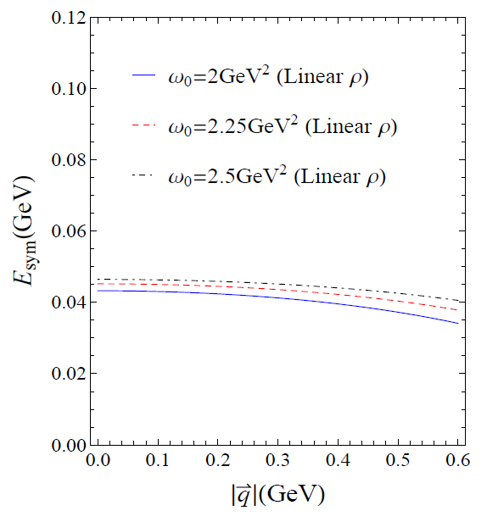
Sum Rule analysis up to dimension 5
Nuclear Symmetry Energy
Main ingredient?
Nuclear Symmetry Energy is ~40 MeV and do not strongly depend on
Consistency with previous studies in order of magnitude
Mainly consists of `potential’ like part -> Phenomenological ansatz works well

Slide 10
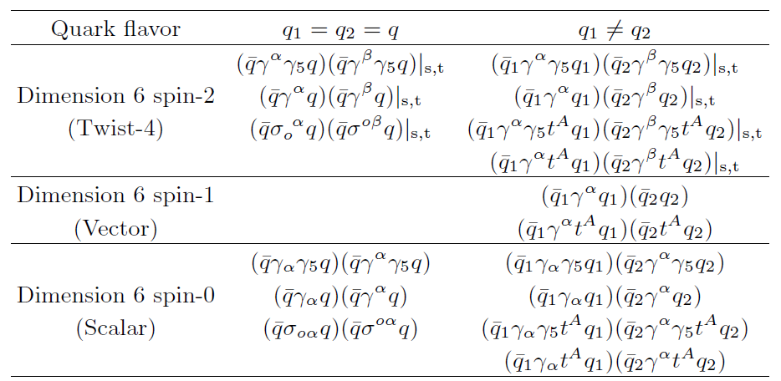
4-quark Operator Product Expansion
By using Fierz rearrangement we have found the exact four-quark operators in the nucleon sum rule
With constraint from `zero identity’ and assumed P, T symmetry of medium ground state
Among these, except for , all proton expectation value of twist-4 operators can be estimated from experiment (DIS)

Slide 11
Twist-4 operator from DIS data
(SHL et al., Physics Letter B 312 (1993) 351-357)
Where, Ku, Kd and Kud are
From these result…

Slide 12
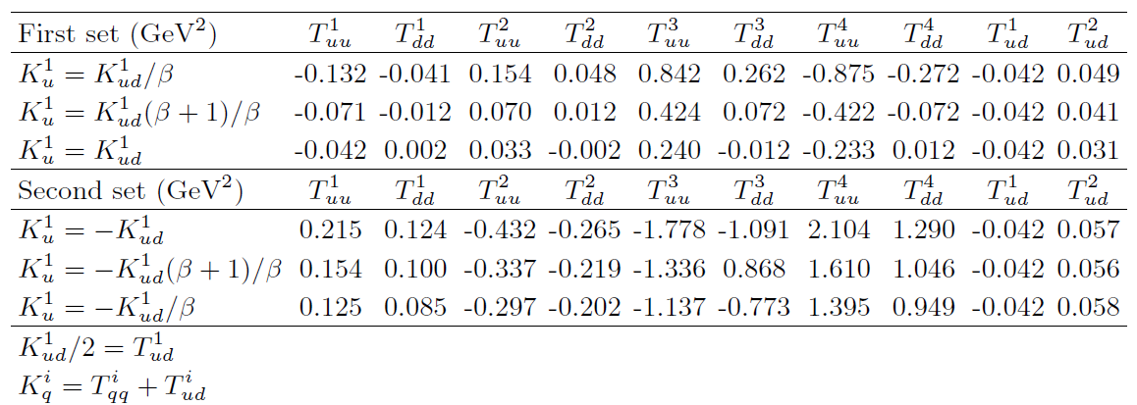
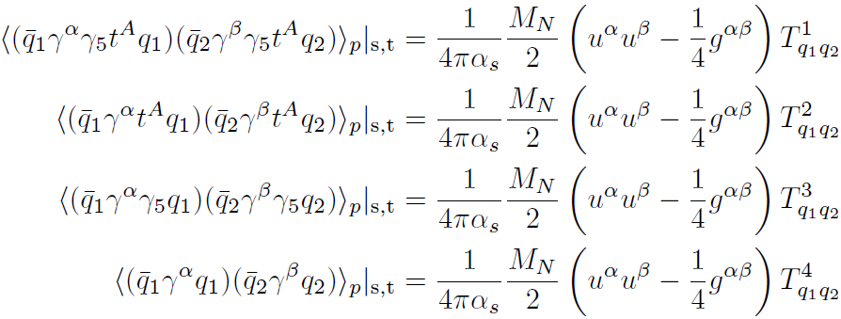
Twist-4 operator from DIS data
Table for Twist-4 matrix elements for the nucleon SR
Only first set gives physically meaningful results

Slide 13
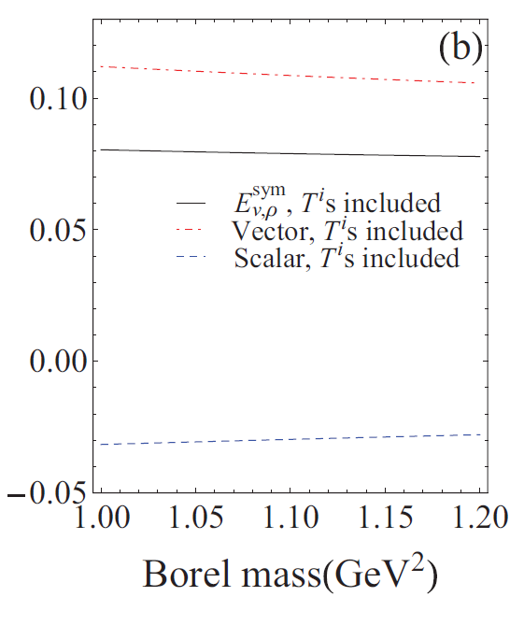
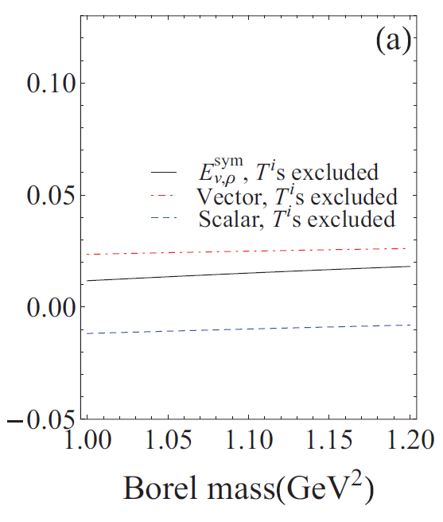
Nuclear Symmetry Energy with Twist-4 ops.
Iso-vector scalar / vector decomposition of Nuclear Symmetry Energy
RMFT result
In the result without twist-4 ops., both self energies give weak contribution
Which part gives reduction to Symmetry energy in our QCD sum rule?
Iso-vector meson exchange
Vector meson exchange -> Repulsive
Scalar meson exchange -> Attractive
Esym (GeV)
(V.Baran, et al. Physics Reports 410 (2005) 335–466)
Contribution of Twist-4 Ops. mimics rho-delta meson exchange channel in RMFT

Slide 14
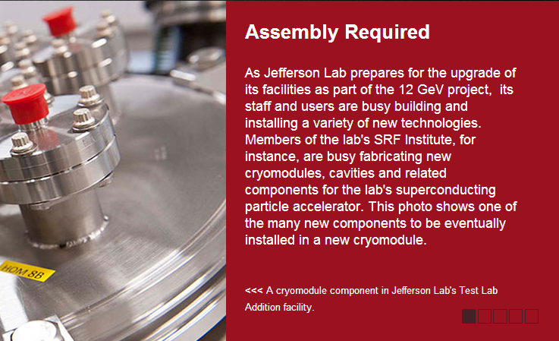
DIS data will be improved
Table for Twist-4 matrix elements has some uncertainty
Jefferson Lab has a plan for accelerator upgrade
This plan will lead to more precise structure functions for Twist-4 matrix elements

Slide 15
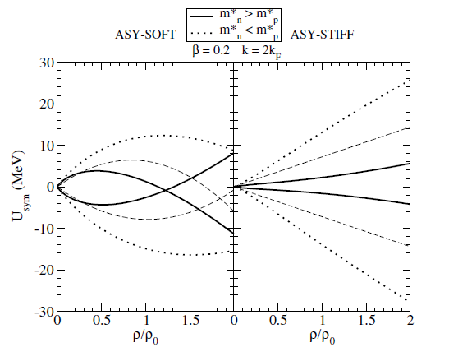
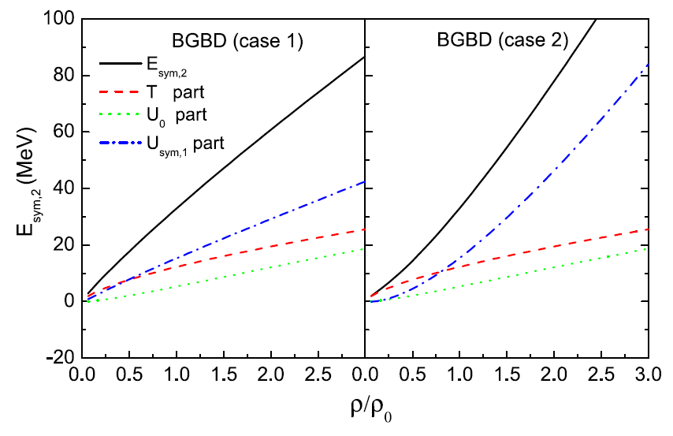
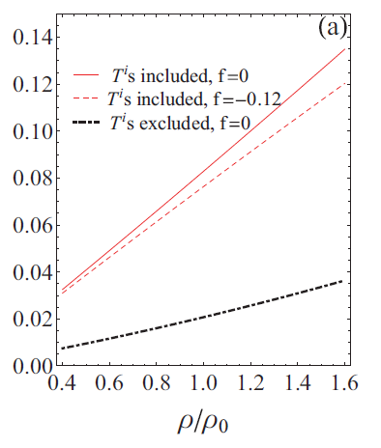
At extremely high density?
Model predictions for Nuclear Symmetry Energy at extreme condition
The origin of nuclear reaction in asymmetric matter may comes from Multi-quark operators like Twist-4 ops.
At high density, phase of nuclear matter may become quark phase, and the dominating dynamics will be QCD
We may make naïve guess that this kind of prediction for dense condition might be justified by QCD via studying multi-quark operators at high density
C. Xu, Bao-an Li, Lie-wen Chen, Che Ming Ko. / Nuclear Physics A 865 (2011) 1–16
Figure 3 of J.Phys. G 37 (2010) 083101 Di Toro et. al.

Slide 16
Conclusion
We have successfully reproduced numerical value of the Nuclear Symmetry Energy of previous studies and found exact four-quark operators in the nucleon sum rule.
Twist-4 matrix elements give important contribution to Nuclear Symmetry Energy. Its contribution mimics the iso-vector meson exchange channel in recent RMFT models.
Our study shows that Nuclear Symmetry Energy can be understood via QCD, its fundamental origin may comes from quark and gluon degrees of freedom.
Extremely high density behavior remains unclear, but this also might be understood via QCD. Related study is now in progress.

Slide 17
Back-up slides

Slide 18
In-medium condensate in asymmetric matter
Twist decomposition of 2-quark condensates
Ratio factor for twist-2 operators
Twist-3
Twist-2
can be obtained from matrix elements
Distribution function for quarks and anti-quarks in proton

Slide 19
In-medium condensate in asymmetric matter
Ratio factor for twist-3 operators
Lower lying baryon octet mass relation
This relation can be estimated from lower lying baryon octet mass relation
Phenomenological description for nucleon mass
With renormalizing scheme (Trace anomaly)
Heavy quark expansion
(M.A.Shifman, Physics Letters B 78B, 443 (1978))

Slide 20
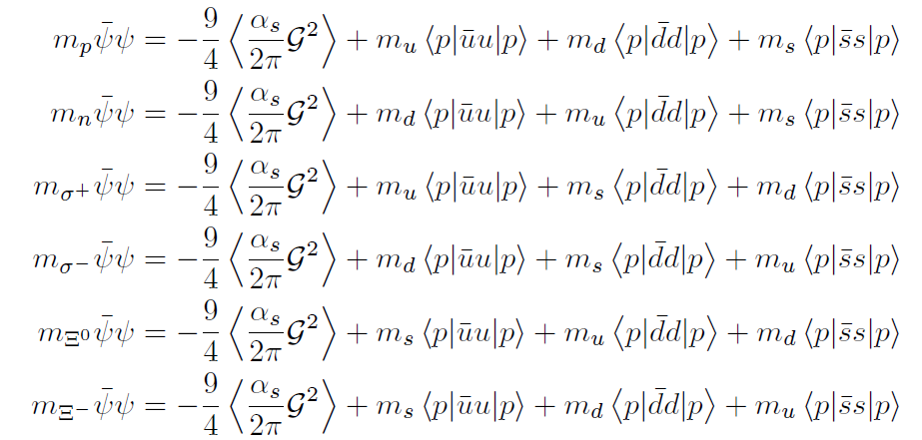
Ratio factor from baryon octet
Lower lying Baryon octet mass relation
(S.H.Choi, Master thesis, Yonsei University. (1991))
With this relation…

Slide 21
Ratio factor from baryon octet
Iso-vector part, can be written as,
Iso-scalar part, comes from pion-nucleon sigma term
Ratio factor for type
Strange quark mass = 150 MeV

