Slide 1



Welcome to 21st Yonsei-Saga workshop!
Study of QCD matter
-Nambu meets BCS-
Motoi(머더이) Tachibana (Saga U.)
Nov. 5, 2024 ＠ Yonsei U.

Slide 2
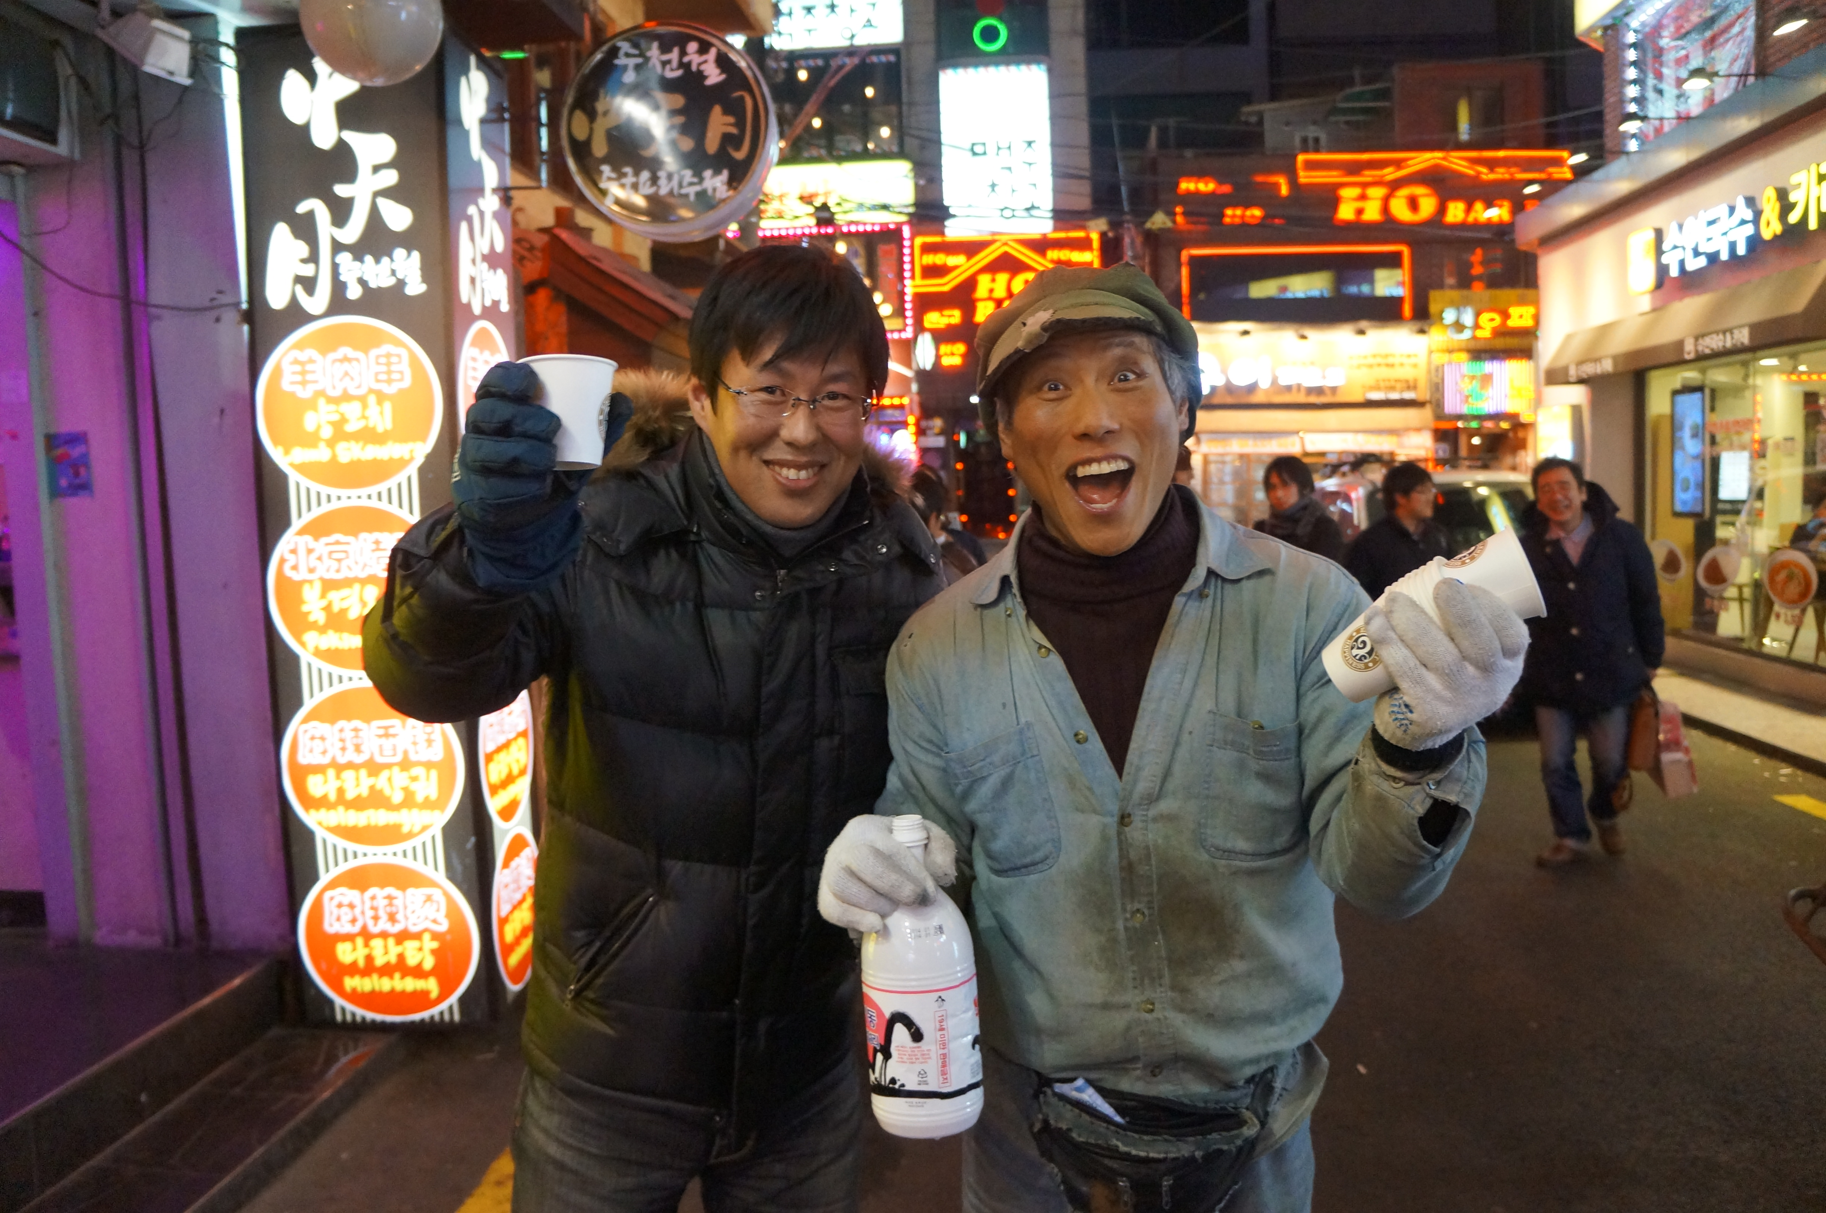

Slide 3
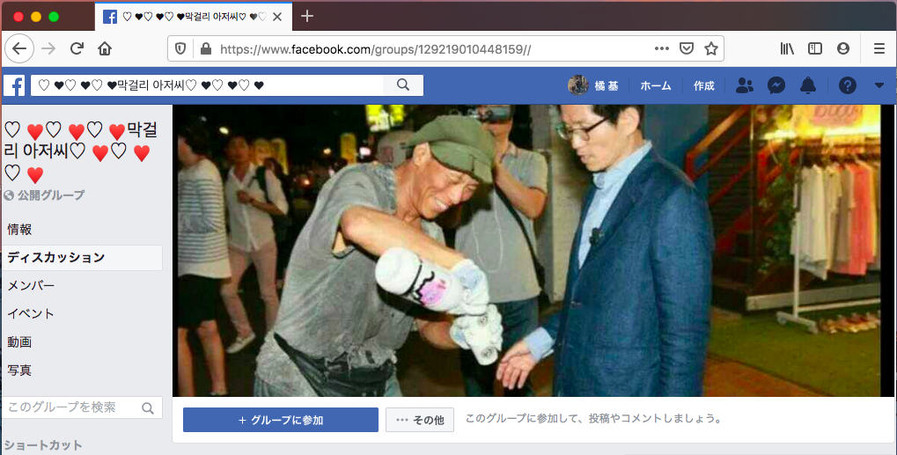

Slide 4
Electron = spin + charge
↓
Charge = Electronics
Spin = Spintronics
Low T dynamics of spin & charge?
↓
Entanglement between
magnetism and superconductivity

Slide 5
Quark = spin + color charge
Q. What is Low T dynamics of
quark spin & color charge?
Study of QCD matter
↓
Entanglement between
chirality and color superconductivity!
(Entanglemet of symmetry breaking)

Slide 6
Physics = Research arena
of Matters and Spacetime
★ What matters are made of？
★ How matters are created and
change in different conditions？
★ How the universe was born and will be ?
Approaches: Experiment, Observation,
Theory, Computer

Slide 7
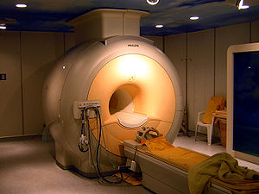
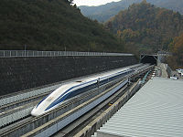
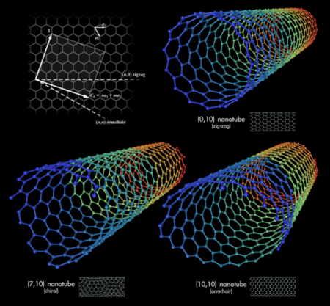
“Children” of Physics
Commun.：Mobile, GPS
Medical：X-ray, MRI, PET
Tech.：Semicond., Computer
Material：Supercond., Nano
Transp.：Linear motor-car

Slide 8
Q. Nobel Prize in Physics 2024?

Slide 9

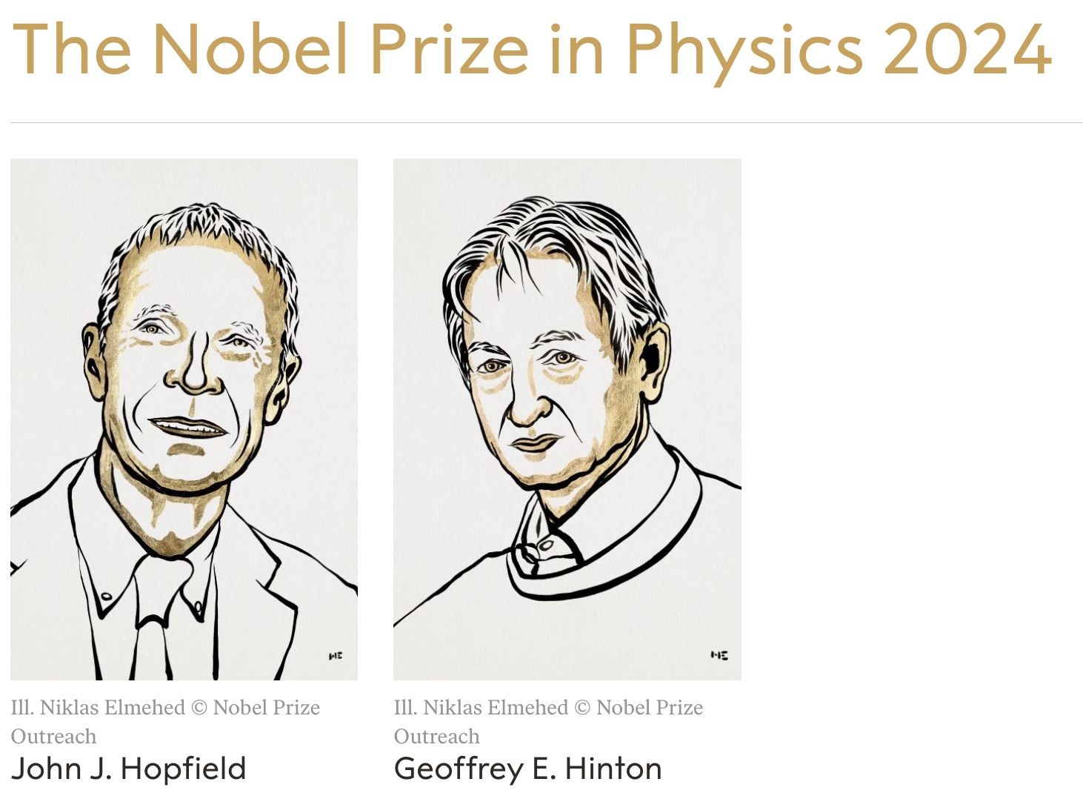
Nobel Prize in Physics 2024 :
Fundamental discoveries and inventions that enable
machine learning with artificial neural networks
Impact of AI

Slide 10
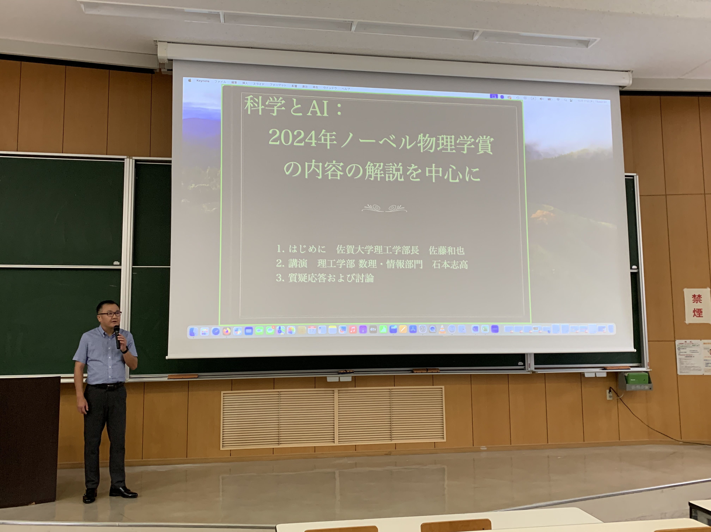
Oct. 17, 2024 @ Saga University
Lectures on Nobel Prize in Physics 2024

Slide 11

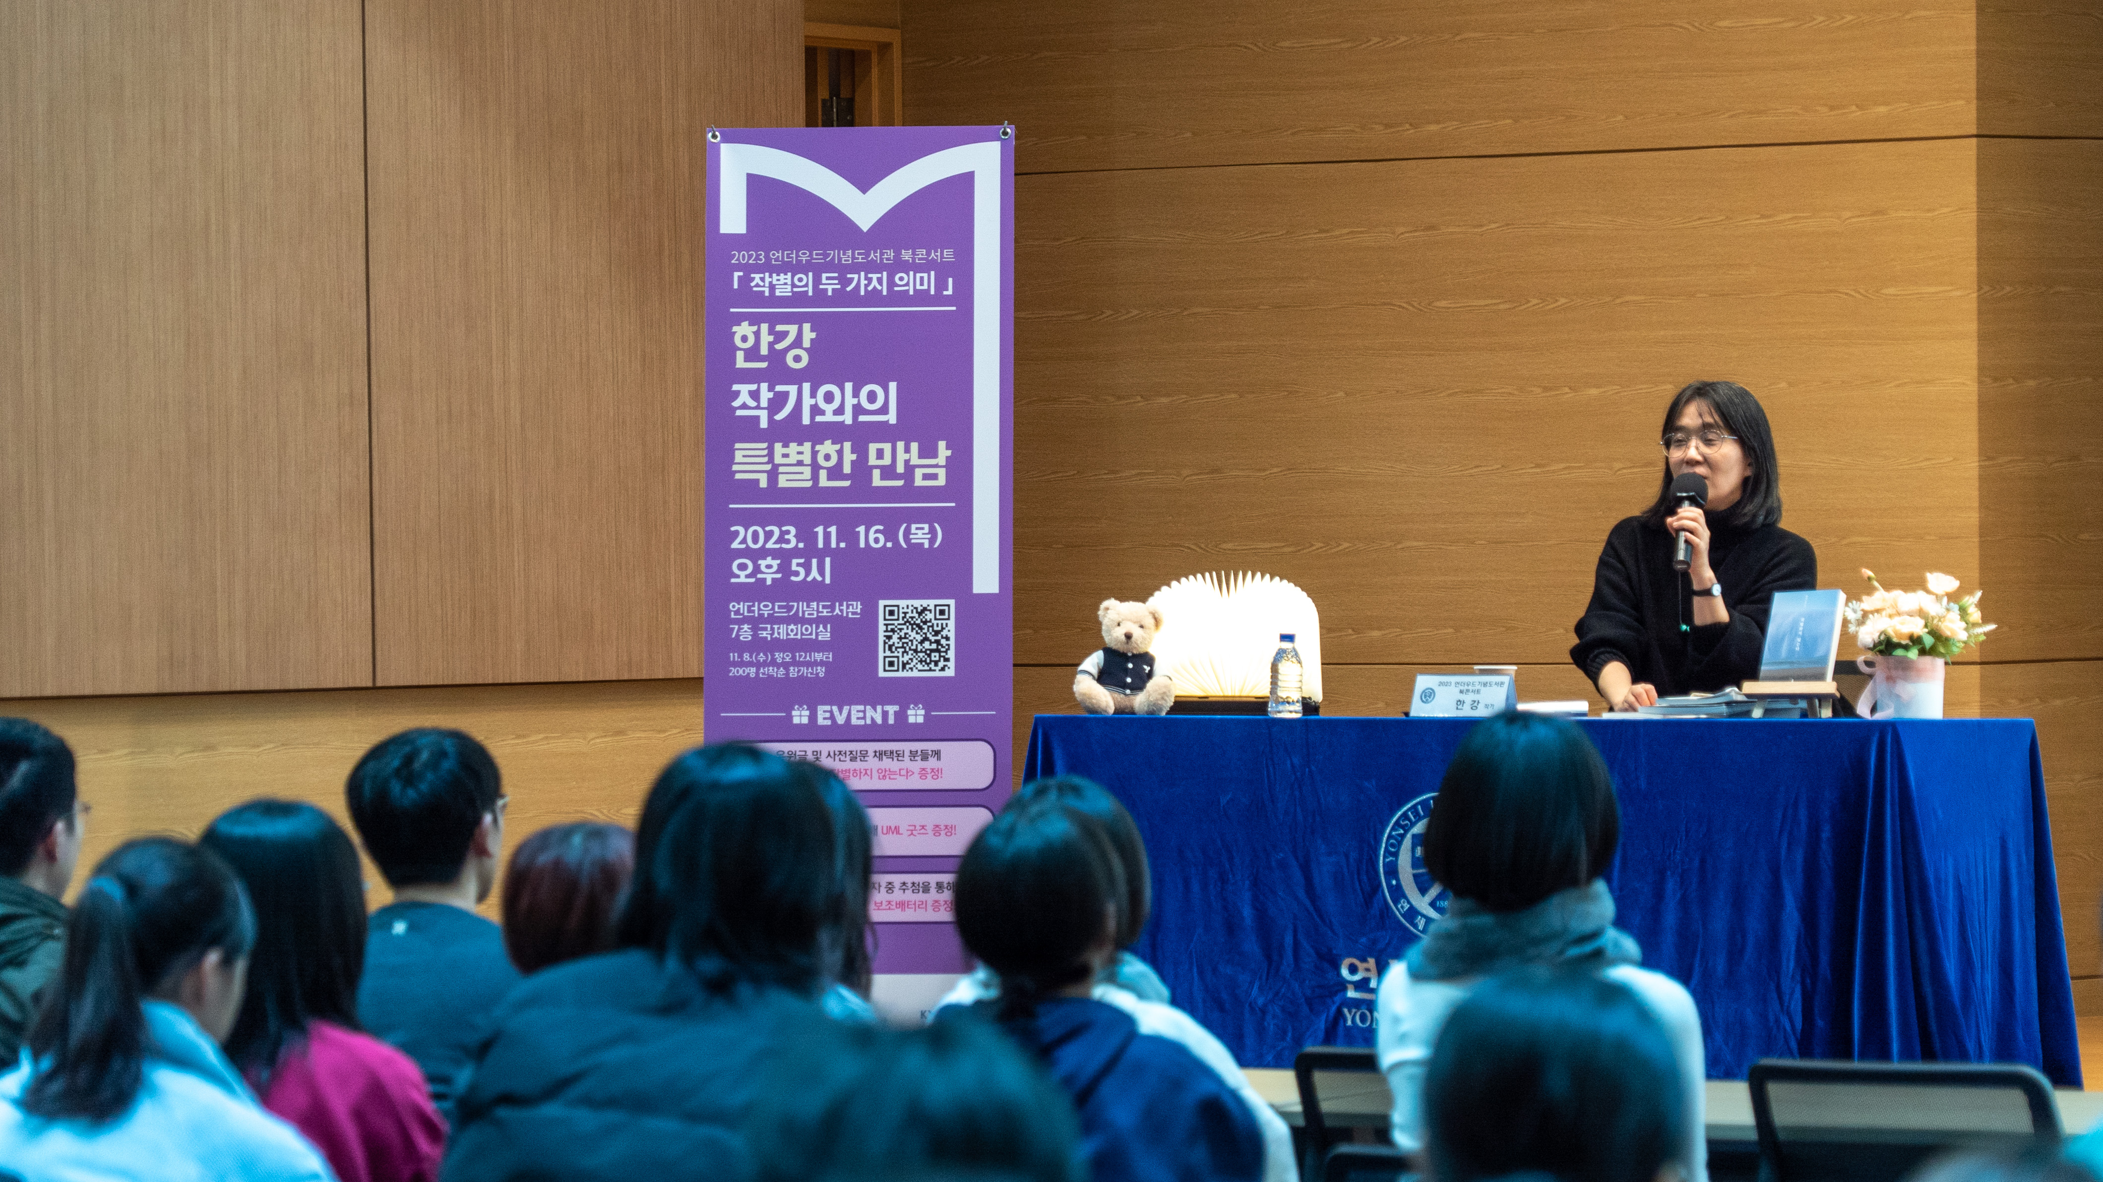
Congratulations, Ms. Han Kang!
Congratulations, Yonsei University!
축하합니다！

Slide 12
Interesting connection
between
matters and universe
Dense matter and Compact Stars
Dense QCD matter and Neutron Stars
Harmony of particle, astro-, and condensed matter physics
Physics Orchestra !

Slide 13

Short introduction of Neutron Star

Slide 14
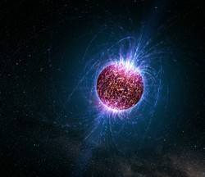
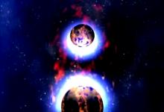
Wikipedia, our Maestro
• Stellar remnant after supernova explosion
• Composed almost entirely of neutrons
• Approximately same density as human population
condensed to the size of a sugar cube (*o*)
something extraordinary

Slide 15
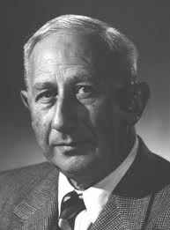
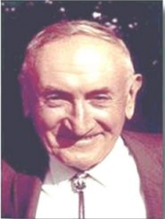
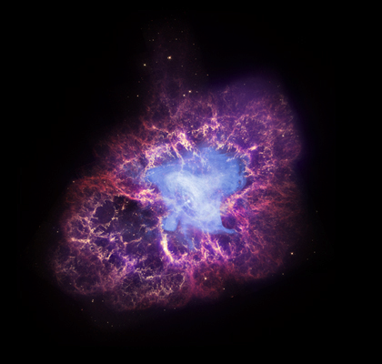

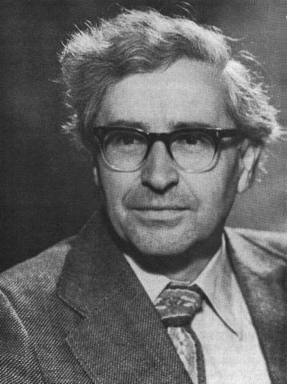
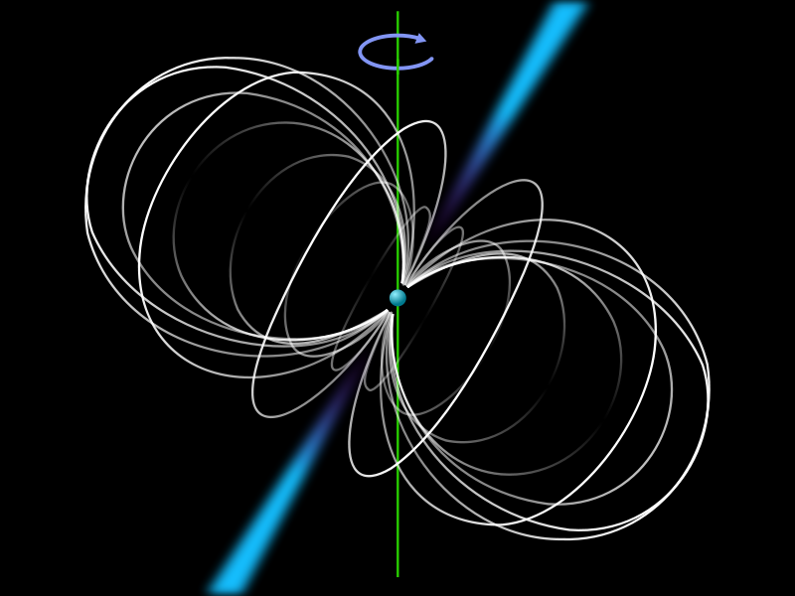
History of Neutron Star
Baade and Zwicky (1934): 1st theoretical prediction of NS
Crab Nebula
W. Baade
F. Zwicky
Supernova
Bell and Hewish (1967): Discovery of Pulsar (1st radio pulsar)
Jocelyn Bell Burnell
A. Hewish
Pulsar image

Slide 16
Basic profile of Neutron Star
(Typical) radius:
(Typical) mass:
Temperature:
Magnetic field:
Rotation period:
M : solar mass
Earth’s B field ~ 0.6G
4
SUN
1eV ~ 10 K

Slide 17
Major questions
How to be born and evolve?
Why so compact?
How it cools down?
Why so huge magnetic field?
Why so rapidly rotating?
How particle physics
comes into this business?

Slide 18
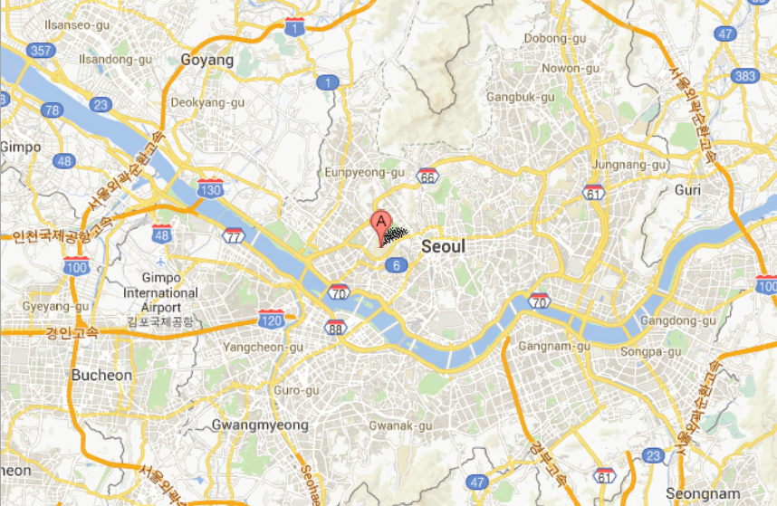

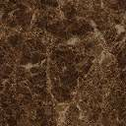
Yonsei Neutron Star !
Oops!

Slide 19
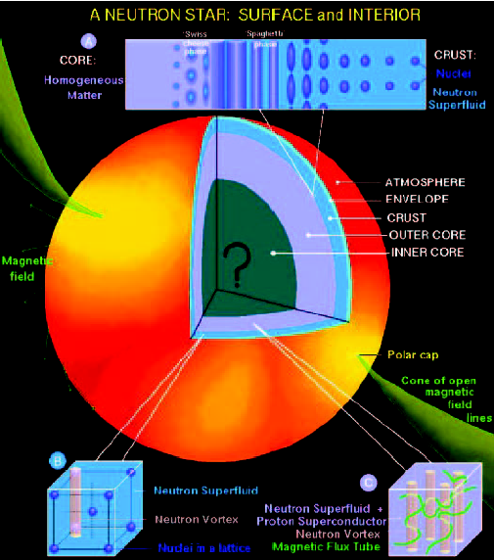
Theorist’s view of NS structures
① Atmosphere: hydrogen, a mix of
heavy elements
(providing info. of temperature)
② Envelope: a few tens of meters
(acts as a thermal insulator)
③ Crust: 500-1000m thickness
④ Nuclear Pasta: In-btw crust/core
⑤ Outer Core: a few kilometers
⑥ Inner Core: Big question mark!

Slide 20
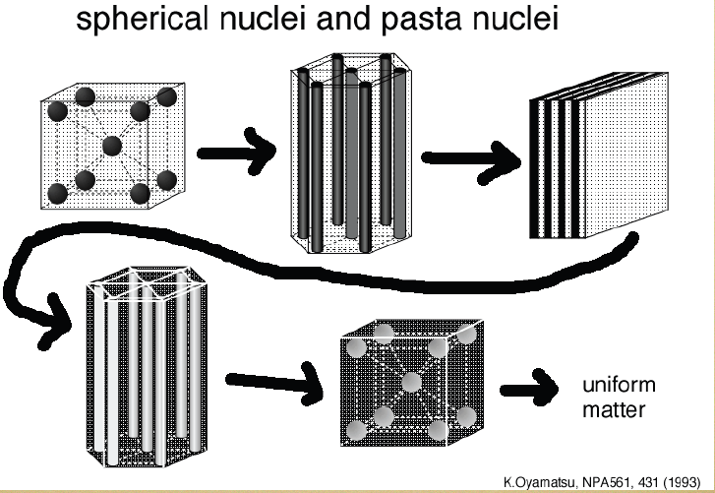
Nuclear “Pasta”
Meat ball
Spaghetti
Lasagna
Try to eat?
anti-Spaghetti
Swiss cheese

Slide 21
Yes! We love Exotica!
New states of matter present in NS !
Superfluid neutron/Supercond. Proton
Bose-Einstein condensate (BEC) of mesons
Hyperons (hadrons w/ strangeness)
Deconfined quarks
Neutron star = laboratories for
studying matter in Xtreme!
Quantitative differences among them?

Slide 22
Study of QCD matter

Slide 23
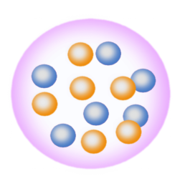
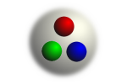

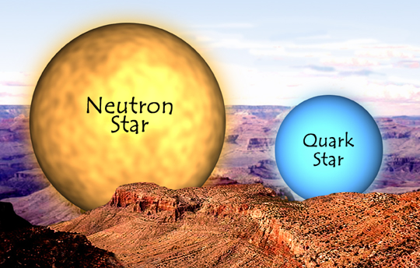
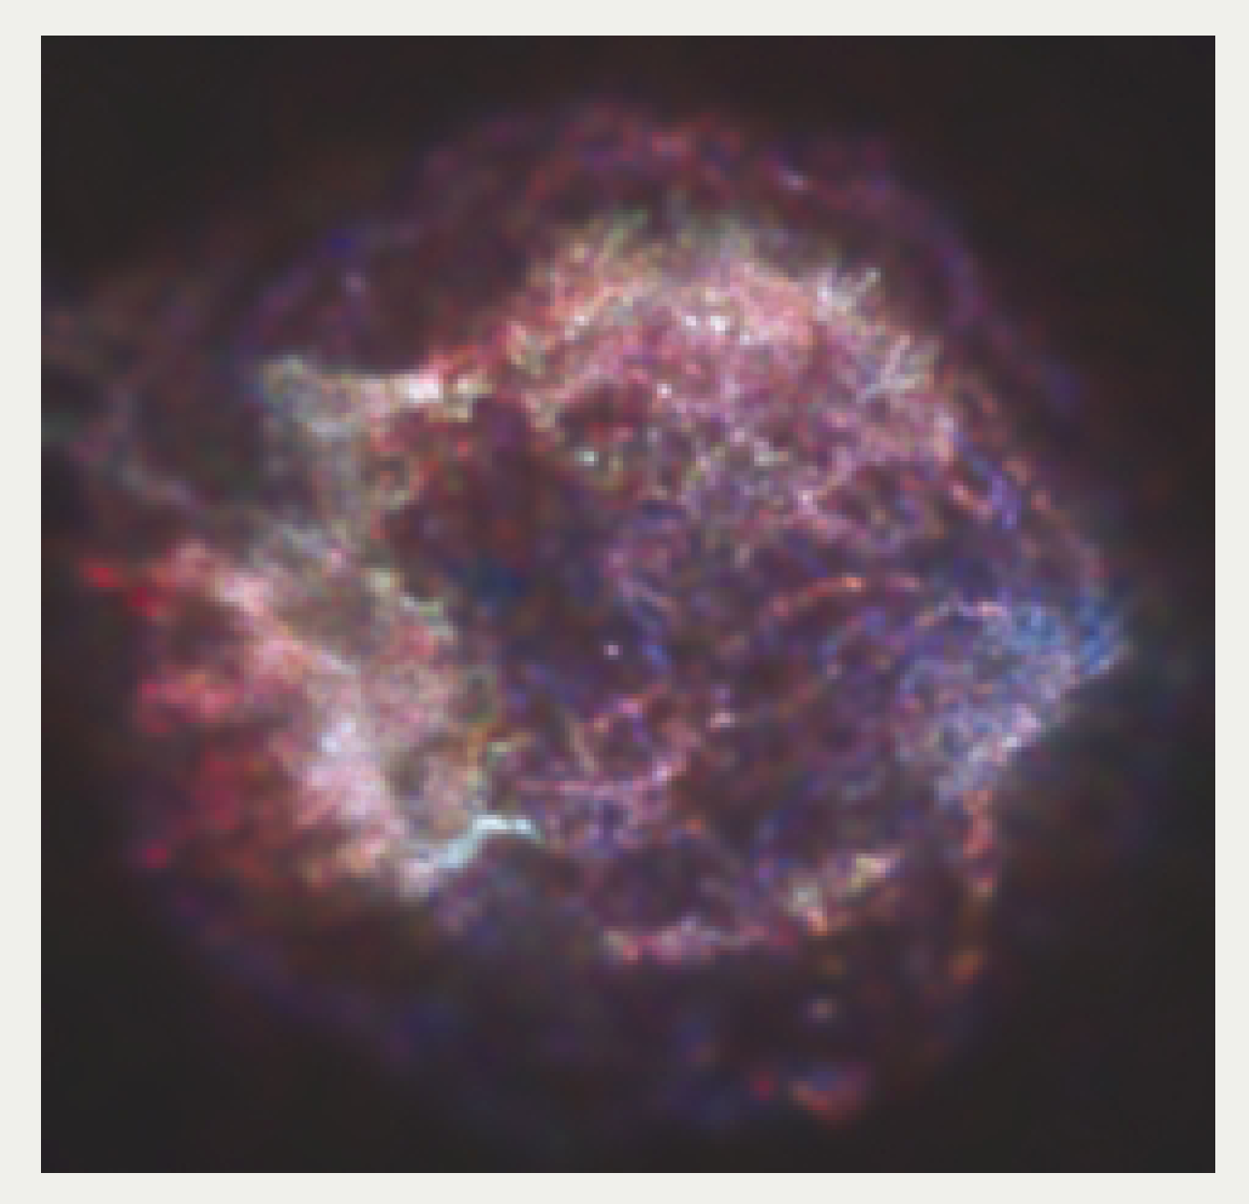
Grand Challenge
- Space-time evolution of QCD matter -
Hadrons
Nuclear force
Nucleons
Nuclei
No QCD, no life
Early universe
Neutron/quark star
Supernovae
The answer to the ultimate question
“Why the matter of our universe can be stable?”

Slide 24
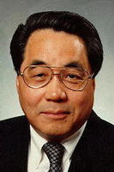
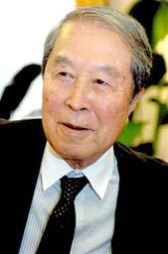

QCD Lagrangian
(Han-Nambu, 1965)
Yes! We love QCD ♥
Simple, but very rich in physics and math.
Providing testing field for any new idea.
inexhaustible spring (汲めども尽きない泉)

Slide 25
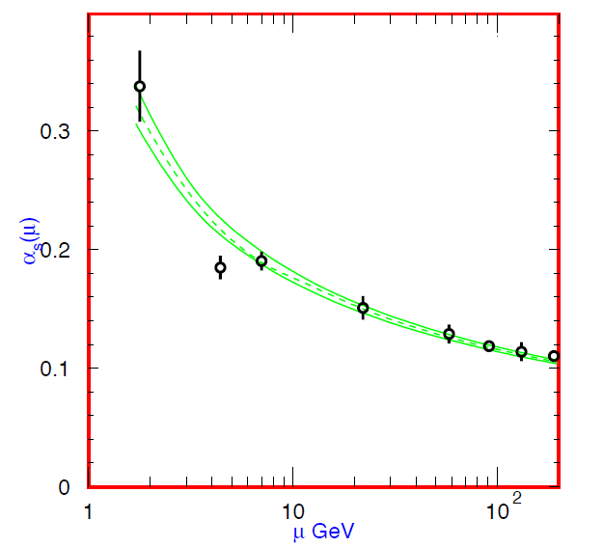
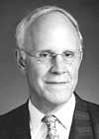


Basic properties of QCD
■ Asymptotic freedom (Gross-Politzer-Wilczek, 1973)
“QCD coupling gets weaker as the energy grows”
Color
Confinement
τ width
Υ decay
DIS
D. Gross
H. Politzer
F. Wilczek
_{Coupling}
_{constant}
(2004, Nobel Prize)
e⁺e⁻
Asymptotic
freedom
α_{s}(κ)
long distance
energy scale κ (GeV)
short distance

Slide 26

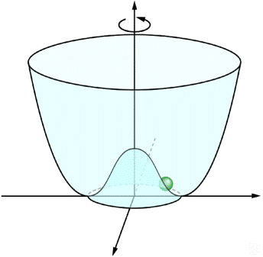



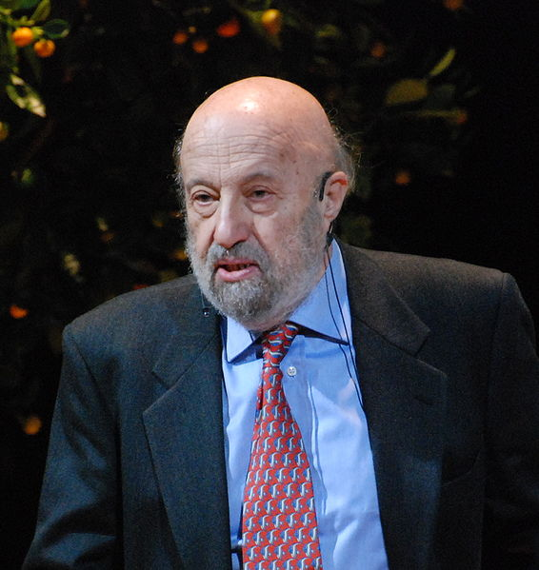
■Symmetries in QCD and their breaking pattern
Chiral basis :
QCD Lagrangian :
classical QCD symmetry (m=0)
Quantum QCD vacuum (m=0)
Chiral condensate :
spontaneous mass generation
Axial anomaly :
quantum violation of U(1)_{A}

Slide 27
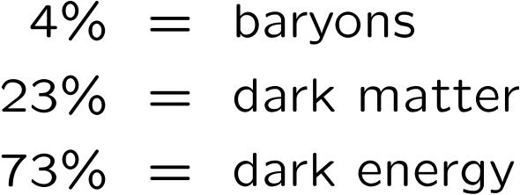
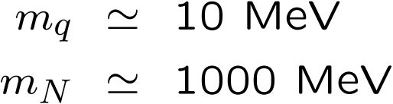
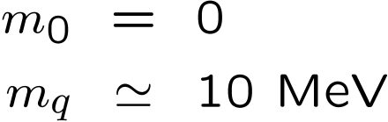
Origin of masses Structure of the vacuum
quark
baryons
bare
quark
quark
Universe
baryon
Cosmological constant
“Chiral” condensate
“Higgs” condensate
Einstein (1917)
Nambu (1960)
Anderson (1963)
Englert-Brout, Higgs (1964)
WMAP, Planck
RHIC, LHC
LHC, ILC

Slide 28
Confinement of quarks/gluons (Origin of us)
Chiral symmetry breaking (Origin of mass)
Strong coupling nature of QCD vacuum
Condensed matter physics of QCD
Moreover recently physics of quarks/gluons at
moderate temperature/density
has been intensively investigated, indicating
the created matter is yet strongly-interacting
(e.g., QCD equation of state, shear viscosity)

Slide 29
Content
§1. Introduction
§2. QCD at finite baryon density
§3. Ginzburg-Landau study in dense QCD
§4. Astrophysical application
§5. Summary

Slide 30
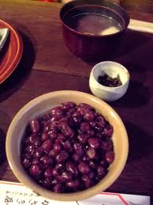
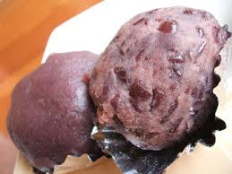
Hadrons, hadronic matter and quark matter
Quark matter
(KOSHI-AN)
Hadronic matter
(TSUBU-AN)
Hadrons (AZUKI)

Slide 31
QCD@high temperature(T )/density(ρ)
[ Collins-Perry (1975) ]
QCD vacuum undergoes a phase change at some values of T and ρ!
T
“Conjectured phase diagram”
Each phase characterized by
RHIC
LHC
Quark-gluon plasma (QGP)
chiral condensate
Hadron
diquark condensate
Color superconductor
(CSC)
NS
μ
”order parameters”

Slide 32
Why dense QCD is so difficult?
1. Lattice QCD: tough
Violation of the positivity of the action (sign problem)
2. Experiment: hard
Entropy production brings us to higher temperature regime
3. Supersymmetry: hopeless
Nuclear world would be a very different place with bosonic quarks
4. Quantum phase transition: rich
Entanglement among different orders
As some trial, see
N. Maru and M. Tachibana,
“Color superconductivity from Supersymmetry”, hep-ph/0411079

Slide 33


A possible phase diagram (via Occam’s razor)
QGP (quark-gluon plasma)
Barducci-Casalbuoni-De Curtis-Gatto-Pettini(‘89)
Asakawa-Yazaki(’89)
~200 MeV
Terra Incognita
Terra Firma
Hadronic NG
(Nambu-Goldstone)
CSC (color superconductivity)
~1 GeV

Slide 34
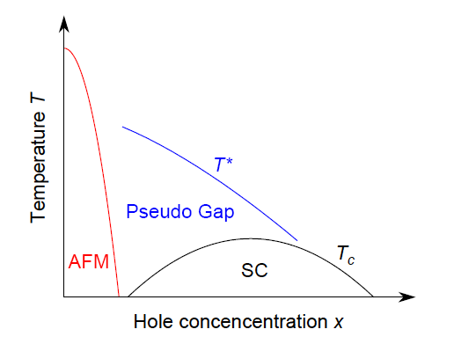
Similarity between QCD
and High Tc Superconductor
QGP
χSB
CSC
Common features in QCD, HTS, and ultracold atoms
1. Competition between different orders
2. Strong coupling

Slide 35
Content
§1. Introduction
§2. QCD at finite baryon density
§3. Ginzburg-Landau study in dense QCD
§4. Astrophysical application
§5. Summary

Slide 36
Ginzburg-Landau (GL) analysis
Ginzburg-Landau (GL) approach : model independent, analytic
Topological structure of the phase diagram
Order of the phase transition
Critical properties
Recipe
: Order parameter field
Same symmetry with underlying theory
K = {T, m, μ, … } : External parameters
Ginzburg-Landau = Saddle point approximation
Wilson = Fluctuations by renormalization group method

Slide 37
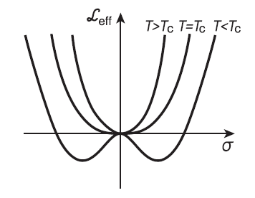




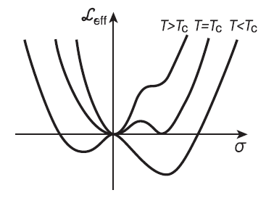



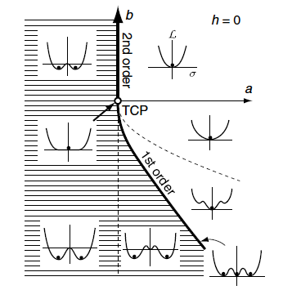

Some examples of GL analysis
・ 2nd order phase transition
Z(2) Ising model
N_{f}=2 QCD
・ 1st order phase transition
Z(3) Potts model
N_{f}=3 QCD
・ Tri-critical behavior
Meta-magnet
N_{f}=2+1 QCD
・ Spacially modulated
( is called a “Lifshitz point”)

Slide 38
Chiral-super interplay in dense QCD
Hatsuda, Yamamoto, Baym, M.T., PRL(’06)
QCD symmetry:
Order parameters
Chiral field:
Diquark field:
Underlying sym. (QCD)
GL potential

Slide 39
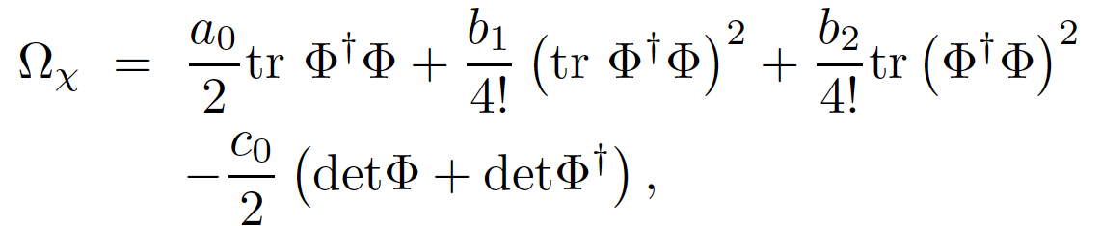


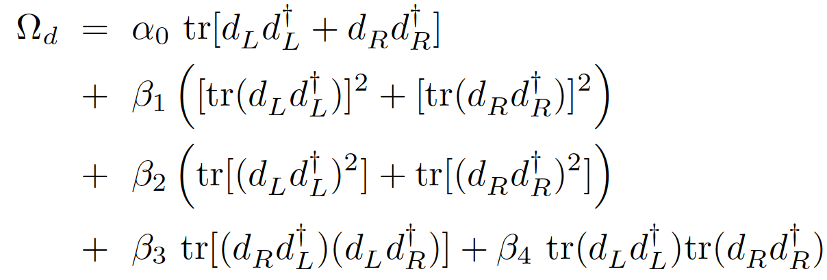


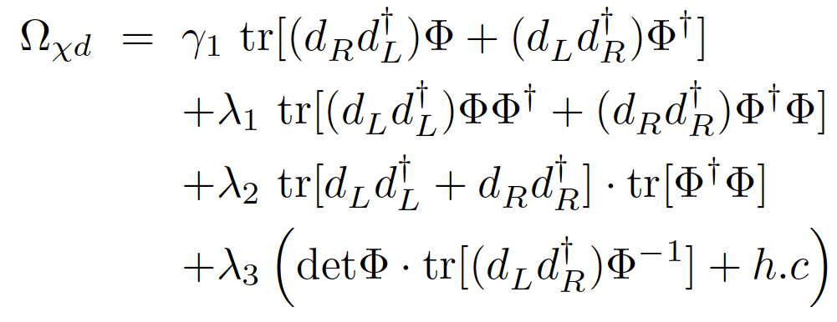


Axial anomaly
(Pisarski-Wilczek)
(Iida-Baym)
KMT
(New)
2 possible ways
of contraction of
6-q KMT vertex
in dense QCD !!
leading int. term come from anomaly

Slide 40
Some simple ansatz for condensate fields
(I) 3-flavor massless quark matter
Ansatz
Color-Flavor
Locking (CFL)
Alford-Rajagopal
-Wilczek (1998)
(※)Srednicki-Susskind
proposed a similar
idea in the context
of χSB (1981)
(II) 2-flavor massless quark matter
Ansatz
2-flavor color
superconductivity
(2SC)

Slide 41




For 3 flavor massless quarks
Chiral condensate
Diquark condensate (CFL)
GL parameters
Possible phases
NOR
・d ,σ≠0 is favored
•ext. source for σ
NG
CSC
Equivalent to Ising-ferro！
COE
→ Critical point！

Slide 42
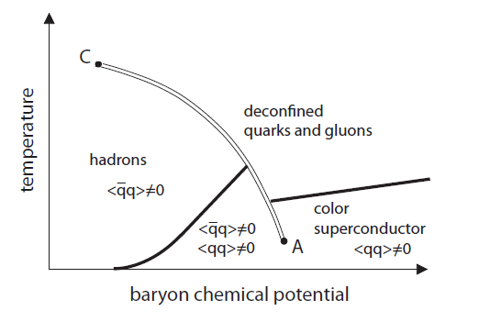
Possible phase diagram in QCD
AY
QGP
χSB
CSC
AY=Asakawa•
Yazaki
HTYB
“Anomaly-induced critical point in dense QCD”
Hatsuda, Tachibana, Yamamoto & Baym, PRL(’06)

Slide 43
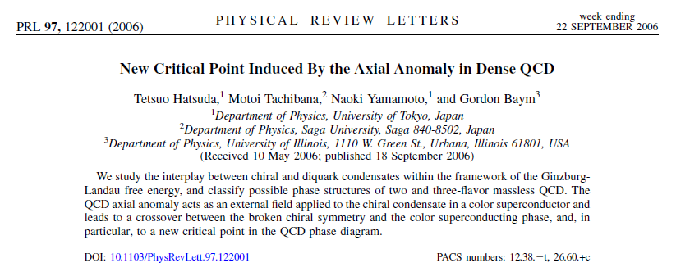
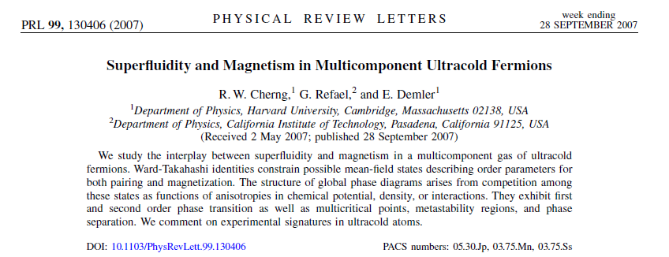

Slide 44
Collective modes
----pions at intermediate density----
A concrete realization of quark-hadron continuity?

Slide 45




Pion at intermediate density
T
Quark-Gluon Plasma
Gell-Mann-Oakes-Renner (GOR) relation
Inverse meson mass ordering
Hadrons
Color
superconductivity
?
What is the form & mass spectrum of the pion at intermediate density?
μ_{Β}

Slide 46
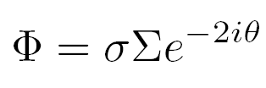
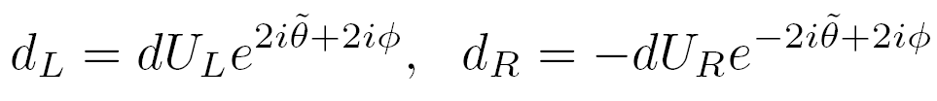
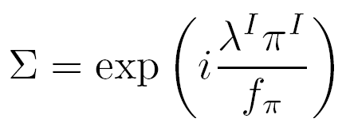
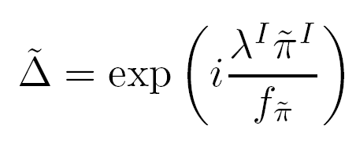


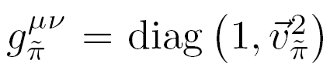
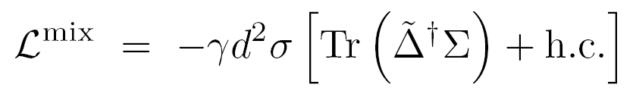


Ginzburg-Landau effective Lagrangian
“Pion” on the hadron side
“Pion” on the CSC side
Effective Lagrangian:
・ Kinetic term:
・ Mixing term:
・ Mass term: (up to )

Slide 47








Mass spectrum of the generalized pion
Mass eigenstate :
Iis a mixed state of & with mixing angle .
Generalized Gell-Mann-Oakes-Renner (GOR) relation
Axial anomaly（breaking U(1)_{A}）
＝
Hadron-quark continuity is also realized for excited states.
Axial anomaly plays a crucial role on pion mass spectrum.

Slide 48




Mass splitting

Slide 49
Summary
Study of dense QCD matter
0. Physics of Neutron Stars
1. Dense QCD world as “Terra Incognita”
2. Ginzburg-Landau study in dense QCD
3. A realization of quark-hadron continuity

Slide 50
Thank you !
感謝

