Slide 1
Toward Neutrino Oscillations in Neutron Star
SAGA Univ. M2
Kazutoshi Matsumoto
1/24
Notes:
Hello everyone. My name is Kazutoshi Matsumoto from saga university. Let’s start my presentation which theme is “Toward to Neutrino Oscillations in Neutron Star”

Slide 2
Contents
§１ Introduction
§２ Neutrino Emission
§３ Neutrino Quantum State in Background Matter
§４ Conclusion and Problems
2/24
Notes:
In section 1, I introduce properties of a neutron star and its interesting phenomena. Among them, I focus on a characteristic phenomenon that is thermal evolution of the star. In section 2, we consider the neutrino emissions which is a dominant process for a cooling of a neutron star. In section 3, we derive the energy spectrum of a neutrino in the background matter by solving the corresponding Dirac equation and discuss its properties. In section 4, I introduce the conclusion and the future out look.

Slide 3
§１ Introduction
3/24
Notes:
First, I introduce a neutron star and its characteristic internal structure and interesting physical phenomena.

Slide 4
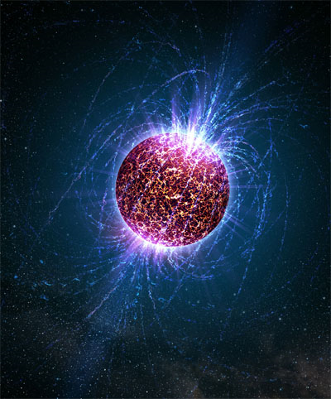
What is a Neutron Star ??
1cm
〜１０km
〜１００００００００００００kg!!!!!!
4/24
Notes:
Neutron star is the dense star to the next black hole in the nature, and its density is 1000 billions kilograms per one sugar cube. Understanding this unique object that actually exist physically, it is believed to lead to new discoveries.

Slide 5
Birth of Compact Stars
Black Hole
Supernova
Explosion
Neutron Star
White Dwarf
： solar mass
5/24
Notes:
Next, I introduce the situations when the compact stars birth. When the stars finish life, sometimes compact star is born by supernova explosion. Star changes the appearance after the explosion, depending on the mass that had before the explosion. If the star has almost same the solar mass, the star becomes a white dwarf which supports own gravity by the electron degeneracy pressure. If the star has 8 to 30 times the solar mass, the star becomes a neutron star, and if the star has more mass, the star becomes a black hole collapsed due to its own gravity.

Slide 6
Properties of Neutron Star
●Properties of Neutron Star
・High Density
・Strong Electromagnetic Field
・Pulsar (Rotating Medium)
・Superconductivity(e)
and Superfluidity(p)
・Quark-Gluon Plasma???
LECTURE NOTES IN PHYSICS 811
Dense Matter in Compact Stars A Pedagogical Introduction
Andreas Schmitt Springer
6/24
Notes:
The structure inside the neutron star is like an onion. And its internal density is so higher toward to the center of the star. Inside the star, it is expected that the proton superconductivity, neutron superfluidity is happening, and the center region of the star, it is believed that the quark-gluon plasma is happening, but the truth nobody knows.

Slide 7
Thermal History of Neutron Star
NS Birth ・・・・・・・
a large number of neutrinos are emitted
about 1 day later ・・・・・・・・
very rapid cooling
Neutrino emission
Is a dominant process
that cooling of the star!!
about 1000 years later ・・・・・・・・ becomes uniform
about
10000~100000 years later ・・・・・・・・
Black body radiation
Is domeniant
7/24
Notes:
Next, I introduce the thermal evolution of neutron star. Since the order of the center temperature is 10 to the power of 12K, neutron star is a very high temperature immediately after birth. But from after born, neutron star falls its order of temperature 1to 2 order in 1 day by emits a large amount of neutrinos. For the cooling process, neutrino emission is dominant in the initial. Then, the black body radiation which almost same the surface temperature of neutron star relative increase due to the decrease of neutrino emissions. When after 10 thousands to 100 thousands years, the black body radiation becomes dominant process for cooling of the neutron star. Since it is meaningful that understanding better the neutrino emission for the thermal evolution of neutron star, so the next chapter, we focus on the neutrino.

Slide 8
§２ Neutrino Emission
8/24
Notes:
In this section, I introduce the properties of neutrino and the dominant neutrino production processes for the cooling of the neutron star.

Slide 9
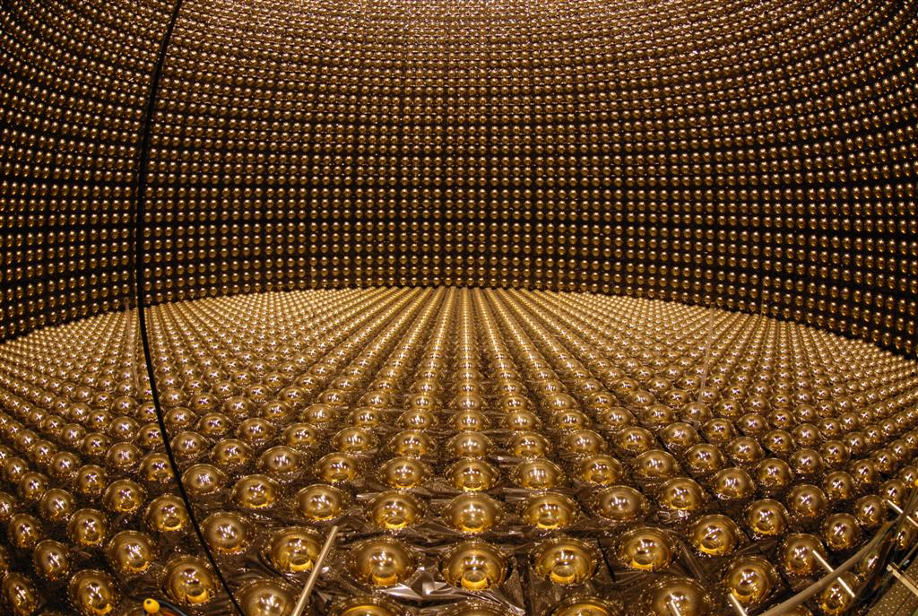
Properties of Neutrino
Leptons
Generation | name | mass
1 | Electron Electron-neutrino | ~0.5 MeV <3.0 eV
2 | Muon Muon-neutrino | ~106 MeV <0.2 KeV
3 | Tauon Tauon-neutrino | ~1.8 GeV <18 KeV
Super-Kamiokande
http://osksn2.hep.sci.osaka-u.ac.jp/~naga/kogi/konan-class06/ch3-nu-property.pdf
→Since the mass of neutrino is very small,
neutrinos take away the energies without interaction
with other particles
9/24
Notes:
Neutrino is a neutral lepton and has 1/2 spins, no electric charge. Then neutrino corresponding electron, muon, and tauon each 3 generations are exist. Since the mass of the neutrino is very small and the its transmittance is very high, neutrino is able to bring out the energy out of the neutron star.

Slide 10
URCA process
Direct URCA Process
These reactions
are strongly suppressed
Modified URCA Process
＝
＝
Add N to both sides respectively
＝
＝
N : nucleon
10/24
Notes:
In the neutrino emissions which happens in neutron star, the most dominant process is these processes, called direct URCA process and modified URCA process. Now, I introduce the difference between this 2 processes.

Slide 11
URCA Process (2)
The neutrino momentum can be neglected compared to Fermi momenta PF(n, p, e)
momentum conservation for Direct URCA processes
Therefore, the Fermi momenta must form the triangle as a right picture
11/24
Notes:
Now, for the Direct URCA process, since the neutrino momentum can be neglected, the conservation of momentum establishes that the triangle can be formed as a right picture. But in the neutron star, since the Fermi momentum of neutron is too large, this process is strongly suppressed. Then, we add the nucler which plays the role of the compensation of momentum to the both side. This is the modified URCA process. By this process, a large amount neutrino is produced.
Therefore, this Modified URCA process is a dominant process for the cooling of the neutron star.

Slide 12
§３ Neutrino Quantum State
in Background Matter
12/24
Notes:
To find the neutrino oscillation in neutron star, we have to understand better the neutrino quantum state in matter. In this section, we consider the neutrino quantum states in back ground matter by solving the corresponding Dirac equation. It should be noted, we will consider, based on the thesis of Mr. Studenikin from here.

Slide 13
Dirac Equation for Neutrino Wave Function in Background matter
（based on the work arXiv:080417v1 [hep-ph] 9 Apr 2008）
Neutrino effective interaction Lagrangian
: matter potential
Modified Dirac Equation
→This is the most basic form of the equation
for neutrino wave function in background matter
13/24
Notes:
To find the neutrino quantum states moving in matter, we introduce the modified Dirac equation which accounts for the interaction between the neutrino and the background matter. Adding the Lagrangian into usually form, we can derive the modified Dirac equation. This is the most general form of the equation for the neutrino wave function in background matter.

Slide 14
Dirac Equation for Neutrino Wave Function in Background matter
Matter potential
Where,
14/24
Notes:
Here, I and Q are respectively values of the isospin third components and the electric charges of matter particles. J and lambda are respectively corresponding currents and polarization vectors.

Slide 15
Neutrino Quantum State in Matter
Conditions
・Background matter → only electrons
・No electro magnetic field
・Matter is unpolarized →
→determine form of f
For the stationary states of the Modified Dirac equation
15/24
Notes:
Slide15, 16
Now, we consider the case when the background mater is composed of electrons and no electromagnetic field. And suppose that the matter is unpolarized. Therefore, since lambda is 0, the form of f is determined. Then, since for the stationary states of the neutrino is given by this form, we can solve the Modified Dirac equation for the neutrino energies,
where, alpha is the density of matter. if alpha is 0, the energies become the value of vacuum. Then, the values s specify the two neutrino helicity states, and epsilon splits the solutions into the two branches that in the limit of the vanishing matter density, reproduce the positive and negative frequency solutions, respectively.

Slide 16
Neutrino Quantum State in Matter (2)
The energy spectrum of a neutrino moving in matter
Matter density
16/24

Slide 17
Neutrino reflection, trapping and neutrino-antineutrino pair annihilation and creation in matter
condition for the energy-gap in matter
vacuum matter
energy-gap is deviated
If
There is no energy-gap overlapping
(right figure)
For in vacuum ・・・since it can not remain in matter, reflected at boundary surface
For in matter ・・・similarly, it is trapped in matter
17/24
Notes:
The expression of neutrino energy in matter implies that interesting phenomenon happens at the surface between vacuum and matter. the energy-gap at vacuum and matter is deviated. If this condition is satisfied, there is no energy-gap overlapping as right figure. Consider such a situation, when the neutrino in vacuum enter into matter, since the neutrino can not enter in the energy-gap region, the neutrino is reflected at boundary surface. Similarly, the anti-neutrino in matter is trapping by the matter. Further, at the area where the energy regions are overlapping, neutrino-anti-neutrino pair annihilation or creation may occur.
The neutrino-antineutrino pair creation can be interpreted as a process a particle state appearance in the positive energy region accompanied by appearance of the hole state in the negative energy sea. This phenomenon is similar to the spontaneous electron-positron pair creation.

Slide 18
Neutrino energy spectrum in a rotating medium
Matter potential accounting for rotation
Neutrino energy spectrum in a rotating medium
Where, for the sign , negative sign corresponds neutrino energy,
positive sign corresponds anti-neutrino energy
18/24
Notes:
Next we consider the case when neutrino is propagating in a rotating medium of constant density.
Now, suppose that a neutrino is propagating perpendicular to uniformly rotating matter composed of neutron. This situation can be considered for modelling of neutrino propagation inside a rotating neutron star. Changing the matter potential f and solving the correspond Modified Dirac equation, we can derive the neutrino energy spectrum which interested situation. The energy depends on the neutrino momentum component p3 along the rotation axis of matter, and quantum number N that determines the magnitude of the neutrino momentum in the orthogonal place.

Slide 19
Modified Dirac-Pauli equation for neutrino in matter
Modified Dirac equation → the case when there is
no electromagnetic field
Dirac-Pauli equation
: neutrino magnetic moment,
Modified Dirac-Pauli equation
19/24
Notes:
Until now, we considered the case that there is no electromagnetic field using Modified Dirac equation. Now we consider the case that the constant electromagnetic field is exist and neutrino interacts with matter using Modified Dirac-Pauli equation.

Slide 20
Neutrino energy spectrum in electromagnetic field
Consider an explicit solution of Modified Dirac-Pauli equation
for case of unpolarized matter composed of only electron
we have
: neutrino three-dimensional speed, : number density of electron
Corresponding neutrino energy spectrum
・
20/24
Notes:
Now, we consider the case of an unpolarized matter composed of only electrons. In this case, since G becomes the form like this, we can derive the neutrino energy spectrum.

Slide 21
Neutrino Oscillation
Example,
Probability
→Since neutrinos is propagating in the state of superposition of waves, neutrinos which can be observed to vary depending on the distance
Distance
This is neutrino oscillation !!
Observable flavor
21/24
Notes:
Next, I introduce neutrino oscillation. As this figure, since neutrino propagates in the state of superposition of waves, neutrino can be observed to vary depending on the distance.

Slide 22
Neutrino spin oscillation in matter
Probability of the oscillations
Where,
: distance traveled by the neutrino,
: transversal to the neutrino momentum component of the external field
: energy difference of two opposite helicity states in magnetized matter
22/24
Notes:
Next, I introduce the neutrino spin oscillations in non-moving matter being under influence of an arbitrary constant magnetic field. In adiabatic approximation the probability of the oscillations can be written in this form.

Slide 23
§４ Conclusion and Problems
23/24
Notes:
Finally, I introduce the conclusion and problems.

Slide 24
Conclusion and problems
⚫︎We have considered the neutrino quantum states for
some situations
→apply this result to neutron star,
to find the neutrino quantum state in neutron star
⚫︎To find neutrino flavor and spin oscillations
→study the fundamental knowledge for neutrino
oscillation, and apply it.
24/24
Notes:
since we have considered the neutrino quantum states for some situations, I apply this result to neutron star, to find the neutrino quantum state in neutron star.
since goal of my research is to understand the neutrino oscillations in neutron star, I study the fundamental knowledge for the neutrino oscillation and apply it to neutron star.

Slide 25
Thank you for your attention !!
Notes:
My presentation is that is all. Thank you for your attention.

