Slide 1
Holography or String theory
The 12th Saga-Yonsei Joint Workshop on High Energy Physics
20 December 2015 ~24 December 2015
Yonsei University, Seoul, Korea
Kyung Kiu Kim(Yonsei Univ.)
Based on works with
Dongsu Bak(Univ. of Seoul), Keun-Young Kim(GIST), Ki-Seok Kim(Postech), Nakwoo Kim(Kyung Hee Univ.), Youngman Kim(IBS), O-kab Kwon(SKKU), Hyeonjoon Shin(Postech), Ik Jae Shin(IBS), Yunseok Seo(Hanyang Univ.), San-Jin Sin(Hanyang Univ.), Chanyong Park(APCTP), Miok Park(KIAS), Yun-Long Zhang(National Taiwan Univ.)

Slide 2
Outline
Short note for string theory
Short note for AdS/CFT correspondence
Examples ( AdS/QCD, Fluid/Gravity, AdS/CMT )
Holographic principle
Summary

Slide 3
Short note for string theory
Quantum field theories and gravity theories are theories for point particles.
These theories have UV divergence problem.
The point particle theory cannot avoid the UV divergence problem, because the size of particles is zero.
The only way to avoid this problem is eliminating all dimensionful couplings.
For the field theories, we can extract physical quantities successfully by “renormalization”.
In gravity theories, we have no way to control quantum correction.
We cannot eliminate the dimensionful couplings in gravity theory, because gravity theories have the Planck’s constant in the kinetic term of the graviton.

Slide 4
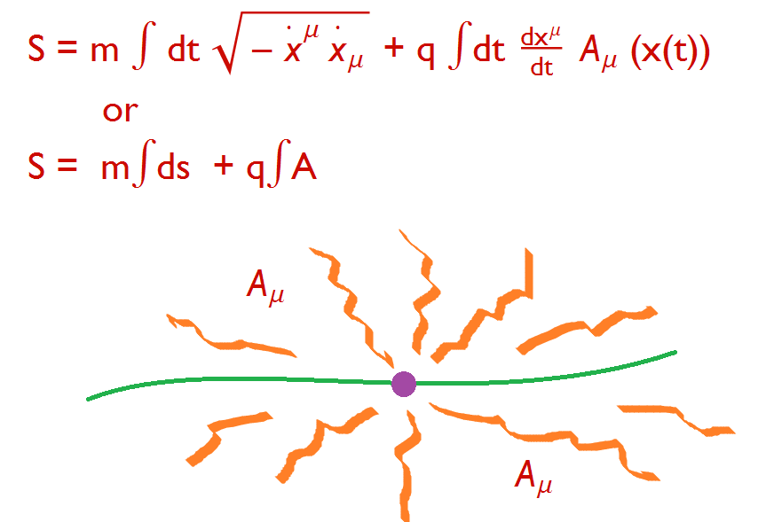
Short note for string theory
So we may take some theory which have the extended objects(string, membrane and so on…..) as fundamental particles.
An example of point particle theory

Slide 5
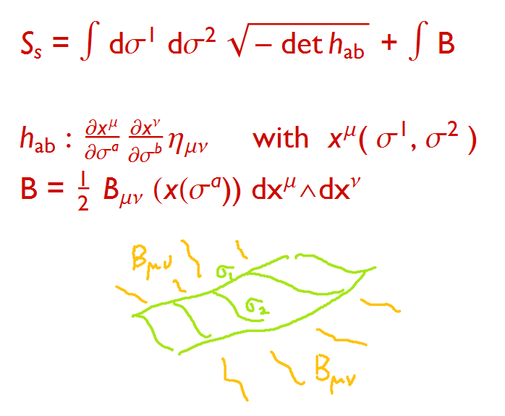
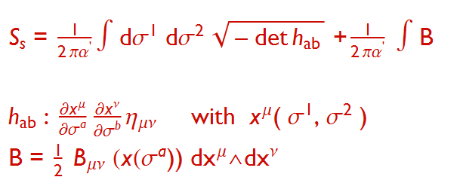
Short note for string theory
String theory

Slide 6
Short note for string theory
Better Action ; Polyakov Action
Quantization

Slide 7
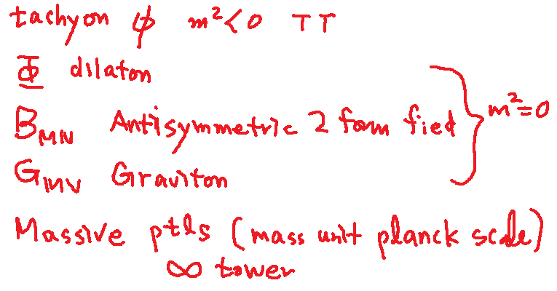
Short note for string theory
Closed string -> periodic boundary condition
Result
D=26

Slide 8
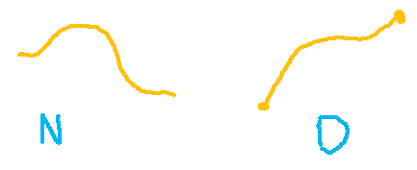
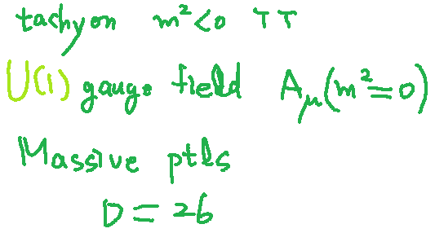
Short note for string theory
Open string ; -Neumann boundary condition -Dirichlet Boundary condition
Result (N. B.C)

Slide 9
Short note for string theory
D . B.C -From the wave mechanics, we can see that the physical meaning of such a B.C is related to existence of other object.
If there are some object at the end points of open strings, open string ends can have generalized charges.

Slide 10
Short note for string theory
D . B.C -> Some extended object -> “D-brane”
D(-1) brane world point instanton like object
D 0 brane world line particle like object
D1 brane world sheet string like object
D2 brame world volume membrane like object
D3 brane 3 dimensional object
It is well known that these object are really dynamical objects.

Slide 11
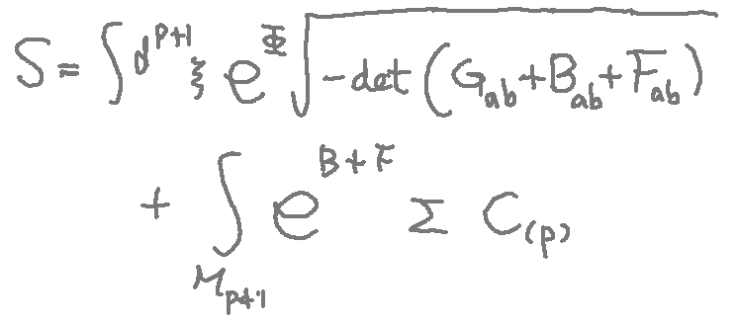
Short note for string theory
What is effective action for D-p brane
Ramond fields: Generalized gauge fields sauced by D branes

Slide 12
Short note for string theory
In order to eliminate tachyons, one may introduce super symmetry.
Results - No tachyon - Consistent theories --type I (D=10) --type IIA (D=10) --type IIB (D=10) --Heterotic E8 X E8 (D= 10+26) --Heterotic SO(32) (D= 10+ 26)

Slide 13
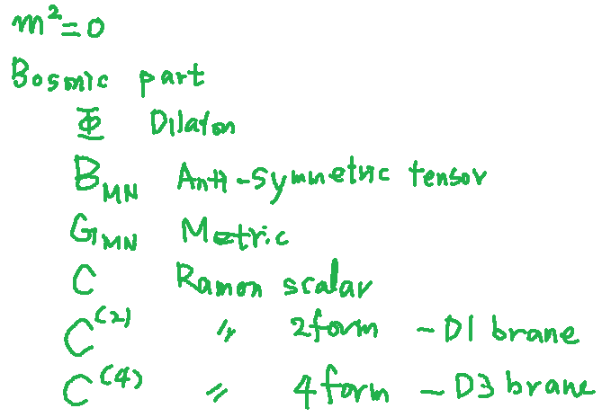
Short note for string theory
One example- type IIB string theory

Slide 14
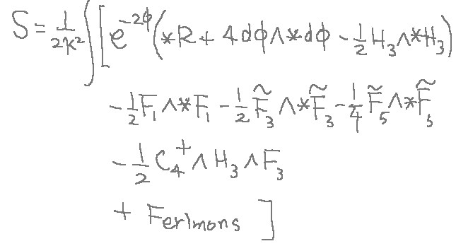
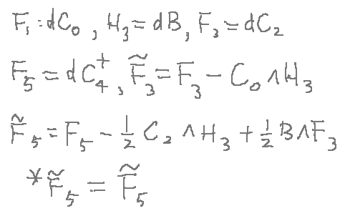
Short note for string theory
Low energy effective field theory. --→ Type IIB supergravity theory

Slide 15
Short note for string theory
There is a supersymmetric black 3-brane solution in type IIB SUGRA
Actually this black hole-like 3 brane solution is same with the D3 brane on end point of open strings. (Polchinski)

Slide 16
Short note for string theory
So this is main difference from usual point particle theory.
The D brane can be described by a closed string or a open string.
In closed string theory, the D branes are kinds of black brane solutions in the gravity theory.
In open string theory, the D branes are ends point of the strings.

Slide 17
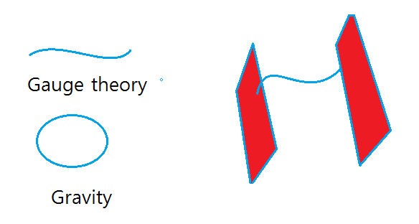
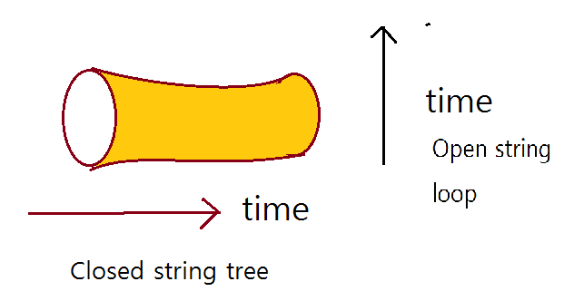
Short note for string theory
This is an example of the open-closed duality.
This duality is also important for the UV finite theory.

Slide 18
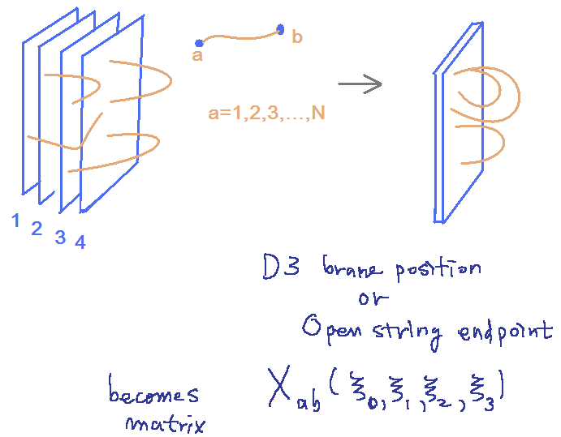
Short note for AdS/CFT
Now let us use the fact in the previous short note. Let’s consider N D3-brane.
The D-brane has two descriptions, D-brane in open string theory and Black brane in supergravity as a low energy limit of closed string theory.
D-brane in the open string picture
What is the effective action?

Slide 19
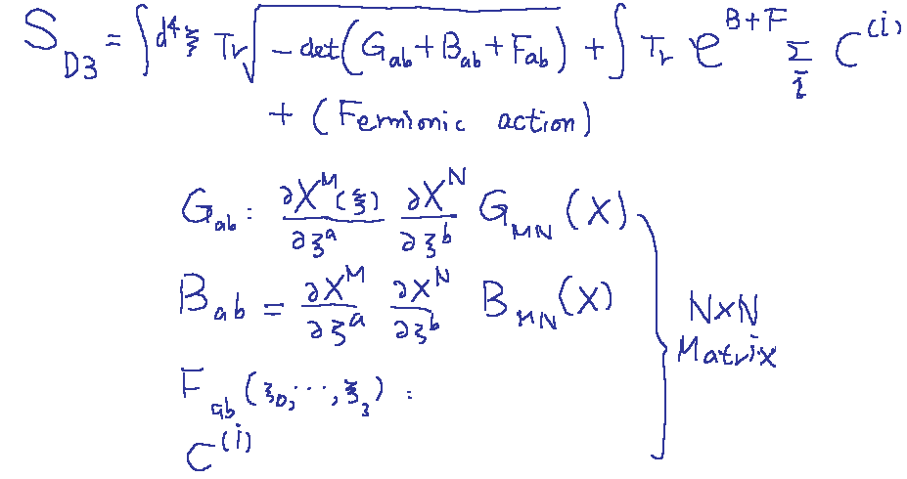
Short note for AdS/CFT
The effective D3 brane action becomes Non-abelian DBI action.
The perturbation theory can be well defined, when a t’hooft coupling is small.

Slide 20
Short note for AdS/CFT
Let us consider a low energy limit.
The higher derivative terms can be ignored.
The SUGRA fields are decoupled from the D brane action.
Then the action turns out to be U(N) Super Yang-Mill theory with 4 super-charges.

Slide 21
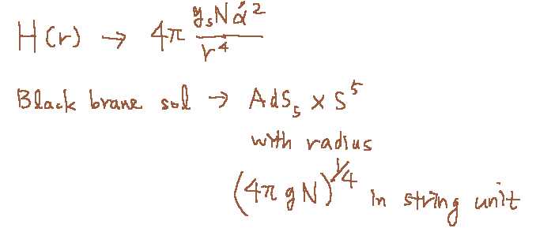
Short note for AdS/CFT
Supergravity(Closed string) point of view
Low energy limit -> Near horizon limit(r -> 0)
The SUGRA is valid when two following quantities are large.

Slide 22
There are two descriptions for the N coincident D3 branes.

Slide 23
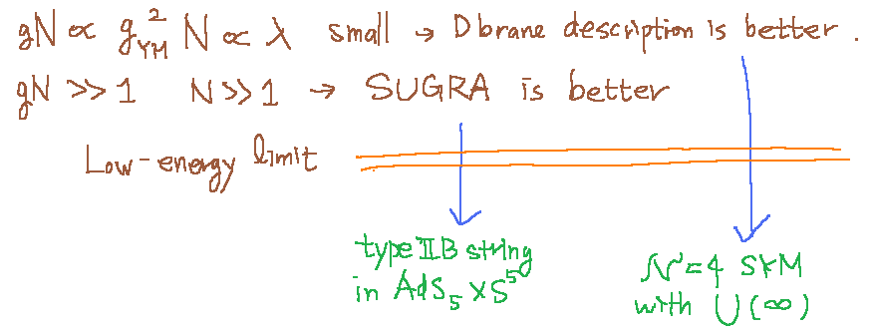
Short note for AdS/CFT
Once you consider an adiabatic change from the type IIB on AdSXS to SYM theory, you may conjecture that two theories are equivalent.
This is the Maldacena’s conjecture.
Also, Witten gave a prescription.
This is the AdS/CFT correspondence.
Strong/Weak duality
We cannot check both sides.

Slide 24
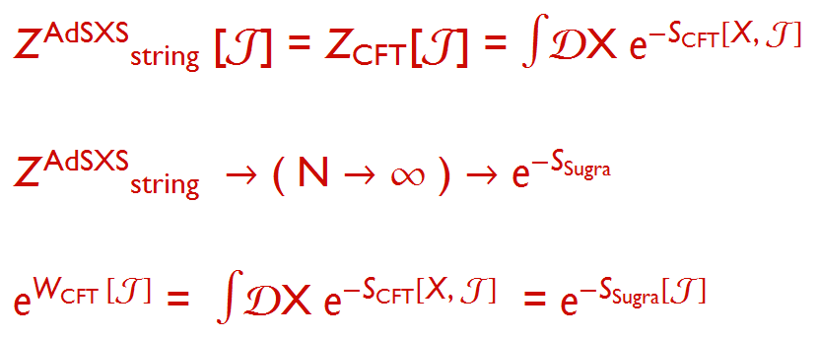
Short note for AdS/CFT
Fortunately, however there are many evidences in integrable cases of the SYM theory.

Slide 25
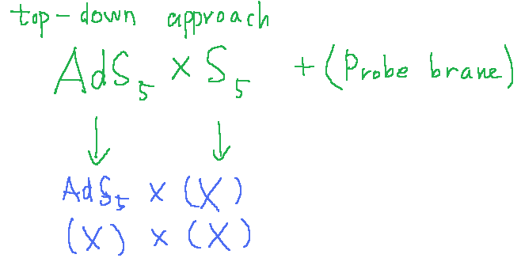
AdS/QCD
This super conformal YM is interesting theory but it is very far from real YM theory, QCD. In order to make a similar theory to real QCD, we need to deform the conjecture.
The representative work is the Sakai-Sugimoto model.

Slide 26
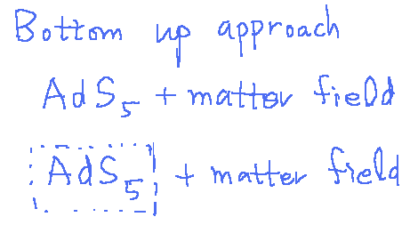
AdS/QCD
Or we may think phenomenological models

Slide 27
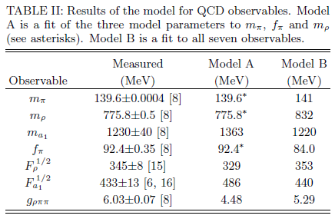
AdS/QCD
An example ; EKSS(J. Erlich, E. Katz, Dam T. Son and M. A. Stephanov, 05’), model

Slide 28
AdS/QCD
It is very easy to consider systems with finite temperature and finite density : AdS charged BH in Einstein-Maxwell theory.
Shear viscosity to entropy ratio in RHIC or LHC.
Two point functions can be easily computed in AdS BH background using AdS/CFT prescription.

Slide 29
It does not depend on details of BH.

Slide 30
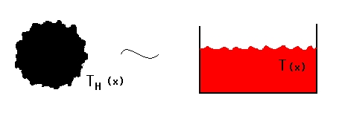
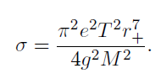
Fluid/Gravity correspoondence
Fluctuating AdS BH = Fluid dynamics

Slide 31
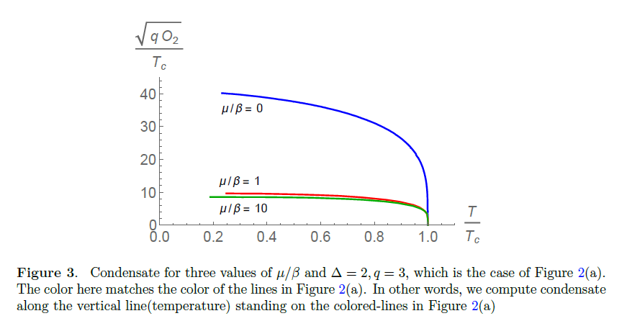
AdS/CMT
Holographic superconductor model(Gubser, Hartnoll, Horowitz, Herzog)

Slide 32
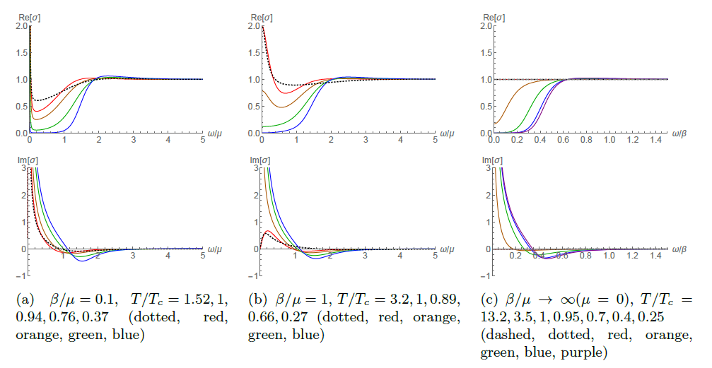
AdS/CMT
AC conductivity

Slide 33
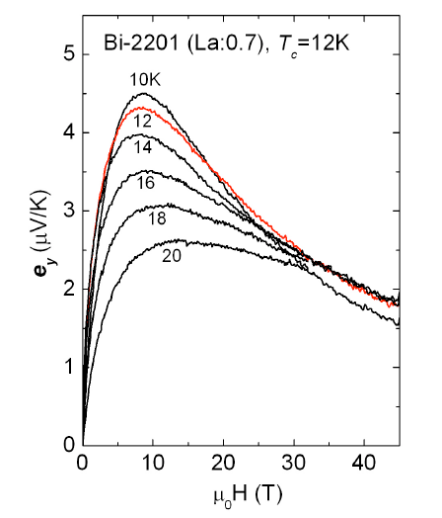
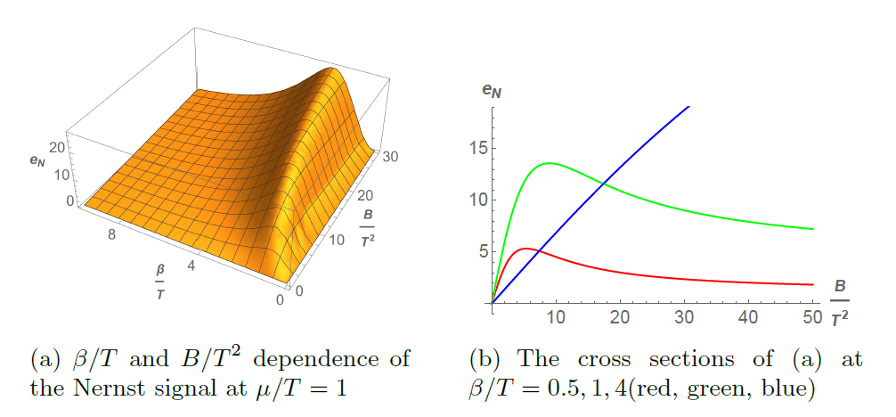
AdS/CMT
Nernst Effect

Slide 34
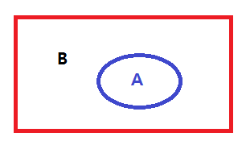
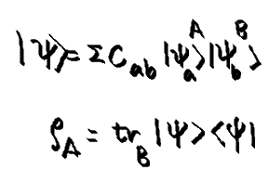
Entaglement Entropy
Ryu-Takayanagi : Holographic Entanglement Entropy
Area of minimal surface in AdS = Entanglement entropy of CFT

Slide 35
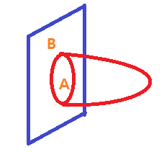
Area of minimal surface in AdS = Entanglement entropy of CFT

Slide 36
1+1 d case
C. Holzhey, F. Larsen and F. Wilczek,
From field theory 94’
Minimal surface(geodesic) in AdS3
Mass deformation

Slide 37
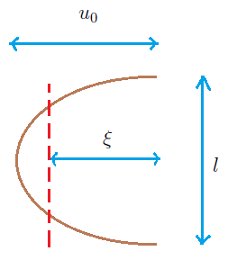
Computation through HEE
= log ( tan s/2 )

Slide 38
Holographic Principle
Can we give a new principle for the strongly coupled field theories without string theory or supersymmetry.
Let us revisit How we construct QFT
In QFT construction -Symmetry -Renormalization -n-point functions with experimental data
Holographic Approach -Symmetry -Holographic renormalization -n-point functions with experimental data

Slide 39
Holographic principle

Slide 40
AdS/QCD or Neutron star arXiv:1007.2470 [hep-ph], arXiv:1206.4421 [hep-ph]
Fluid/Gravity arXiv:0809.4541 [hep-th], arXiv:1307.0428 [hep-th]
AdS/CMT arXiv:1011.5749 [hep-th], arXiv:1104.3491 [hep-th], arXiv:1409.8346 [hep-th], arXiv:1501.00446 [hep-th], arXiv:1502.02100 [hep-th], arXiv:1502.05386 [hep-th]
Entanglement Entropy arXiv:1404.1044 [hep-th], arXiv:1407.6511 [hep-th]

Slide 41
Summary
String theory contains closed string and open string. They are describing gravity theory and gauge theory.
There exist open-closed duality.
Thus the gravity theory can be described by the gauge theory.
The exact example is the AdS/CFT.
This idea has been applied to many area of physics.
We may introduce a new principle of holography for strongly coupled field theories.

Slide 42
Thank you for the attention!

