Slide 1
Me: You know what?
I’m so excited now!
A: For what? Diphoton?
Me: No~! Look.

Slide 2

A long time ago
in a galaxy
far, far away…

Slide 3
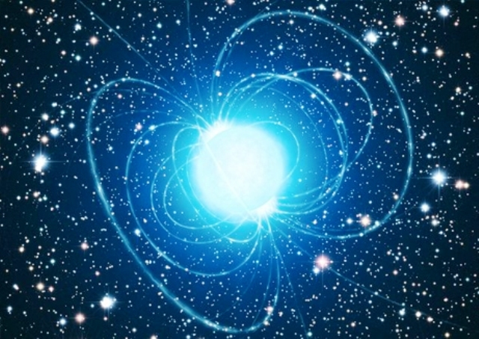

Physics of Star Wars
Physics of Neutron Stars
-The most impressive Saga in Galaxy-
-The 2nd densest object in the Universe-
Motoi Tachibana (Tatooine)
Motoi Tachibana (Saga U.)
Dec. 20, 2015 @ May-the-Force-be-with-You program
Dec. 20, 2015 @ 12th Yonsei-Saga partnership program

Slide 4
Physics = Vast research arena
of Matters and Spacetime
★ What matters are made of？
★ How matters are created and
change in various conditions？
★ How the universe was born and will be?
Approaches: Experiment, Observation,
Theory, Computer

Slide 5
Q. Nobel Prize in Physics 2015?

Slide 6


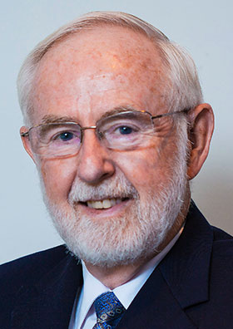
Nobel Prize in Physics 2015 :
The discovery of neutrino oscillations,
which shows that neutrinos have masses
Yes! Beyond the SM (BSM) !
Metamorphosis in the particle world
A neutrino puzzle had been resolved.
Compared to theoretical calculations of
the number of neutrinos, up to 2/3 of
the neutrinos were missing in
measurements performed on Earth.
Now, the two experiments discovered
that the neutrinos had changed identities.
The discovery led to the far-reaching
conclusion that neutrinos, which for
a long time were considered massless,
must have some mass, however small.
The observations had clearly showed that the Standard Model cannot be the complete theory of the fundamental constituents of the universe.
Something dark is
another clue?
T. Kajita
A. B. McDonald

Slide 7
Interesting connection
between
matters and spacetime
Physics of Neutron Stars
Harmony of particle, astro-, and condensed matter physics

Slide 8
Content
§1. Introduction
§2. Neutron Star: What is it?
§3. Various properties of Neutron Stars
Stellar structure, mass-and-radius, thermal behavior,
rapid rotation, strong magnetic field and dark matter
§4. Summary

Slide 9
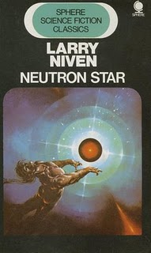
Neutron Star: What is it?

Slide 10
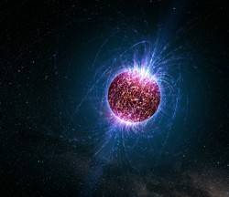
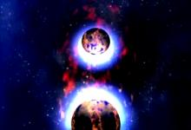
Wikipedia, our Maestro
• A stellar remnant after Supernova (SN) explosion
• Literally, composed almost entirely of neutrons
• Its density is approximately equivalent to the
human population condensed to the size of
a sugar cube (*o*)
something extraordinary

Slide 11
Major questions
How to be born and evolve?
How it cools down?
Why so huge magnetic field?
Why so rapidly rotating?
How particle physics
comes into this business?

Slide 12
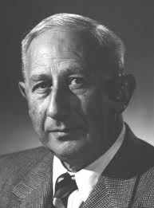
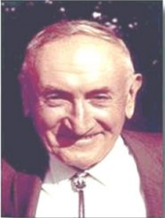
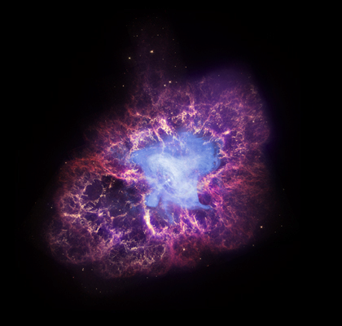

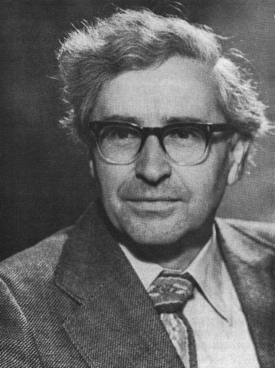
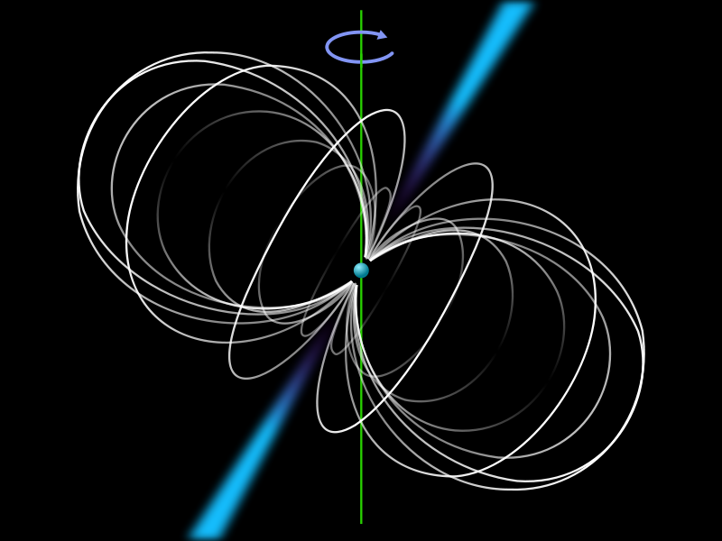
Neutron Star History
Baade and Zwicky (1934): 1st theoretical prediction of NS
Crab Nebula
W. Baade
F. Zwicky
supernova
Bell and Hewish (1967): Discovery of Pulsar (1st radio pulsar)
Jocelyn Bell Burnell
A. Hewish
pulsar image

Slide 13
Basic profile of Neutron Star
(Typical) radius :
(Typical) mass :
Temperature :
Magnetic field :
Rotation period :
May the forces be with NS!
4
1eV ~ 10 K
Earth’s B field ~ 0.6 G

Slide 14
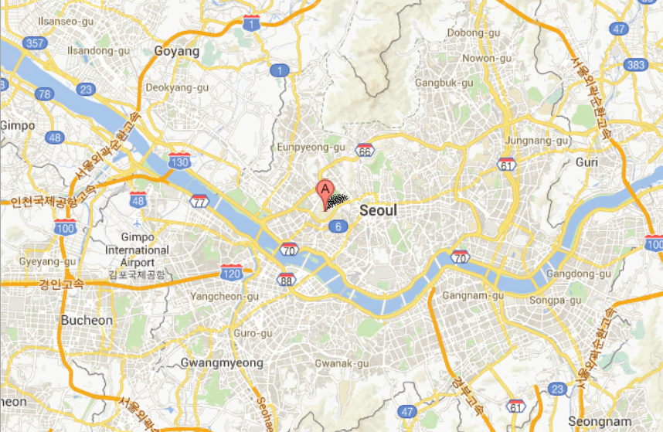

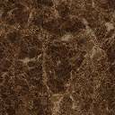
Yonsei Neutron Star !
Oops!

Slide 15
Speed of the equator is…
About 10% of speed of light !!

Slide 16
Density of the star is…
Just like a gigantic nucleus!!

Slide 17
Quantum critical magnetic field
In some cases, called “MAGNETAR”,
B gets much larger than the above
and the mechanism is not known yet!

Slide 18
Content
§1. Introduction
§2. Neutron Star: What is it?
§3. Various properties of Neutron Stars
stellar structure, mass-and-radius, thermal behavior,
rapid rotation, strong magnetic field and dark matter
§4. Summary

Slide 19
Stellar structure

Slide 20
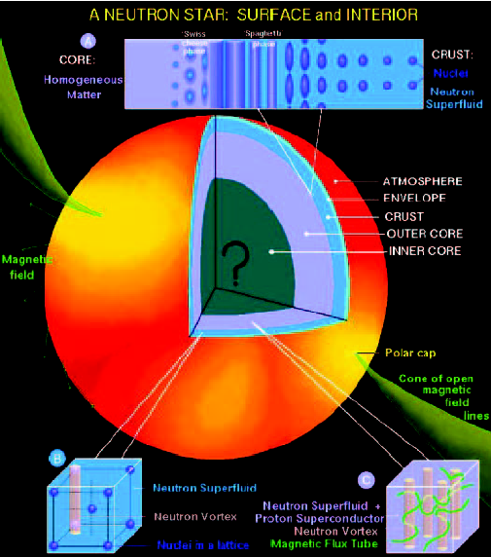
Theorist’s view of NS structures
① Atmosphere: hydrogen, a mix of
heavy elements
(providing info. of temperature)
② Envelope: a few tens of meters
(acts as a thermal insulator)
③ Crust: 500-1000m thickness
④ Nuclear Pasta: In-btw crust/core
⑤ Outer Core: a few kilometers
⑥ Inner Core: Big question mark!

Slide 21

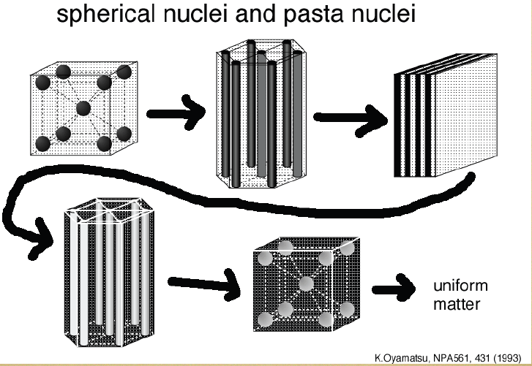
Nuclear “Pasta”
Meat ball
Spaghetti
Lasagna
Try to eat?
anti-Spaghetti
Swiss cheese

Slide 22
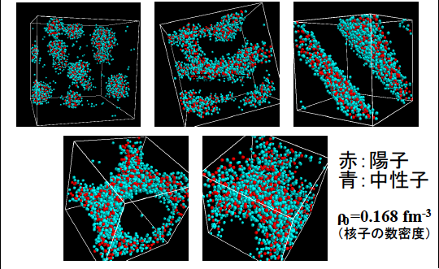
Quantum Molecular Dynamics (QMD)
proton
neutron
G. Watanabe et al. (2002)

Slide 23
“Exotic” is interesting!
New states of matter could be present in NS !
Superfluid neutron/Supercond. proton
Bose-Einstein condensate (BEC) of mesons
Hyperons (hadrons w/ strangeness)
Deconfined quarks
Neutron star = laboratories for
studying matter in Xtreme!
Quantitative differences among them?

Slide 24
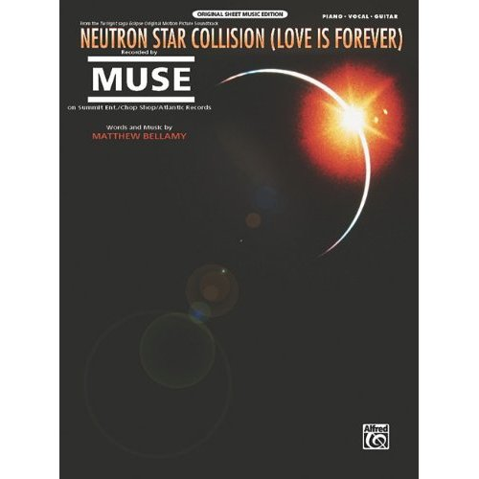

A song of Neutron Star
Our hearts combined like
a neutron star collision

Slide 25
Mass and radius

Slide 26
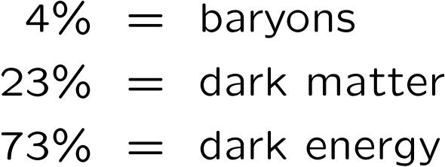
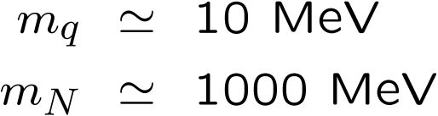
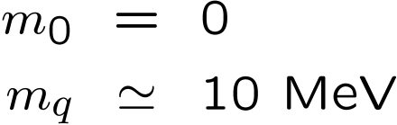
Origin of masses Structure of the vacuum
quark
baryons
bare
quark
quark
Universe
baryon
Cosmological constant
“Chiral” condensate
“Higgs” condensate
Einstein (1917)
Nambu (1960)
Anderson (1963)
Englert-Brout, Higgs (1964)
WMAP, Planck
RHIC, LHC
LHC, ILC

Slide 27
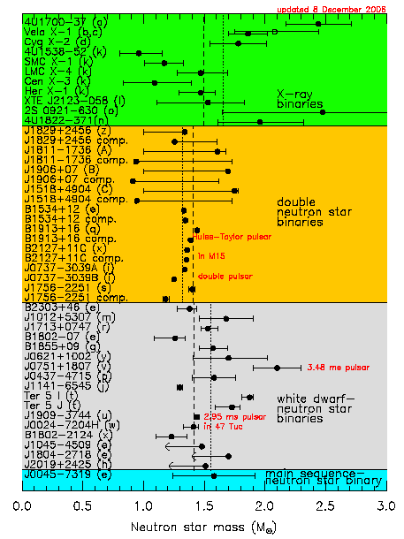

Slide 28
Simple estimate of NS mass/radius
For the stability of the star : R > Rs = 2GM
Consider a star made out of a number of nucleons,
whose number A and mass m~939 MeV and
distance r0 ~0.5 fm. Then the radius of the star is
R~r0A and the mass M~mA .
Then from the limit R=2GM,
1/3
Not bad!

Slide 29
Another estimate by G. Baym
By assuming that the physics governed by QCD,

Slide 30

NS Mass & Pressure
Hydrostatic pressure balance
dr
r
R
This is not the end of the story..

Slide 31
Tolman-Oppenheimer-Volkov(TOV) equations
with find
Then and NS radius
Need one more eq.!
Equation of State
(EOS)
“A bridge btw particle physics and NS !”

Slide 32
Theory curves for NS Mass-Radius
All the exotics may be killed
just by a few observations (><)

Slide 33
Jargons
Nuclear matter
= matter made of nucleons
(quarks are confined into hadrons)
Quark matter
= matter consisting of quarks
(quarks are liberated from hadrons)
NM
NM
NM
QM
QM
DM
Neutron star Hybrid star Quark star
Death star?
Dark

Slide 34
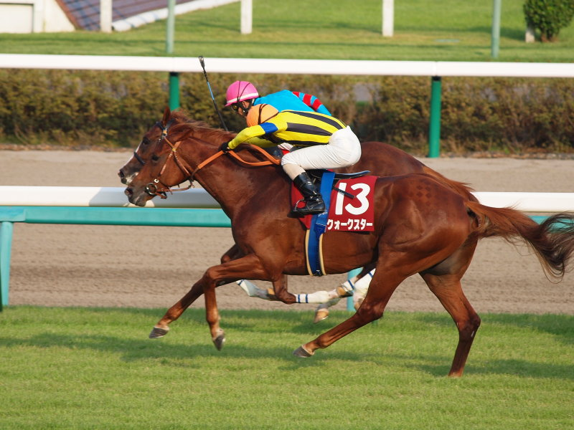
By the way…
A quark star!

Slide 35
Thermal behavior

Slide 36
Thermal history of a Neutron Star I
Cooling eq.
Cv : heat capacity L : luminosity
Bulk property
Microscopic
★Particle physics comes into THE GAME !★

Slide 37
Thermal history of a Neutron Star II
For regular NS cooling via neutrino emissions, there are 2 types:
① Direct URCA process (rapid cooling, sub-dominant effect)
② Modified URCA process (slow cooling, dominant)
spectator
carrying
momentum

Slide 38
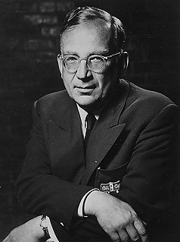
URCA process
(named by Gamow-Schoenberg)
From the name of Casino in Rio de Janeiro,
where these two gentlemen were visiting
“The energy disappears in the nucleus of
the supernova as quickly as the money
disappeared at that roulette table”
G. Gamow
In Gamow’s South Russian dialect,
it can also mean a “robber” or “gangster”

Slide 39
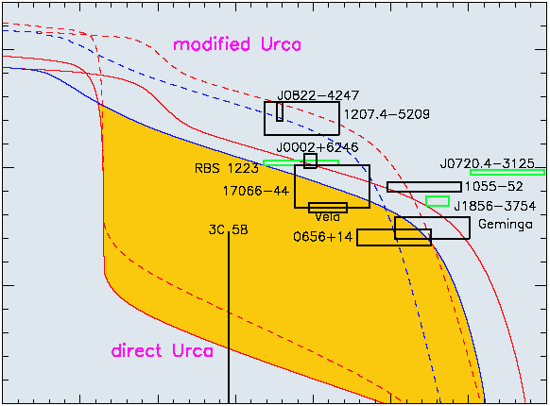
Cooling curves of Neutron Star
T
t

Slide 40
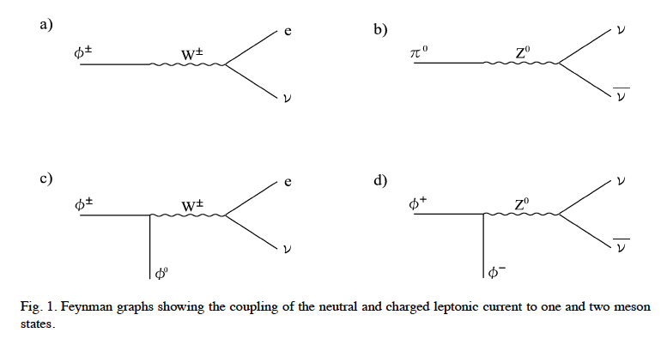


An interesting example of the medium effect
ーweak decay of CFL mesonsー
Reddy-Sadzikowski-Tachibana, NPA(‘02)
Neutral pion can decay into νν !
ー

Slide 41
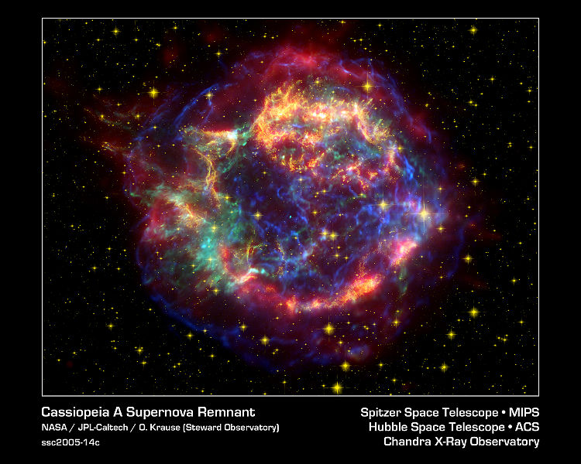
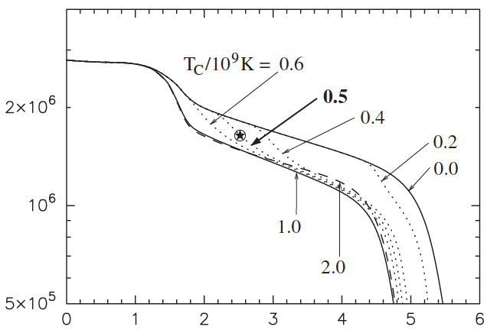
Rapid Cooling of NS by Neutron Superfluidity?
NS in Cas A
Discovered in 1999 by Chandra
Youngest known in the Milky Way (330 yr)
Distance ~ 3.4 kpc (11, 000 lyr)
(cf. large Magellanic Cloud ~ 48.5 kpc)
This is unfortunately gone…
Heinke-Ho [APJL719(2010)]
Recent triggering of
enhanced neutrino emission
resulting from the P2 neutron pairing in the star’s core?
Cas A’s surface temp. has rapidly decreased from to (2000-2009).
3

Slide 42
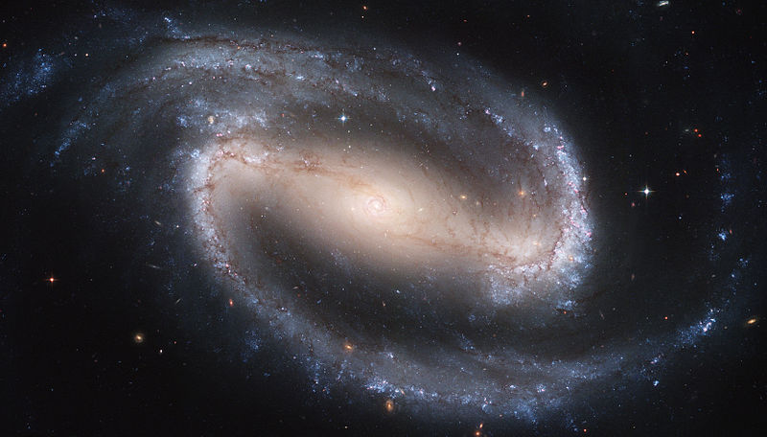
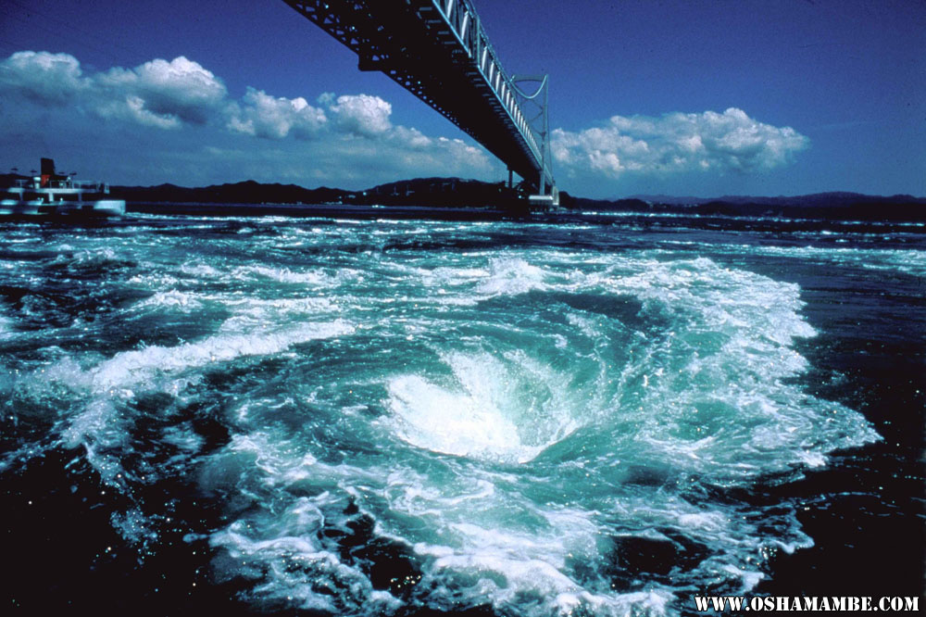
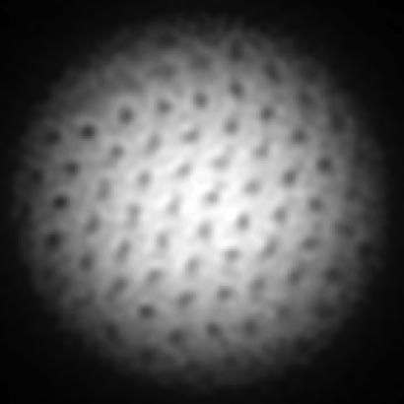
Neutron Star
as a rotating magnet
ーthe strongest magnet in the universeー

Slide 43
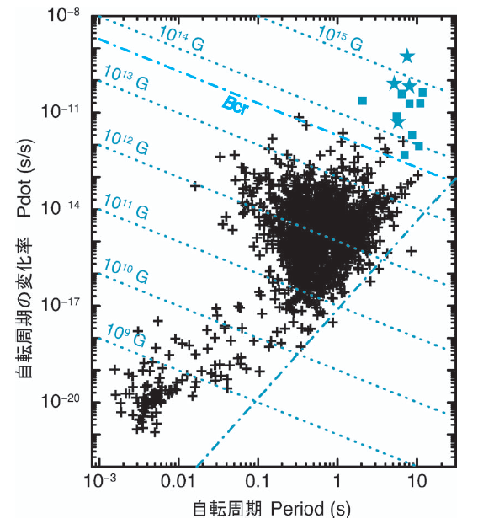
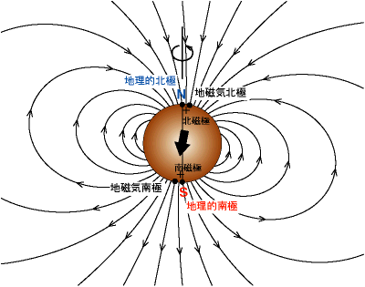
Pulsar as a rotating magnet
Rot. energy loss Esd
Magnetar
hypothesis
Duncan-Thompson
(1992)
Magnetic dipole radiation Lmag
then

Slide 44
So far the origin of huge magnetic field
not known and there are various proposals:
[Macroscopic]
• Fossil-field model
• Dynamo formation
[Microscopic]
• Nuclear ferromagnetism
• Quark ferromagnetism
• Dark matter? etc…

Slide 45
Neutron star and dark matter
ーBlack hole formation in neutron starsー
M. T and M. Ruggieri, arXiv:1312.5802 [hep-ph]
Y. Sanematsu and M. T, arXiv:1511.00249 [hep-ph]
T. Hatsuda and M. T, work in progress

Slide 46
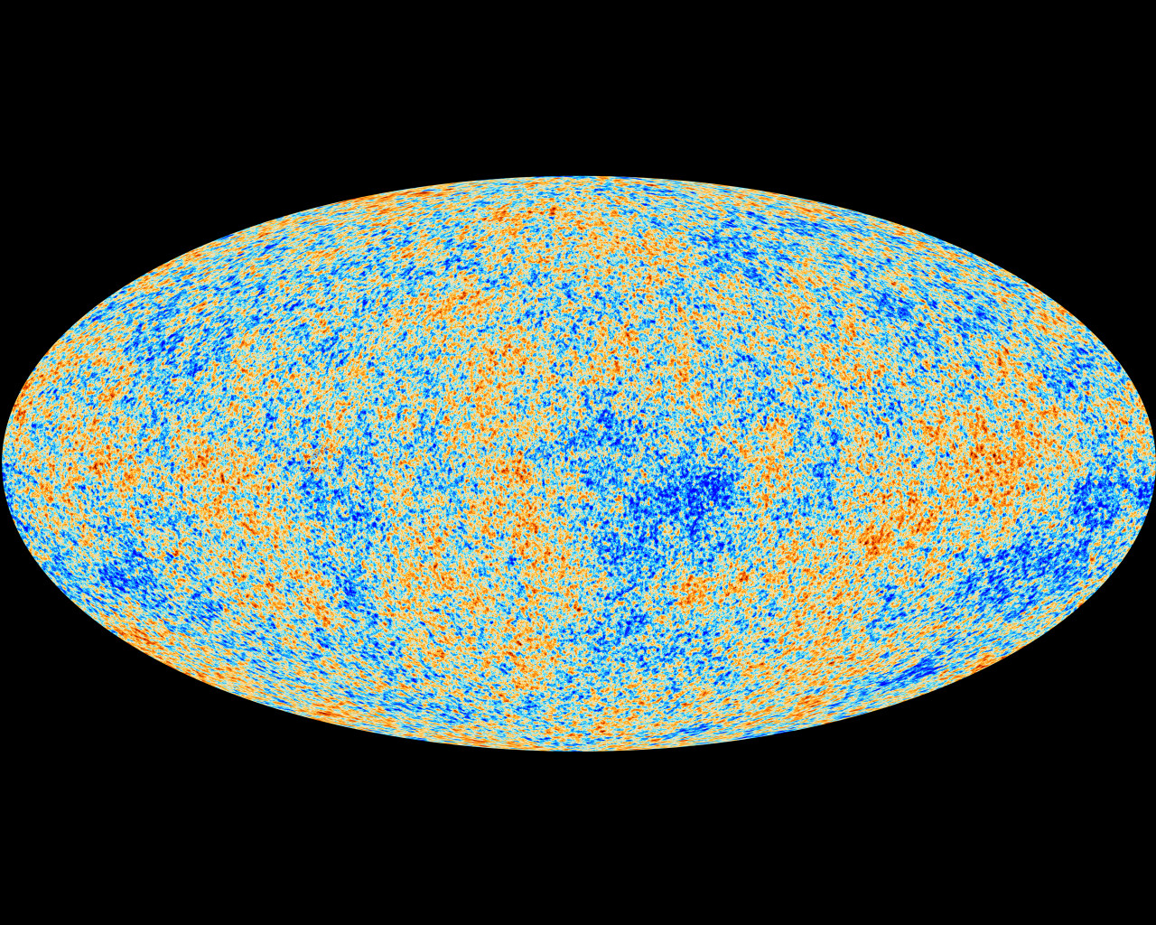
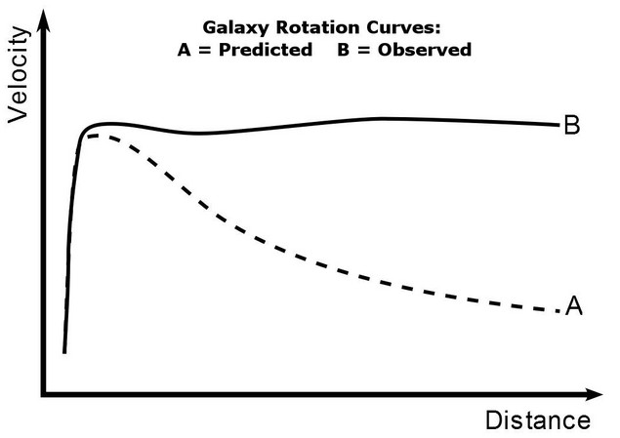
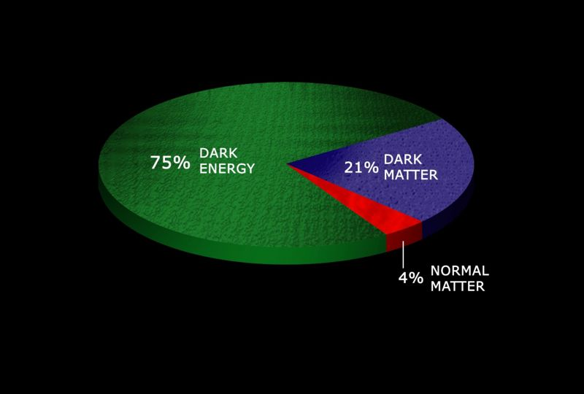
What/Why dark matter (DM)?
Undoubtedly exists, but properties unknown
Just weakly-interacting with other particles
Proposed by Zwicky as missing mass (1934)

Slide 47
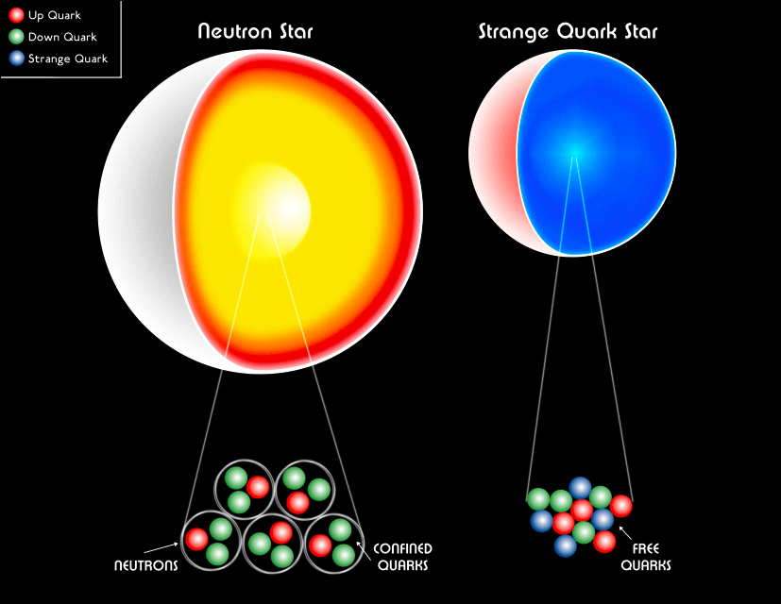
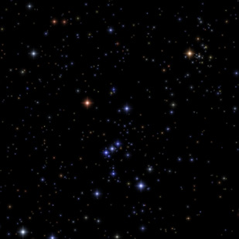
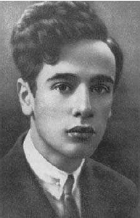
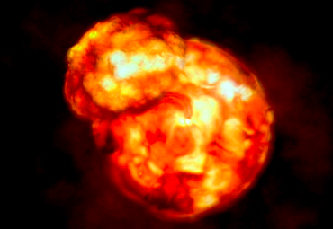
What/Why neutron star (NS)?
Landau’s gigantic nucleus
Good market selling ultimate environments
Proposed by Baade and Zwicky
as a remnant after supernova explosion (1934)
arXiv:1210.0682

Slide 48
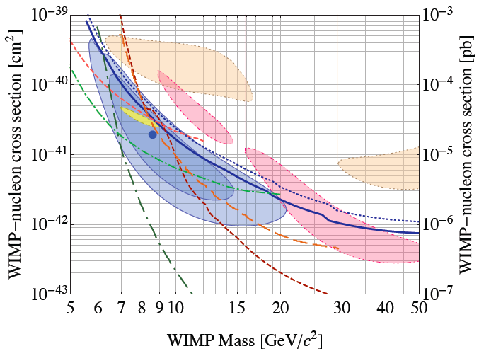
Why their connections?
Possibly constraining WIMP-DM properties via NS
CDMSII, 1304.4279
For a typical neutron star,
Way below the CDMS limit!
NS may constrain the DM properties

Slide 49
Impacts of dark matter on NS
• NS mass-radius relation with dark matter EOS
• NS heating via dark matter annihilation
：
• Dark matter capture in NS and formation
of black-hole to collapse host neutron stars
cf) This is not so a new idea. People have considered
the DM capture by Sun and the Earth since 80’s.
W. Press and D. Spergel (1984)
Application to NS : Goldman-Nussinov (1989)
cosmion

Slide 50
*
DM capture in NS
*Ref.) McDermott-Yu-Zurek (2012)

Slide 51
Accretion of DM
Thermalization of DM (energy loss)
BH formation and destruction of host NS
on-set of
self-gravitation

Slide 52
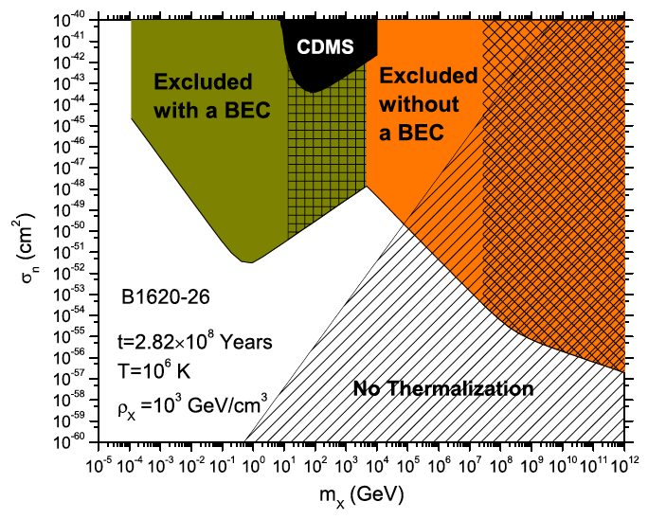
McDermott-Yu-Zurek (2012)

Slide 53


Slide 54
Cooling eq. revisited
Cv : heat capacity L : luminosity
Bulk property
Microscopic
★Particle physics plays the role again !★

Slide 55
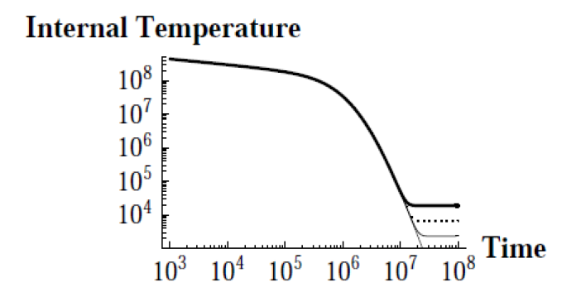
DM heating of Neutron Star
C. Kouvaris (‘10)

Slide 56
Our recent works
★Ruggieri-Tachibana(2012, 2015)★
Some effects of exotic phases of NS
★Sanematsu-Tachibana(2015)★
Generalized DM thermalization in NS
★Hatsuda-Tachibana(in progress)★
Dipolar DM in NS

Slide 57
Content
§1. Introduction
§2. Neutron Star: What is it?
§3. Various properties of Neutron Stars
Stellar structure, mass-and-radius, thermal behavior,
rapid rotation, strong magnetic field and dark matter
§4. Summary

Slide 58
Summary
Physics of Neutron Stars
Neutron star (NS) = Orchestra of Physics
Connection to other unsolved issues (SN, DM..)
Future development of the NS observations
New people, new ideas and new results !
Concept of matters and spacetime
감사합니다

Slide 59
Back-up

Slide 60
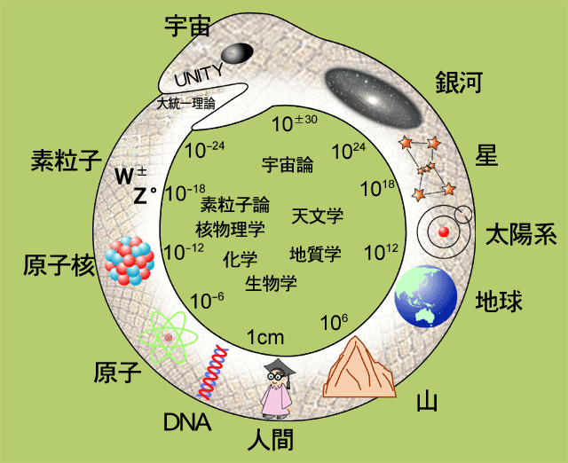
The world is UROBOROS
Our world is QUANTUM
Universe
Galaxy
Particles
Stars
cosmology
nuclear
particle
physics
astro
physics
Sun
Nuclei
chemistry
biology
Earth
Atom
Mountain
DNA
Human

Slide 61
Main Messages
★ Orchestra♪ of theoretical physics
★ Connection to other unsolved issues
★ Development of the observations

Slide 62
A lesson from history
-Landau and neutron star-
According to recollections of Rosenfeld,
Landau improvised the concept of NS
in a discussion with N. Bohr and Rosenfeld
just after the news of the discovery of the
neutron reached Copenhagen in February
1932, and published his paper a week later.
But this is not the case. The discussion took
place in March 1931 but not published until
February 1932.
“Maximum mass of NS”
“One gigantic nucleus”
Ref.) D. Yakovlev et al., arXiv:1210.0682
Lev D. Landau (1908-1968)

Slide 63
Q. Why neutron star can stably exist?
(we know neutron beta-decays)
Because of degenerate electrons !

Slide 64
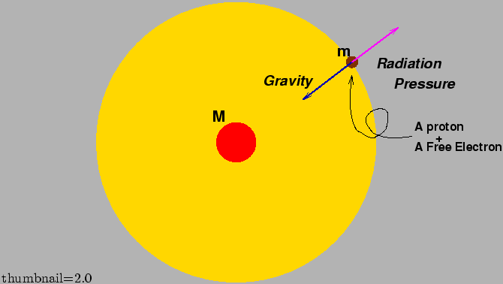
Determination of mass
-Eddington (luminosity) limit-
Obtained by setting the outward continuum radiation
pressure equal to the inward gravitational force
For pure hydrogen gas, the Eddington limit LE is
Thus, once the limit can be measured, the mass of
neutron star M is determined.

Slide 65
Escape velocity

Slide 66
Recent topics for the observations 1
ー Massive Neutron Star ー

Slide 67
A NS measured using Shapiro delay
Demorest et al., Nature 467:1081–1083(2010)
PSR J1614-2230
(Binary Millisecond Pulsar w/ White Dwarf)
(Measurement based on Shapiro delay)
Announcement in NRAO webpage:
“Astronomers Discover Most Massive Neutron Star Yet Known”

Slide 68
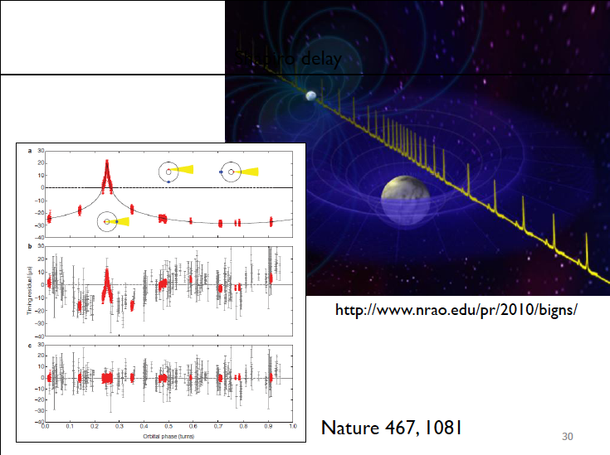
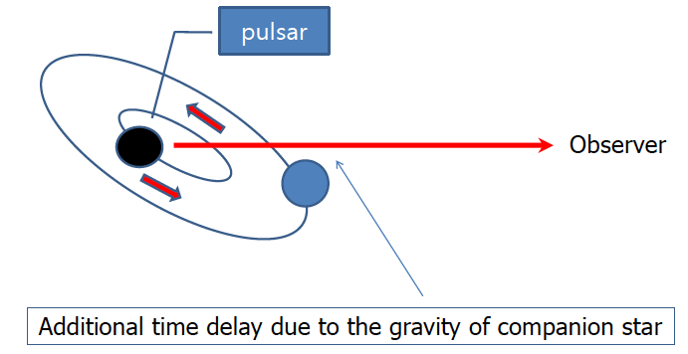
Shapiro delay
Shapiro delay
Slide from C.H.Lee

Slide 69
The authors has insisted that this observation
rules out almost all currently proposed
hyperon or boson condensate EOS’s and
quark matter can support a star this massive
only if the quarks are strongly interacting
and therefore not “free quarks”.
Theorists have to confront the observation!
What happens in quark matter case?

Slide 70
Maximum mass for (simple) quark matter
Ozel-Psaltis-Ransom-Demorest-Alford, ApJL(2010)
★
★
★
for free quarks
to
for
CFL quark matter
chosen to provide
nuclear→quark
(Slide from Alford @ Vienna)

Slide 71
Topic on a new observation
ーUltraluminous X-ray source (ULXs)ー

Slide 72
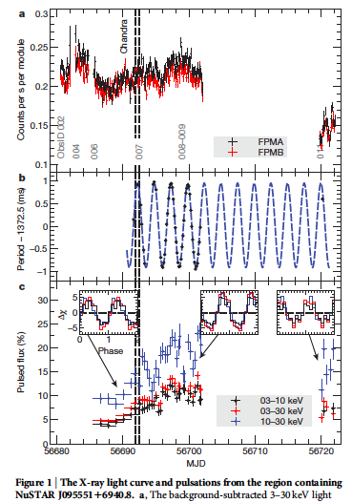
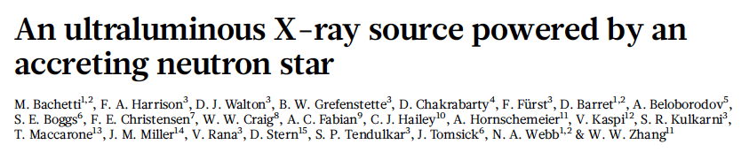
Ultraluminous X-ray source as NS?
Pulsation observed!
But the luminosity is
100 times the Edd.
limit of ordinary NS!
WHAT IS THIS???
NuSTAR
(Nuclear Spectroscopic Telescope Array)

Slide 73
Fossil model = Flux conservation

Slide 74
Example of ν emissivity and cooling of NS
- Direct URCA process in quark matter -
To compute ν emissivity, one needs ν self-energy Σ
and the W-boson polarization tensor
Π
d
u
d
W
W
Σν =
Π =
u
ν
e
ν
[ν self-energy]
[W polarization]

Slide 75
Then (after a straightforward/tedious comp.) we end up with
On the other hand, the heat capacity for u and d quarks is
Thus we obtain

Slide 76
Neutron Star as Pulsar
ー gravitational wave radiation ー

Slide 77
“rapid” means “compact”
NS loses the energy by dipole EM radiation. This
provides some info. of surface magnetic field.

Slide 78
Pulsar = a star emitting the EM wave regularly
“rapid” means “compact”
NS loses the energy by dipole
EM radiation. This provides
some information of the surface
magnetic field (later). Moreover,
There could be another source
for the energy loss of NS.
gravitational wave radiation
“P-Pdot diagram”

Slide 79
The r(otational) mode instability of NS
(eg. N. Andersson)
A quadrupole flow that emits
gravitational wave (GW) radiation.
If dissipative phenomena are
not strong enough,
the oscillations will grow
exponentially, and the star
will keep slowing down until
some dissipation mechanism
can damp the r-modes.
Therefore, the study of the r-modes is
useful in constraining the stellar structure.
Various mechanisms been proposed

Slide 80
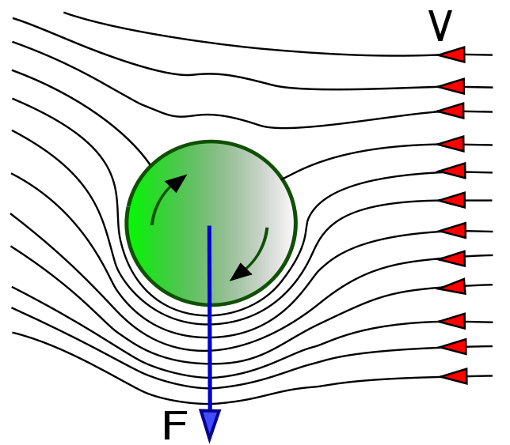
Mutual friction in superfluid vortex system
[Hall-Vinen (1956)]
A friction force btw normal & superfluid components
provided by vortices. It manifests in experiment as
a dissipation present in rotating superfluid state.
• Magnus force btw superfluid comp. and vortex
• Force produced by the normal excitations

Slide 81
• Force balance condition for a vortex
If a perturbation of the superfluid velocity
is introduced, there is no guarantee that two
forces are balanced ( ).
Energy dissipation:

Slide 82
Q. The Nobel Prize in Physics 2014?

Slide 83
Nobel Prize in Physics 2014

Slide 84
Betelgeuse

Slide 85
Precursor of supernova explosion?

Slide 86
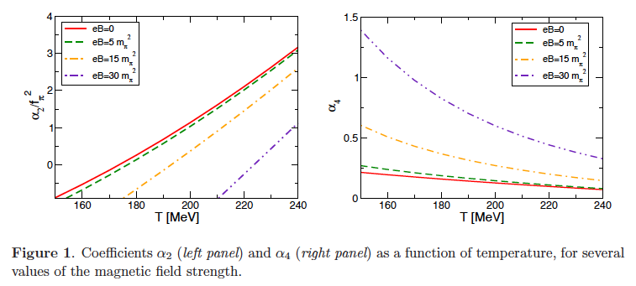
Chiral symmetry in a magnetic field
M. Ruggieri, M. Tachibana and V. Greco, JHEP (2013)

Slide 87
Hey guys! Time to homework!
For the case of massless free fermion,
find the equation of state (EOS).
2. Using the above EOS, solve TOV eqs.
at the Newtonian level. Changing the
initial conditions, find the maximum
mass and the corresponding radius.
Submit your answer to Su-Hong!

Slide 88
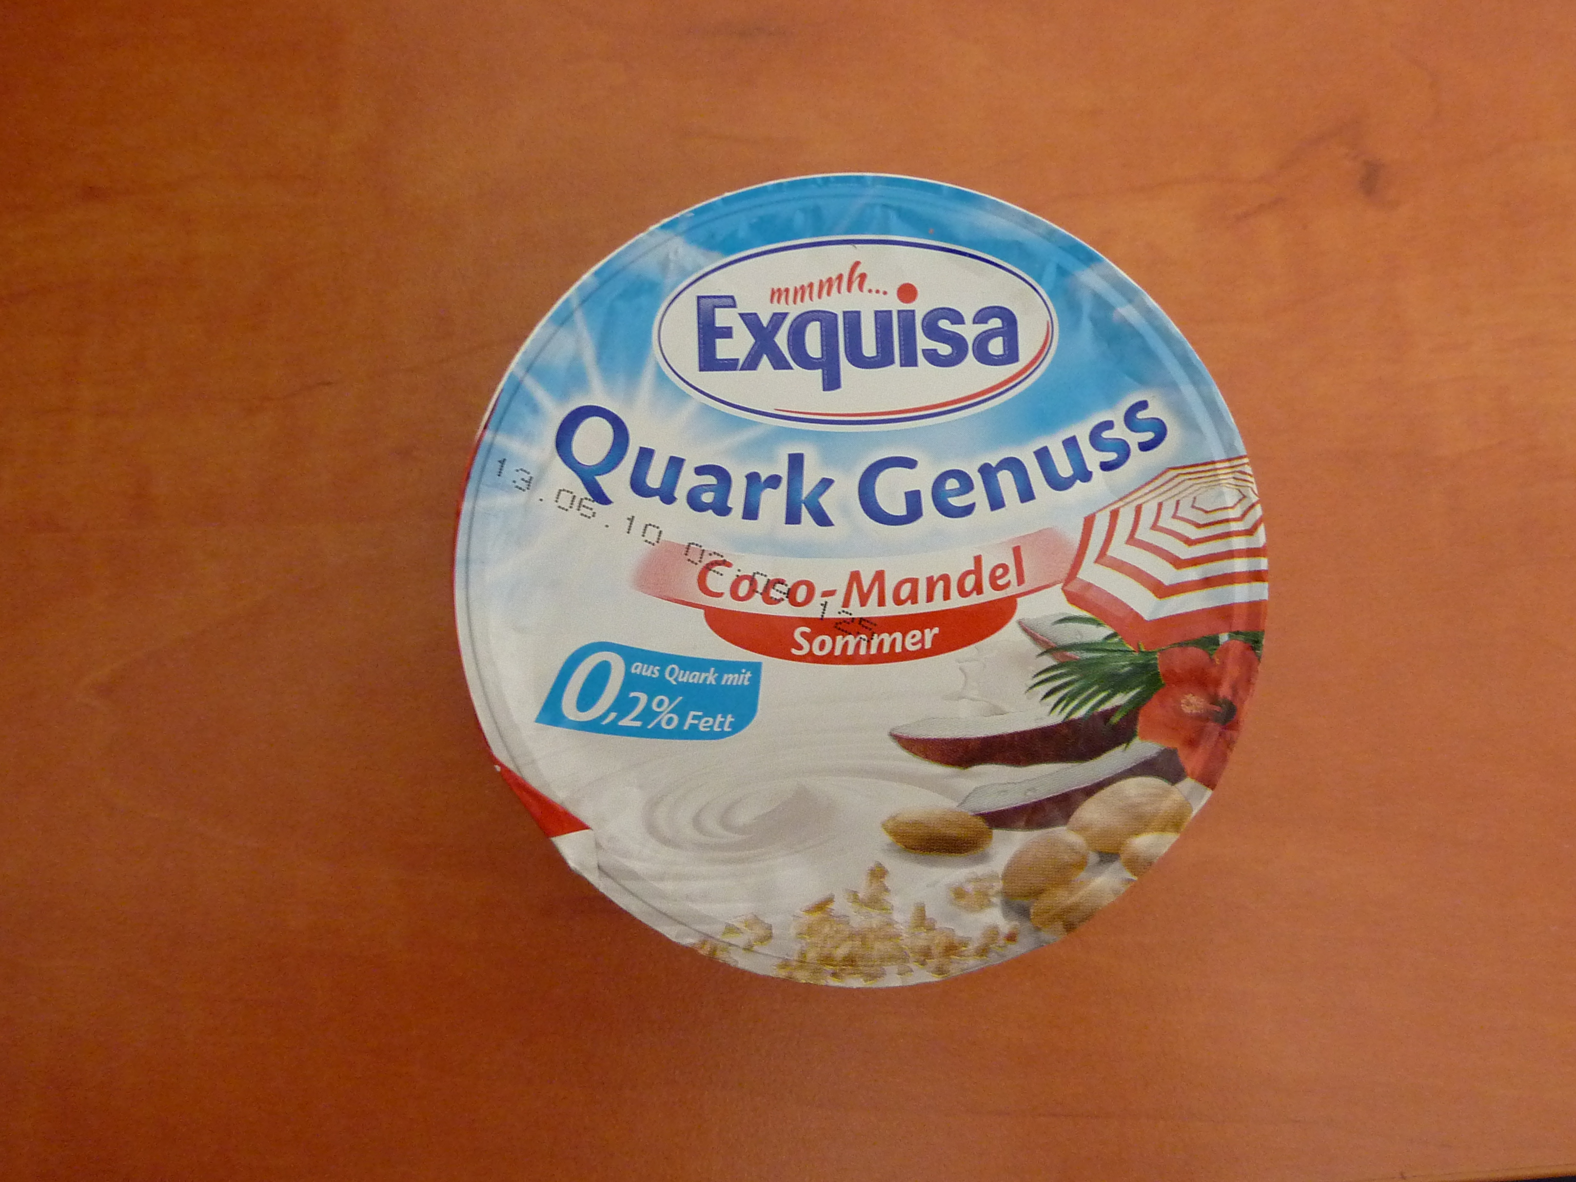
Finally… “Quark” (^0^)/
It says this is QUARK, but I cannot see its color.
Maybe this should be called “QUARKs” ?

Slide 89

A long time ago
in a galaxy
far, far away…

