Slide 1
Simulation of the gating device for ILD-TPC
SAGA-HEP
나가사끼 요씨유끼
（Nagasaki Yoshiyuki）
Partnership @YS.U

Slide 2
Outline
① The principles of ILD-TPC
② Why “The gating device” is needed ?
③ The gating device
④ Electron transmission of gating device
⑤ Summary

Slide 3
The principles of ILD-TPC
TPC is gaseous tracking detector
When the charged particles enter in TPC , ionization occurs according to the energy loss .
Created electrons drift to the cathode by the electric field .
In order to amplify the signal, we consider to use Gas Electron Multipliers.

Slide 4
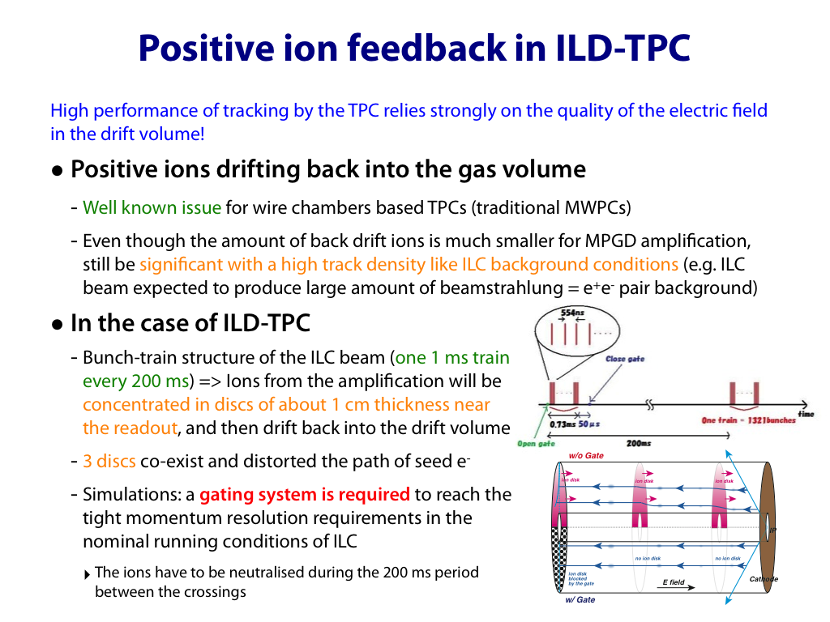
Why
“The Gating device“ is needed?
When the primary collision happen,
Ions are created by GEM
And ions drift like a disk that is width 5mm
During the collision interval , this disk drift about 1m
When the next co
Cathode
GEM
2.3m
Ion drift velocity(5mm/msec) =1/10000 electron drift velocity
When one collision happen,
created ions by GEM drift like a disk that is width 5mm
⬇
During the interval, ion disk drift about 1m
⬇
When the next collision is happed ,ion disk is still exist in TPC
⬇
Ion disks bend the electrons drift

Slide 5
Why
“The Gating device“ is needed?
To brock the positive ion ,
Need to use
“the gating device” !!
Drift velsity : positive ion =10000 X electron(5cm/μsec)
⬇️
Before ion reaches cath ,次々と電子はドリフトする
⬇

Slide 6
The gating device
Turn over the electric field direction
Gate open➡ electrons pass through
Gate close ➡ brock the positive ions
We can install the gating device to be have distance from GEM

Slide 7
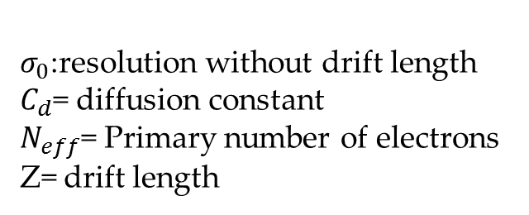
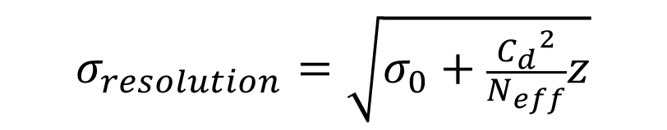
The gating device
The most important thing ➡ to brock ion!!
The gating device must have high electron transmission
$$σ_{resolution}=\sqrt{σ_{0}+\frac{{C_{d}}^{2}}{N_{eff}}z}$$
$σ_{0}$:resolution without drift length
$C_{d}$= diffusion constant
$N_{eff}$= Primary number of electrons
Z= drift length

Slide 8
The gating device
The detector operates in high magnetic field(3.5T)
So, the gating device is also needed to work in same condition
With magnetic field to gating device, electrons do not enter in the gate holes
We consider the gate structure change circle
to honeycomb to raise the optical aperture rates
Hole type changed Circle to honeycomb

Slide 9
Electron transmission by measurement
① process : without gate effect
② process : with gate effect
Electron transmission = main peak ratio ②/①
①histogram
②histogram
Normal condition histograms
①＋②

Slide 10
results
Electron transmission
Vgate
Each device had high Electron transmission
Circle hole < Hexagonal hole
I will inspect the results by simulation.

Slide 11

Simulation Flow
(Simplification)
Create Models from the objects
3-D analysis (electric field) by finite element method (ANSYS)
Simulator for gas detector (Garfield++)
Analysis electron behavior!!
Garfield++ is not GARFILD

Slide 12
results
(measurement and simulation)
Compare to results measurement and simulation
, more or less, simulation reproduced the measurement
But…

Slide 13
Why?
Prev rim
cross section
(square)
Geometry for simulation is simple
the hole as a straight hole
But real rim cross section is like a trapezoid!!
2.7μm
Next rim
Cross section
14.5μm
31μm

Slide 14
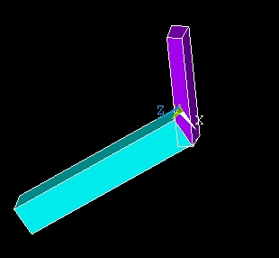
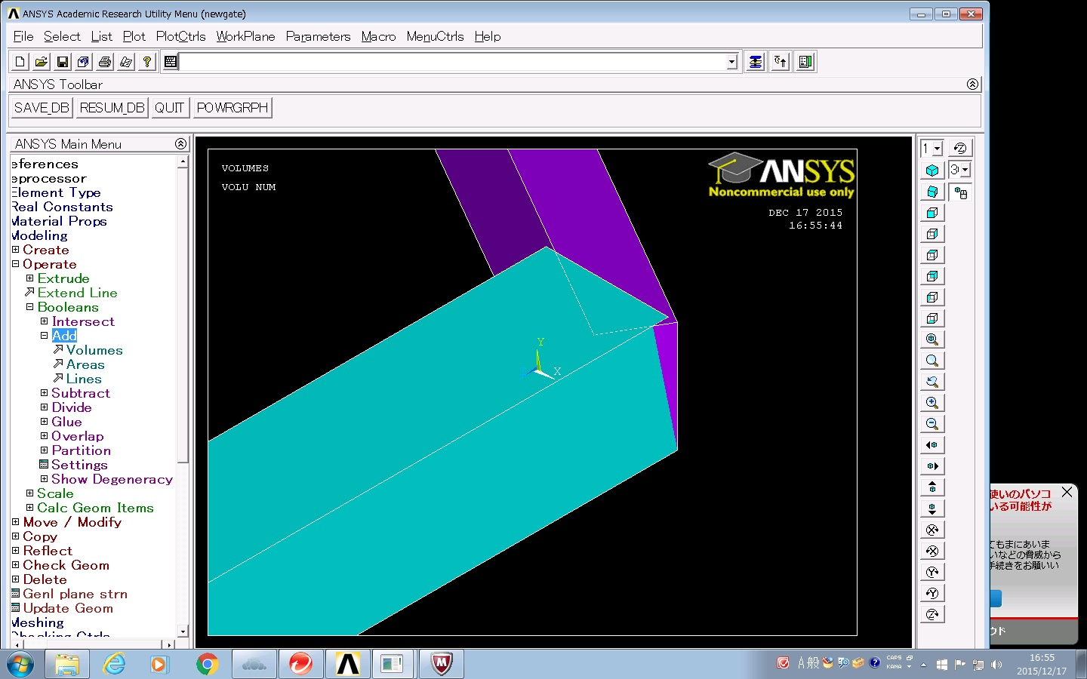
Creating New Model for Detailed Analysis
Did not join
When we analysis the gating device,
we only create this part
Because this part is minimum unit of honeycomb
(image)
And,to analysis with symmetry.

Slide 15
Summary
ILD-TPC is one of the gas detector.
In TPC ,many positive ions are created by amplification.
The ions bend the electron drift.
So gating device is needed to brock ions.
The problem is that Simulation results do not reproduce the measurement in small part .
One of the reason is geometry simplify.
Now , I try to create model put in real geometry .

Slide 16
END

Slide 17
Back up

Slide 18
電子透過率のシミュレーションのために
電子の収集効率（Collection efficiency)と抽出効率(Extraction efficiency)
収集効率=(ホールに入った電子数)/(ドリフト領域で生成された1次電子数)
抽出効率=(トランスファー領域に出て行った電子数)/(ホールに入った電子数)
電子透過率＝(収集効率)X(抽出効率)
ホール電場を上げる
⬇
収集効率は上がる
抽出効率は下がる
Notes:
電子透過率のシミュレーションをする為に、収集効率と抽出効率という２つのパラメータを設定します。収集効率はホールに入った電子数/ドリフト領域で生成された電子数とし、抽出効率はトランスファー領域に出て行った電子数/ホールに入っていった電子数とします。なので電子透過率は収集効率x抽出効率となります。
ゲート装置のホール電場が高い方が、ホールに入る電気力線の数が多くなるので、電子の収集効率は良くなります。このように収集効率はドリフト電場とホール電場の比に依存します。
一方で、抽出効率は、ホール電場とトランスファー領域の電場に依存します。
この黒いラインが電子がホールに入り出て行くことができる領域です。
ホール電場を高くすることで、収集効率は上がりますが、赤い破線のような、ゲート装置の下の電極へ戻る電気力線の数が多くなるので抽出効率は下がってしまいます。

Slide 19
For simulation the gating device
Collection efficiency and Extraction efficiency
Collection efficiency = the number of electrons enter into the gate/ primary electrons
Extraction efficiency = primary electrons / electron go out the gate
Transmission = C.e×E.e

